Slide 1
Share Your Success Stories
A SMiLE Social Media seminar for Lions LCICon 2018, Las Vegas

Slide 2
Welcome!
STEFAN KAUFMANN
RICHARD STEVENSON
PAUL FUGATE
DISTRICT 111MS
DISTRICT 21-B
DISTRICT 9EC

Slide 3
Stefan Kaufmann
Lions SMiLE
Social media for Lions by Lions
Notes:
Lion Stefan:
Introduce Lions SMiLE.

Slide 4
Online communications
It‘s about …
our service
us Lions
the people
Notes:
Lion Stefan:
Online communications, social media, Internet, public relations …
It‘s about
our service
us Lions
the people we support and need our help
so there is no reason not to
do our best and beyond
to promote our service and engagement
to achieve maximum impact

Slide 5
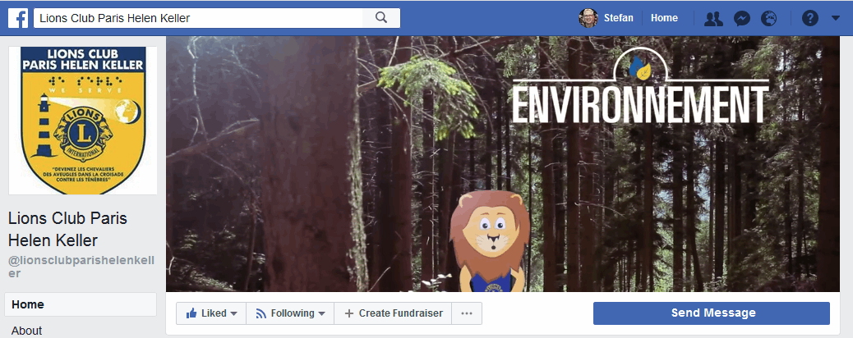
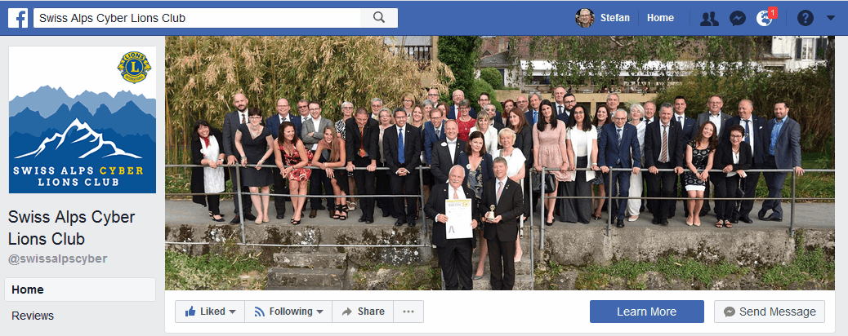
The good, the bad and the ugly …
Notes:
Lion Stefan:
In order to be successful short term AND in the long run …
we need
motivated fellow Lions
supporters and sponsors
who eventually turn into new members
so why would you prefer to look
ugly
the least attractive party to join
or being unknown, an anonymous part of your local community?
and act smart.

Slide 6
reach for the stars
start small, do better each time
be authentic
you are Lions
play as a team
it‘s more fun, it‘s more success
Notes:
Lion Stefan:
Lions SMiLE has been your support and resource
on your social media, on your online communications way since 2012
Our mission is
to see you, all Lions clubs world wide
using online communications successfully
To achieve your goals as Lions.
What we learned over time what is key to this success
be professional – reach for the stars
be authentic
be a team – success has many mothers & fathers ;-)

Slide 7
Notes:
Lion Stefan:
Over the last five years …
We have told you
all about how to start
How to run it and what tools and platforms to use
How being successful
Best practices specifically for Lions
Check out all the material we have created specifically for you
It‘s getting time for the next step …

Slide 8
Social Media Expertise
the Lions perspective
From Lions To Lions
real world experiences
Makes The Difference
your success
Notes:
Lion Stefan:
Today we start a social media camp fire session with you
Social media expertise from a Lions perspective
Real world stuff – from Lions to Lions
Supporting your success
TALK
Let me again welcome our fellow Lion Richard Stevenson
He will be your first social media ranger today ;-)

Slide 9
Richard Stevenson
HANDS ON CLUB SOCIAL MEDIA
How South Tucson Lions Club utilizes social media
Notes:
Lion Richard:
GOOD AFTERNOON,
I AM LION RICHARD STEVENSON, THE PRESIDENT OF THE SOUTH TUCSON BRANCH CYBER LIONS CLUB.
I WAS ATTRACTED TO LIONS 5 YEARS AGO TO WORK ON CHILDREN’S VISION PROJECTS, AND I STARTED OUR SOUTH TUCSON LIONS CLUB
FACEBOOK PAGE 4 YEARS AGO. 2 YEARS AGO I STARTED OUR CHILDREN’S VISION SCREENING PROJECT AND LAST YEAR I FOUNDED OUR
CYBER BRANCH CLUB AS WELL AS THE CYBER LIONS GROUP, A FACEBOOK GROUP FOR CYBER LIONS CLUBS.

Slide 10
Increase your Facebook footprint
(1)
(2)
(3)
Visuals
Content
Followers
Be attractive & establish a brand
Produce quality content
Be an active social networker
Notes:
Lion Richard:
I WOULD LIKE TO SHOW YOU HOW TO INCREASE YOUR FACEBOOK FOOTPRINT IN 3 EASY STEPS
IT IS EASY BUT IT TAKES WORK, BUT IT IS AN ANNUITY THAT KEEPS ON WORKING
STEP 1 - BE ATTRACTIVE
Your personal profile & club page should be attractive
Choose good cover/profile photos
Choose domain name to connect to your page
Put domain name on all your brand material
Insure you have contact information visible
STEP 2 - HAVE CONTENT PEOPLE WANT TO SEE
Post regularly with quality content
Use one attractive action photo - edited
Provide a brief description of what, when, where & why
STEP 3 - GAIN FOLLOWERS
Accumulate personal profile friends and invite them to like page/Choose them from your target audience
Get people to see your posts by tagging and shareing posts to other pages
Have your partners share your page/posts
Invite all to “like” your page
Buy targeted ads for specific markets to “like” the page

Slide 11
2014
Marketing challenge
Build Brand Image
for 70 year old Hispanic Lions Club
Stop
being the “Best Kept Secret”
Notes:
Lion Richard:
2014 MARKETING CHALLENGE FOR THE SOUTH TUCSON LIONS CLUB
BUILD A BRAND IMAGE FOR A 70 YEAR OLD HISPANIC CLUB
OUR SIGNATURE PROJECTS ARE YOUTH MARIACHI AND CHILDREN’S VISION
STOP BEING THE “BEST KEPT SECRET”, CONNECT WITH OUR COMMUNITY
WE STARTED A CLUB FACEBOOK PAGE WITH AGGRESSIVE POSTING OF CLUB’S ACTIVITIES
MADE FACEBOOK FRIENDS WITH TARGETED PEOPLE INVOLVED WITH OUR COMMUNITY PROJECTS
Mariachis and schools,
school boards,
nurses, etc.
INVITED THEM TO LIKE OUR PAGE
CONNECTED WITH SCHOOL AND MARIACHI FACEBOOK PAGES, SHARED LINKS, FRIENDED FOLLOWERS, REQUESTED THEY DO THE SAME
REQUESTED SCHOOL DISTRICT PHOTOGRAPHERS/VIDEOGRAPHERS TO OUR EVENTS
USED TARGETED ADS TO CONNECT WITH PEOPLE IN OUR COMMUNITY

Slide 12
2018
Results
> 7,000 follower
on Facebook
Club brand
well established
Notes:
Lion Richard:
2018 RESULTS
OUR CLUB PAGE HAS 7,300 FOLLOWERS
OUR BRAND IS WELL ESTABLISHED IN OUR COMMUNITY
WE WERE ABLE TO VISION SCREEN OVER 55,000 CHILDREN IN THE LAST TWO YEARS
WE STARTED A NEW CYBER CLUB AND JOINED 21 NEW LIONS LAST YEAR
WE SERVE, AND OUR COMMUNITY KNOWS IT

Slide 13
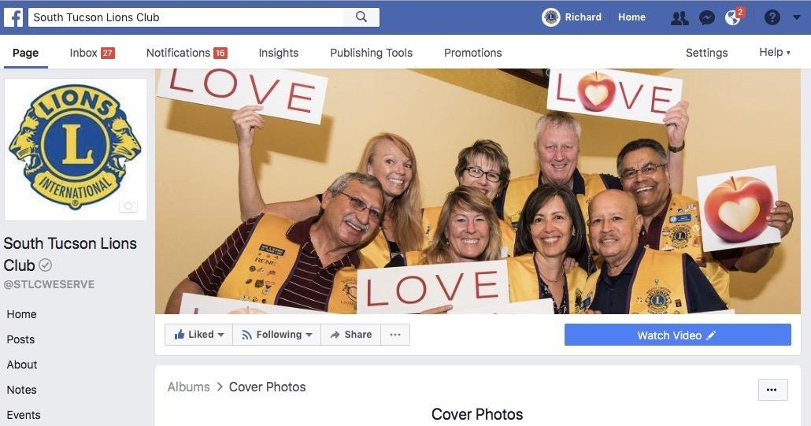
Cover | Profile photo
Notes:
Lion Richard:
YOU WANT TO HAVE A PAGE THAT PEOPLE WANT TO LOOK AT
CHOOSE ATTRACTIVE COVER PHOTO AND PROFILE PHOTO
INSURE THAT YOUR PERSONAL PROFILE IS ATTRACTIVE AND NOT CONTROVERSIAL

Slide 14
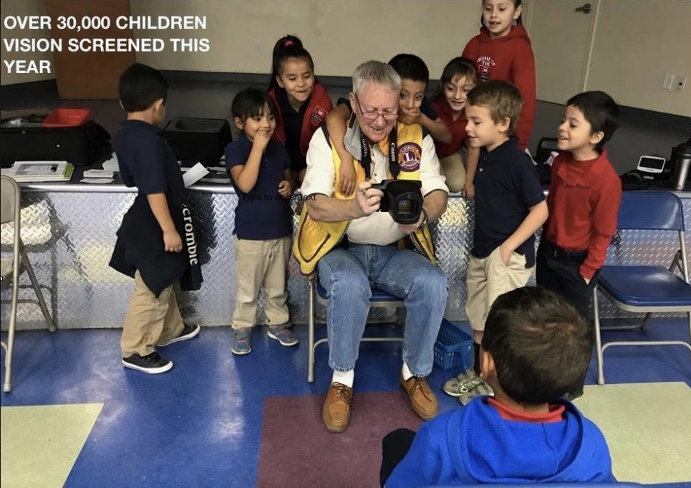
Visuals: use action photos
Notes:
Lion Richard:
POST REGULARLY WITH QUALITY CONTENT
USE ACTION PHOTOS (ONE PHOTO, WELL EDITED)
OUR VISION SCREENING PROJECT

Slide 15
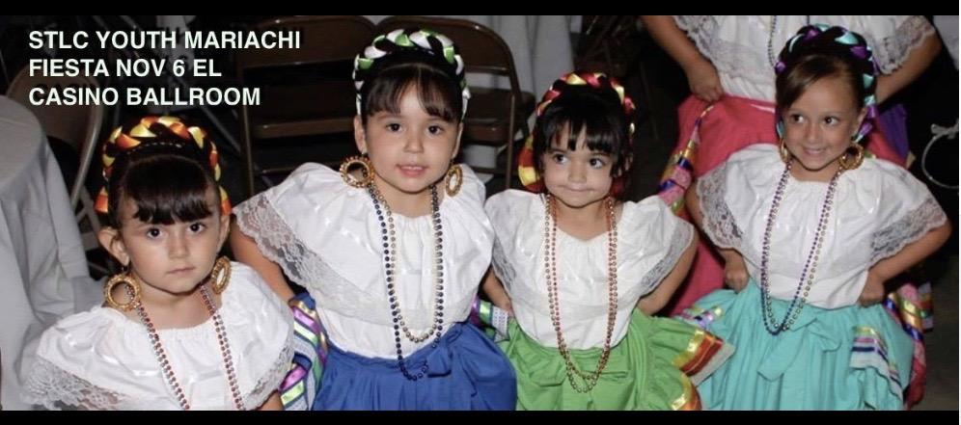
Visuals: gain permission
Notes:
Lion Richard:
OUR YOUTH MARIACHI PROJECT – FOLKLORICOS
YOU CAN NEVER HAVE TOO MUCH CUTE, BUT ALWAYS GAIN PERMISSION.
This is especially true for pictures from under age children!

Slide 16
Visuals: Capture smiles
Notes:
Lion Richard:
TELL PEOPLE YOU ARE GOING TO TAKE A PHOTO TO POST ON THE PAGE
ALWAYS “HAHAHAHAHA” TO GET THOSE SMILES
DON’T USE BAD PHOTOS
TAG YOUR MODELS FOR MAXIMUM COVERAGE
CREATE PHOTOS PEOPLE WANT TO SHARE
THESE ARE TWO PEOPLE WITH LOTS OF FRIENDS WHO WILL LIKE THE PHOTO

Slide 17
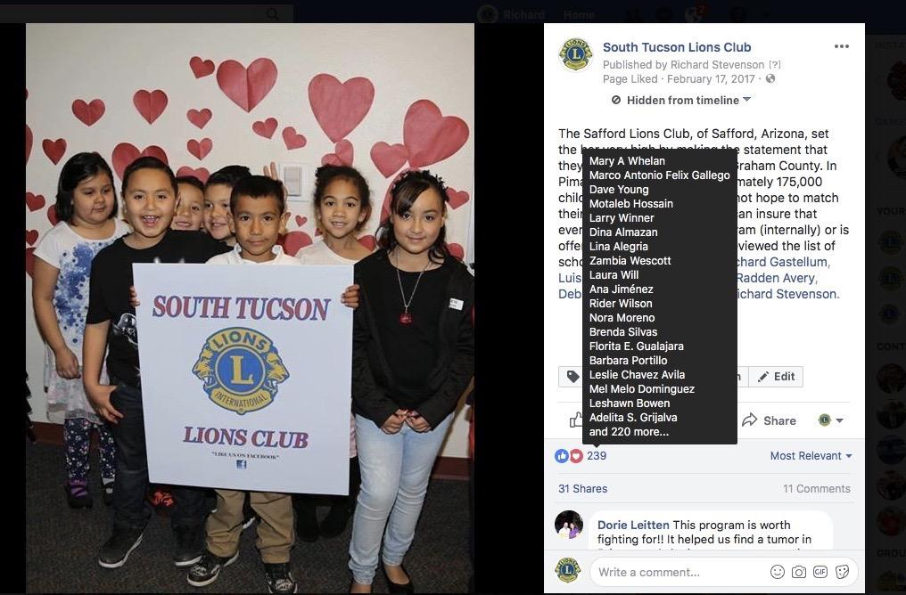
Branding: Get your logo into the picture
Notes:
Lion Richard:
ALWAYS BRING A SIGN, CONNECT YOUR BRAND TO YOUR PHOTO
Make sure that you connect the scene with your club.
This can be a club sign, Lions logo flag, etc..

Slide 18
Best practice: WHO, WHAT, HOW AND WHY
Notes:
Lion Richard:
TELL THE WHO, WHAT, HOW AND WHY BRIEFLY
HOW IS THE WORLD A BETTER PLACE BECAUSE YOUR CLUB IS THERE?
SHARE YOUR PHOTOS, HAVE YOUR CLIENTS SHARE YOUR PHOTOS
THIS IS THE OCHOA MAGNET SCHOOL WHO SHARED THE PHOTO ON THEIR FACEBOOK PAGE
Good public relations practice applies to analog AND digital world.

Slide 19
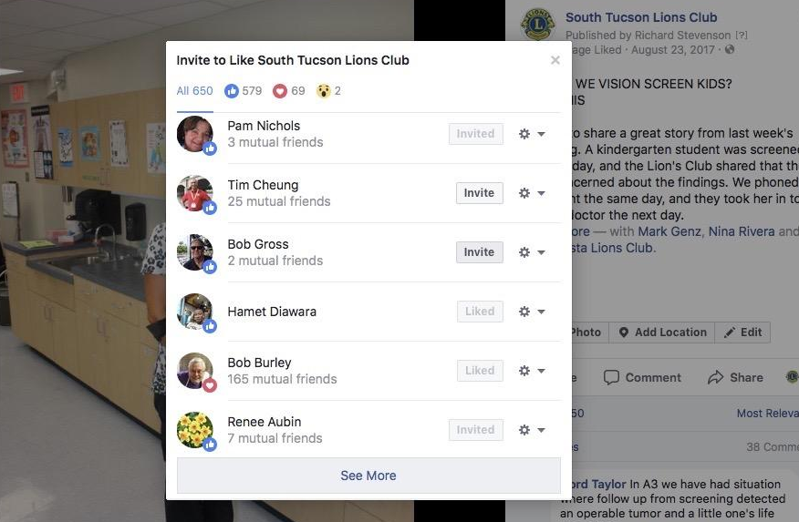
Best practice: Invite to LIKE & FOLLOW
Notes:
Lion Richard:
INVITE PEOPLE WHO LIKE POSTS TO “LIKE” THE PAGE
INVITE ALL OF YOUR “FRIENDS” TO LIKE THE PAGE
GET ALL OF YOUR MEMBERS TO LIKE THE PAGE
GET YOUR MEMBERS TO INVITE THEIR FRIENDS TO LIKE THE PAGE

Slide 20
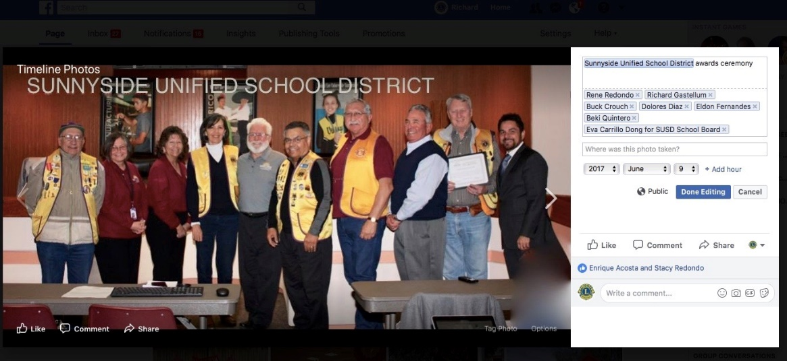
Be sensible: Tagging
Notes:
Lion Richard:
TAG TO GET MORE EXPOSURE
WHO ARE THESE PEOPLE? HINT, THEY HAVE MANY FOLLOWERS
TAG THEM, WITH THEIR PERMISSION, TO HAVE THEIR FOLLOWERS SEE YOUR PAGE
YOU CAN TAG YOUR OWN LIONS TOO, EVEN IF THEY ARE NOT IN THE PHOTO
HAVE THE SCHOOL DISTRICT SHARE YOUR PHOTO ON THEIR PAGE

Slide 21
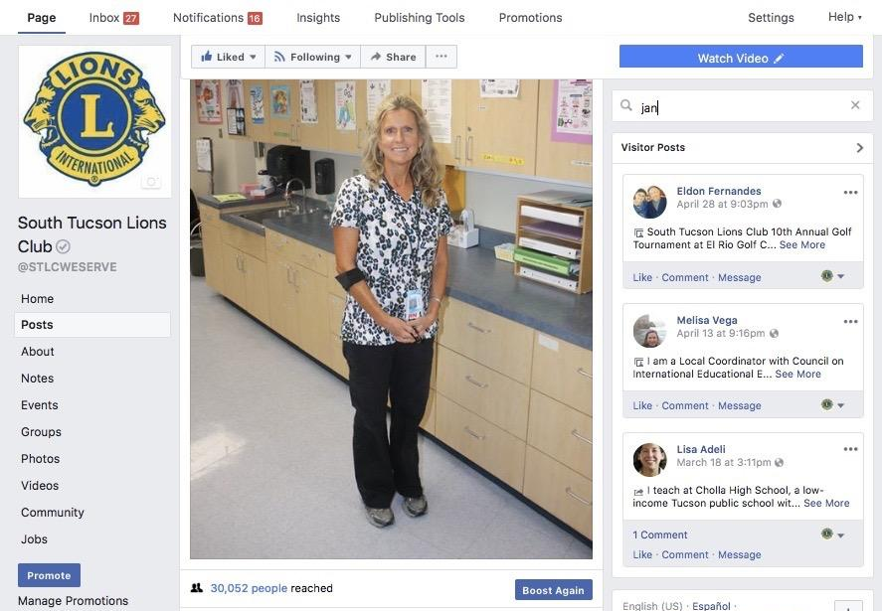
Return of all your investments ;-)
Notes:
Lion Richard:
A NURSE THANKED US FOR IDENTIFYING A CHILD AT RISK FROM A VISION SCREENING
I PUT HER PHOTO UP WITH HER THANK YOU NOTE
IT WAS SHARED 266 TIMES AND REACHED 30,000 PEOPLE
INVITE THE ONES WHO ‘LIKED” IT TO LIKE YOUR PAGE

Slide 22
Spare money? Try targeted ads
Notes:
Lion Richard:
PAY FOR TARGETED ADS TO ATTRACT MORE FOLLOWERS
WE CHOSE PEOPLE LOCATED IN TUCSON WHO WERE INTERESTED IN EDUCATION AND MARIACHI
SPEND WISELY

Slide 23
Paul Fugate
How to attract members through social media
Notes:
Lion Paul:

Slide 24
Page
Make sure ist active
Events
Invite the community
Posts
Post 4 times a week

Slide 25
Use Memes

Slide 26
Pinterest
Lions Club Marketing
Other clubs Pages

Slide 27
Ressources
From Lions SMiLE
lionssmile.org
Blog & website
@LionsSMiLE
Facebook

Slide 28
Thank You
Have a nice day
lionssmile.org | Oak Brook
Notes:
THANK YOU
JOIN OUR CYBER LIONS GROUP ON FACEBOOK FOR MORE INFORMATION ON CYBER CLUBS

