Slide 1

Tools and advantages of having
club membership chairperson
Notes:
Greetings, my name is [Enter Name], [Enter Title, District, Multiple-District, Constitutional Area]. Today I will be presenting the tools and advantages of having a club membership chairperson. Next slide.

Slide 2

Advantages of having a club membership chairperson
Develop a membership growth plan
Ensure members are properly oriented
Promote the club at service events in the public by working other officers in the club
Identify opportunities to recruit prospective members and invite them to join the club
Enhance club visibility, engagement, community impact and utilization of membership satisfaction programs
2
Notes:
Here are some of the reasons for having a membership chairperson:
Develop a membership growth plan
Identifying a short- and long-term goals for recruiting new members over time, but most importantly, training others in the club to “just ask”
Ensure members are properly oriented
Ensuring the members understand the historical point of the club and the association, annual service projects, how meetings are conducted, and leadership opportunities within the club, zone/region and district
Promote the club at service events in the public by working with other officers in the club
Identify opportunities to recruit prospective members and invite them to join the club
Enhance club visibility, engagement, community impact and utilization of membership satisfaction programs

Slide 3

First impressions and retention
3
3
Notes:
When we think of the club membership chairperson, key priorities are first impressions and retention.
Membership chairpersons touch on the following points:
Recruitment of new members
Family/friends/people in their networks
Satisfaction of current members
Ensuring everyone is happy and any issues are addressed prior to inviting new members to join the club
First impression and expectations

Slide 4

aa
Member retention
Step 1: Define membership satisfaction in your club
Learn from your members!
Step 2: Create your plan
Resolve conflict
Not making a difference
Don’t have a sense of belonging
Step 3: Implement and review your plan
Communicate your plan
Dealing with resistance
Ongoing implementation
Resources in the guide:
New member questionnaire
Former member questionnaire
Action planning template
Find this resource at http://lionsclubs.org/membershipchair
4
Notes:
One of the most important steps for new member retention and outside orientation is ensuring all members are engaged and inspired by the work that their club is doing.
The membership satisfaction guide provides a step-by-step process to improve satisfaction in your club.
In step one, it is important that we take a customized approach to membership satisfaction. All clubs are different, so what may work well for one club, may not work for another. It’s important that you take this step in the process to learn what your members want so you can address those needs.
Step 2: Research has shown that a key factor in why people leave is often related to conflict, the feeling of not making a difference, or not having a sense of belonging. This guide offers tips and strategies to help with this, but also reminds users that a personalized approach is important because each member may have a different idea of what “making a difference” looks like, for example.
Step 3: When you are ready, it’s time to implement your plan. First, club leaders will need to be on the same page and ensure they are communicating. This will help make sure that members understand why you are making some changes, which can help mitigate resistance. Of course, there may be some, and the guide will provide some tips on that as well. This is an ongoing process — it’s not something that you can do and simply walk away from. Consider how you want to review your plan and adjust on a regular basis as you try new things.
Finally, while there are other tools that may help you understand your members, this guide does have a few tools that will help with the basics. Use the questionnaires to learn from your new members to make sure they are getting what they hoped for out of your club. Reach out to your former members. You may be able to learn from mistakes, or there may be an opportunity to get them involved again, especially if they realize that the club may be making some changes. Also, use the action plan as a template to help stay organized throughout the process.

Slide 5

Induction and orientation
5
Notes:
The membership chairperson facilitates training for members to learn more about the culture/service/leadership development opportunities within their club, zone, region and district.

Slide 6
aa
New member orientation
Onboarding and orientation should be well planned and thought out. Use the tools below to help ensure success.
New member questionnaire
Found in the Just Ask! guide, can be used to connect the member to experiences they would find rewarding.
New member induction ceremonies guide
New member orientation resources
Trainer’s guide
Participant’s guide
Orientation PowerPoint
Mentoring program
New member experience emails
Find these resources at http://lionsclubs.org/membershipchair
6
Notes:
There are several tools and resources available for clubs to use, all found on the membership chairperson webpage found at lionsclubs.org/membershipchair
Use the new member questionnaire, found in the “Just Ask Guide” to customize the experience for a new member. This will help the new member find ways they can feel like they are making a difference and doing things they feel passionate about.
The “New Member Induction Ceremonies Guide” will help walk you through the oath for a new member, and features tips to help make the event a success — such as ensuring that you have a new member kit ready for your new member(s), and a reminder to personalize the ceremony to make it meaningful for your new members(s). You can also circle back to the New Member Questionnaire and connect the interests of the new member to the speech and presentation.
The new member orientation resources include the trainer’s guide, the participant’s guide and a PowerPoint. Using these resources in conjunction will give your club a professional presentation to educate the new member on the basics of Lions, the history of your club, and help them understand that they are part of something big with many opportunities. They will also learn the impacts made by their extended Lions family around the world.
The mentoring program is a great way to get members beyond the orientation and connected to opportunities that Lions offers within and outside of the club.
Finally, when a new member joins, the new member and their sponsor both receive emails. For the new member, these emails will help educate, inspire and encourage engagement over the first three years of their tenure with their club. The sponsor will receive a corresponding email so they are aware of what the new member is reading. More importantly, they will receive guidance and be ready to continue offering personal support to the new member as they explore all that Lions have to offer in the first few years of membership.

Slide 7

Membership chairperson toolbox
7
Notes:
Fortunately, there are plenty of resources available to help the membership chairperson put together a solid plan to gain members, learn how to orient them to Lions and to your club, and even how to take steps to change the culture of your club to make sure it is a welcoming environment, not just for new members, but for people who have been in your club for a long time.
Let’s start with a guide to help you put together a solid recruitment plan to gain members who will stay in your club.

Slide 8

Key membership chairperson resources
Understand your role and responsibilities
Helps you support members, both current and new
Ensures the members have meaningful, impactful and rewarding experiences as part of your club
Prepare to Lead: Prepared to Succeed
A list of tools and resource ensuring membership chairperson success
8

Slide 9
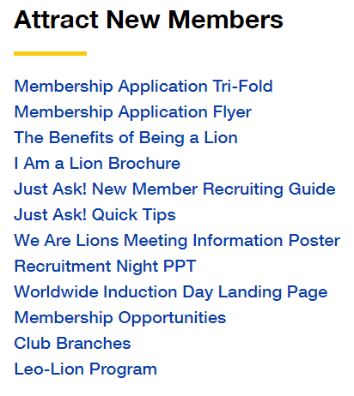
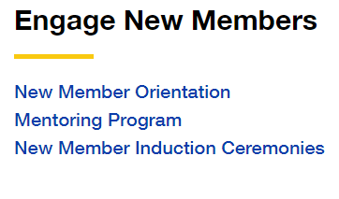
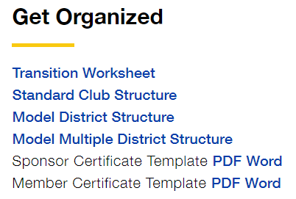
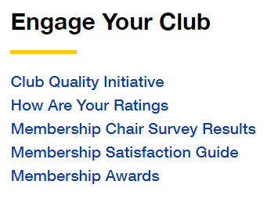
aa
Membership chairperson
Utilizing and tailoring existing resources for the need of your club
9
Notes:
Check out the club membership chairperson page at Lionsclubs.org/membershipchair

Slide 10
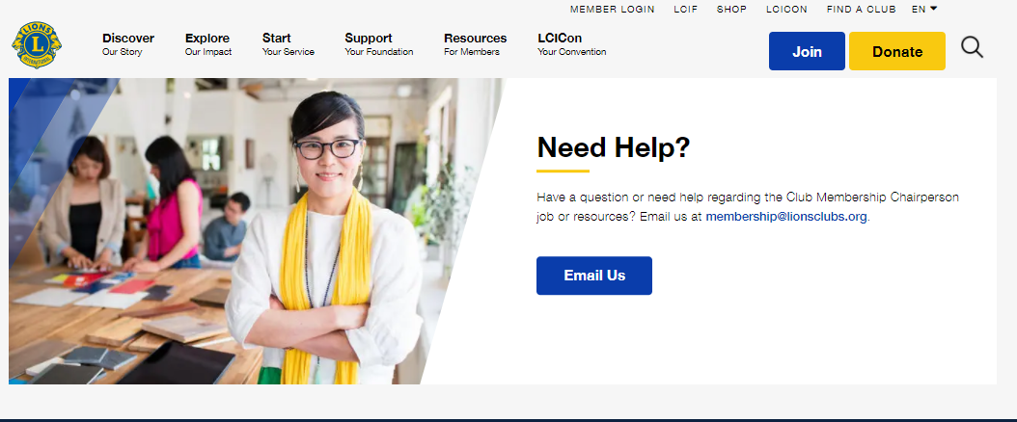
Want to learn more?
Visit the club membership chairperson webpage: Lionsclubs.org/membershipchair
10
Notes:
Resources on continuously being updated to help ensure Lions achieve success.

Slide 11

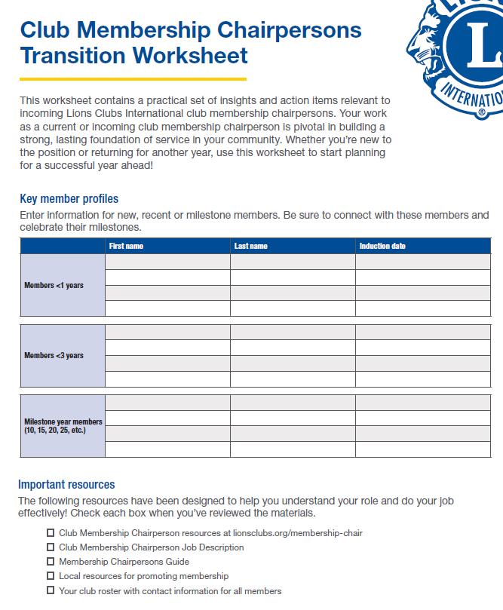
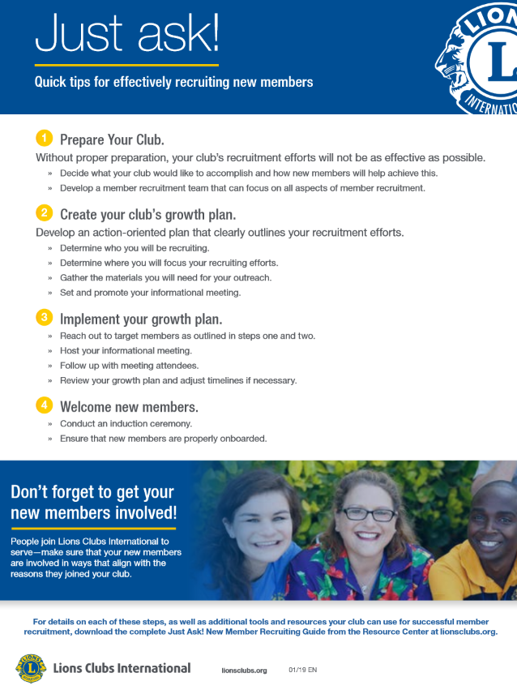

Resources
Notes:
Here is one of our resources that I’ve found helpful:
The “Just ask: Quick tips guide” is a great place to start as club membership chairperson begins planning their recruitment campaign. It outlines the four steps to recruiting new members. Check out the “Just ask! New member recruiting guide” to dive deep into each of these four steps. This guide has been used by Lions around the world, and successful membership chairpersons have reviewed the contents and agree that it helps ensure that your club has a successful recruiting campaign.

Slide 12

Encouraging clubs to appoint
a membership chairperson
12

Slide 13
####
##%
Appointed club membership chairperson
clubs
##%
Total Lions clubs in GAT Groups 4C and 4D
Vacant club membership chairperson
13
Notes:
[Enter #]% (input clubs with Membership Chairperson ex.1,000) Have appointed a membership chairperson
[Enter #]% (input clubs without Membership Chairperson ex.800) of clubs in [Enter District, Multiple District, Constitutional Area] have a vacancy of club membership chairperson

Slide 14

Membership chairperson
Discussion
14
Notes:
What have been some of the successes your club has had with your membership chairperson?
For clubs, what are some challenges your membership chairperson faces?

Slide 15

Please reach out to us at
[Enter in your contact information],
If you have any additional questions.

Slide 16

Thank you
© 2022 Lions Clubs International
XXXX 00/00 EN
16

