Slide 1
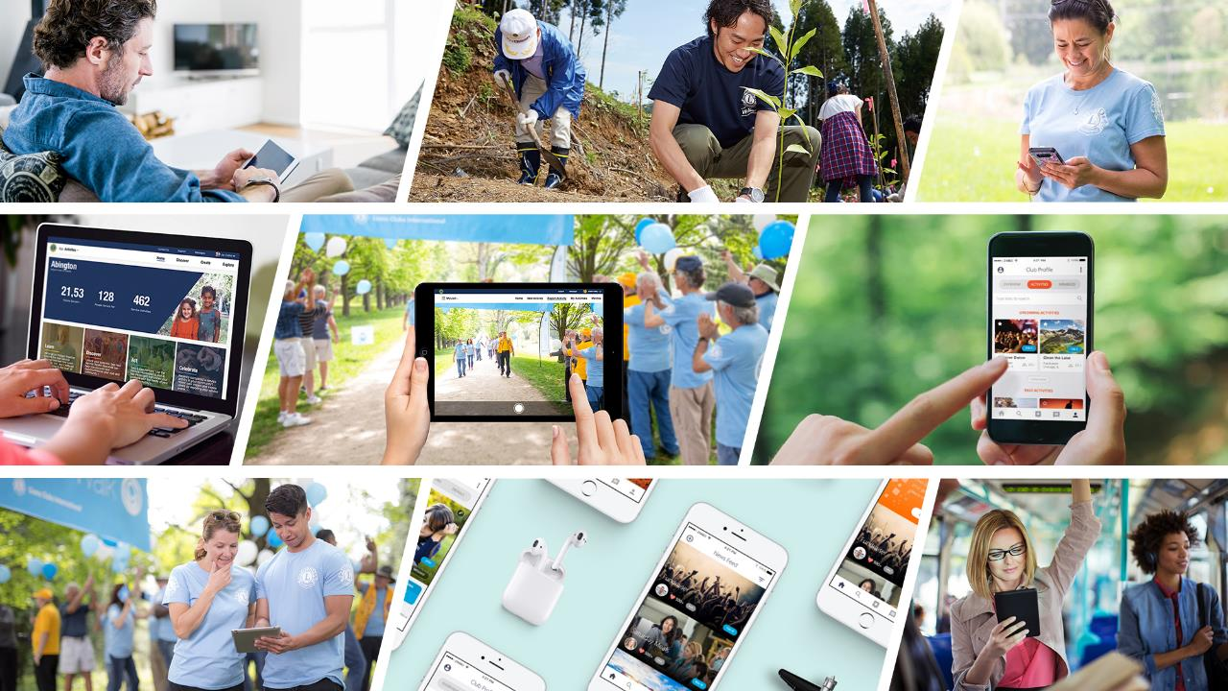

Introducing MyLion®
Connect to serve.
Notes:
Hello, today I’d like to talk to you about MyLion, our new service platform for Lions and Leos. MyLion is one of our new digital tools to enhance service and connect Lions and Leos around the world.

Slide 2
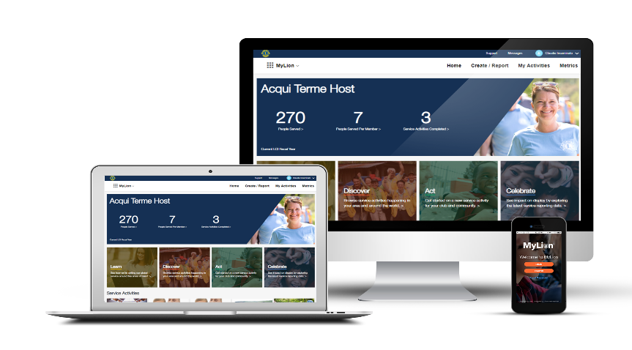

m
MyLion
  Plan, invite, and share service activities with your club
  Report service activities if you are an officer
  Find, connect and chat with Lions and Leos from all over the world
  View key service data for your club, district, multiple district, etc.
MyLion will replace MyLCI service activity reporting starting July 1, 2019. All other MyLCI features will remain available.
2
Notes:
MyLion is one platform that you can use on your desktop computer, laptop, tablet, mobile phone, or any device with a web browser. You can download the MyLion application on your mobile device for free, or login to MyLion from any web browser.
MyLion helps us connect and serve. With MyLion you can:
Plan upcoming service activities and take advantage of service planning resources related to all of our global causes
Quickly report your service activities if you are an officer
Send messages to other MyLion users
Explore local and global service data
Much, much more

Slide 3
What do I need to know about MyLion?
  MyLion is available everywhere from any device
        Login to MyLion from any web browser
        Download the MyLion mobile application on your smart phone
  MyLion is constantly being improved
        MyLion was tested by over 300 Lions and Leos and we continue to develop the platform based on feedback from users
  MyLion will replace MyLCI service activity reporting starting July 1, 2019
        Webinars, MyLion toolkits and other resources will be available for support.
3
Notes:
What should we all know about MyLion?
First, MyLion is now available everywhere from any device. You can login to MyLion from any device with a web browser. For the best MyLion experience on your smart phone, please download the MyLion application from the App Store (for iPhones) or the Google Play Store (for Android phones).
We are constantly improving MyLion based on feedback from Lions and Leos. Before MyLion became globally available, Lions and Leos from all our constitutional areas tested the website and mobile application. Member recommendations make MyLion better. More features will be added to MyLion over time.
MyLion will be the destination for service activity planning and reporting starting on July 1, 2019. MyLCI’s other features will remain available. Webinars, training toolkits and other resources will be available to help Lions and Leos take advantage of MyLion and enhance our service.

Slide 4
Getting Started

Slide 5
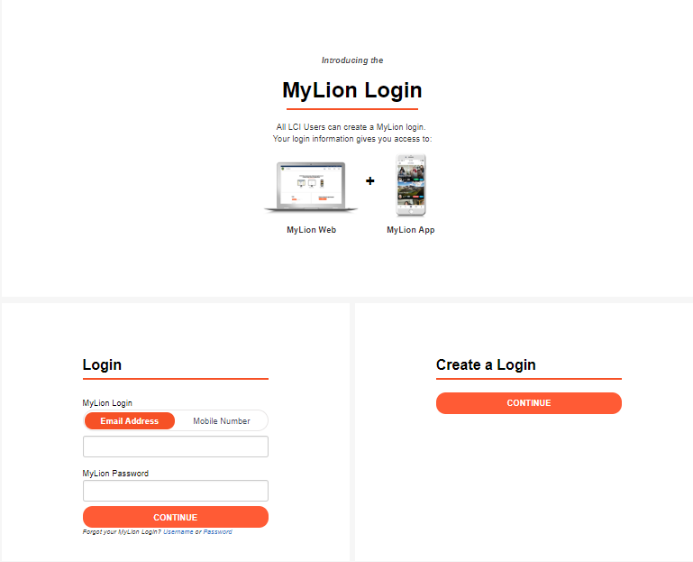
The MyLion website
One-time process
Your MyLion login gives you access to the MyLion website and application.
Chris Bunch – LION Managing Editor
Sanjeev Ahuja – Chief of Marketing & Membership
Dan Hervey – Brand & Creative Director
Stephanie Morales – Meetings Manager
What you’ll need
Your member ID
An email or phone number that matches your email or phone number in MyLCI
A password of your choosing
Your club secretary can help you update your email and phone number in MyLCI, as well as give you your member ID.
Notes:
Registering for MyLion is a one time process. Whether your register on the website or the mobile application, you can use the same username and password to access MyLion anywhere.

Slide 6
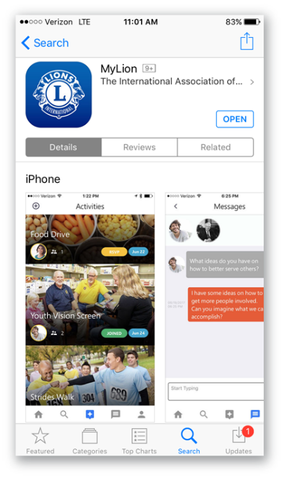


Download and register on the MyLion mobile app.
Go to www.mylion.org
Download the app
Notes:
Registering on the MyLion mobile application includes the same steps. Registration is a one-time process.

Slide 7
MyLion, your way
Explore the features of MyLion
Notes:
Let’s explore the features of MyLion.

Slide 8
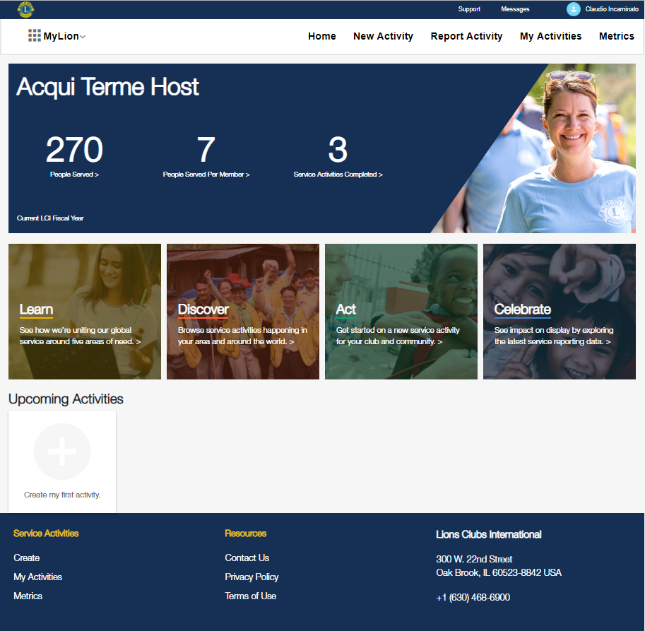
Your MyLion homepage
Navigate smoothly
Simple tabs mean you always know where you are and where you want to go.
See clear
service impact
Service impact is personal. Your homepage proudly showcases your club’s service metrics.
Continue on your Service Journey
Learn about our global causes
Discover service activities you can join
Act by creating your own service activity
Celebrate by sharing your story and exploring service impact metrics.
Be in the know
Check out your club’s upcoming service activities. See what activities you’re attending, join those that interest you and close out service activities that need to be reported.
Notes:
The MyLion homepage presents all of your service options, puts the Service Journey front and center, and makes service impact personal. Look at the boxes on each slide to understand how each feature of MyLion supports our global service.

Slide 9
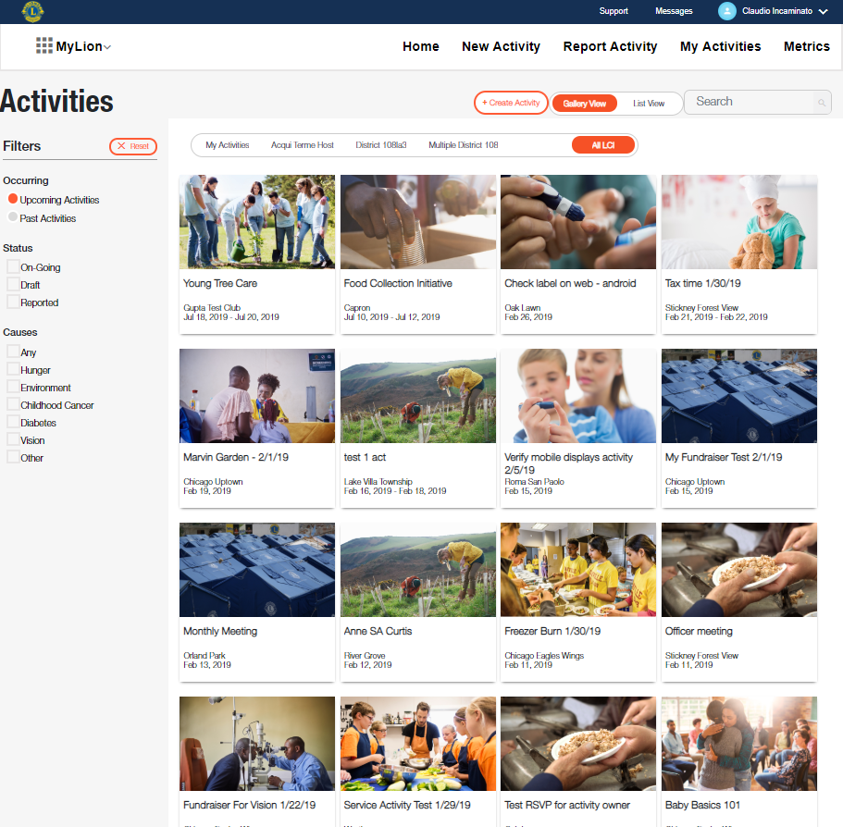
Discover service activities
Filter activities to find what’s right for you
Personalize your search to see past and upcoming activities at every level of Lions. Get inspired and join an activity near you.
Notes:
With the Discover functionality of MyLion you can search for service activities taking place around the world, or see what service activities your fellow members are organizing. Find an activity that interests you, check out the details, and join it.

Slide 10
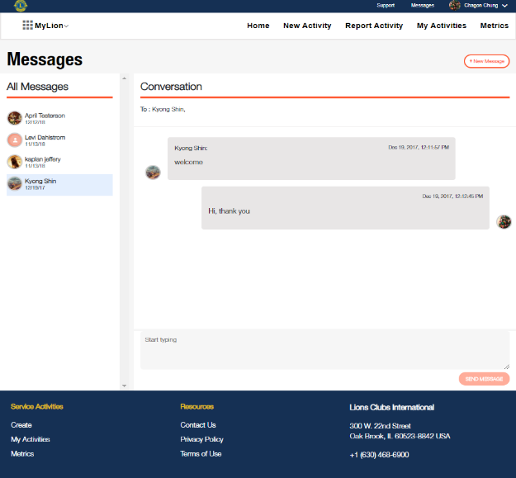
Communicate instantly
Built-in chat features
Communicate with Lions anywhere in the world, and at a local level, too.
Clear communication
Chat “bubbles” appear in different colors so at a glance you’ll know who’s speaking.
Control the message
You can decided when to start or leave a conversation, share a photo or video or delete old messages.
Notes:
Message other members within MyLion as you plan your service.

Slide 11
Plan, report and celebrate
Your service on MyLion
Notes:
MyLion helps you through each step of service: planning, reporting and celebrating.

Slide 12
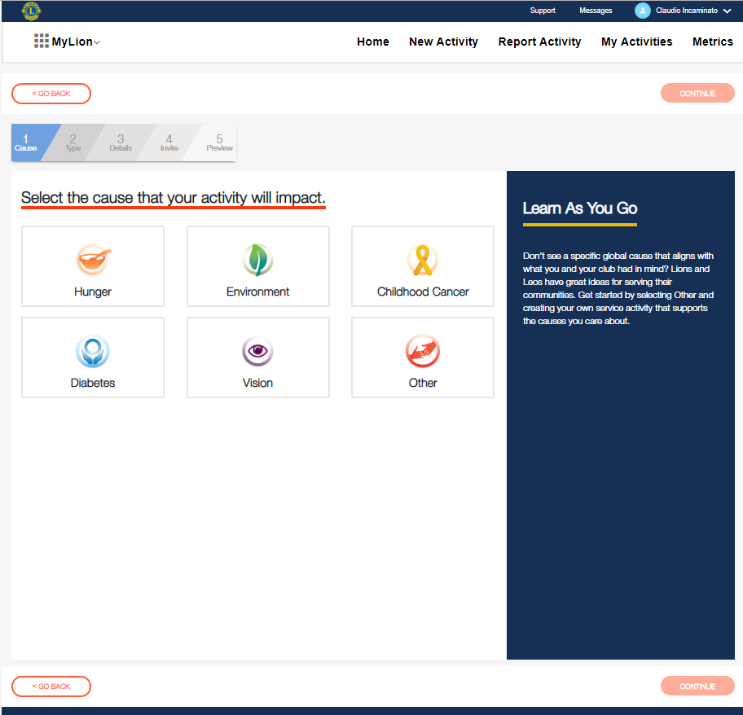
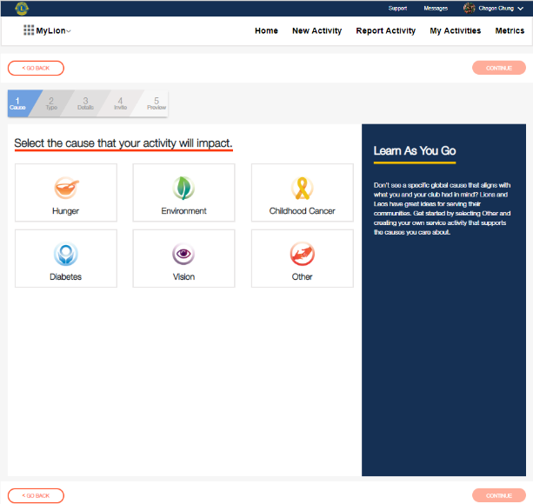
Select the cause that your activity will impact
Track your progress
MyLion guides you through each step to create a service activity. Always know what you’ve finished and what is next.
Learn more, serve better
MyLion’s right hand panel gives you more information about the global cause that you select. If you click a different cause, the information and links to support resources will also change. You may even find a new service passion by reading about our global causes!
Share your motivation
Icons help you choose what global cause motivates your service. You can also choose to impact a different community need by selecting “Other”.

Slide 13
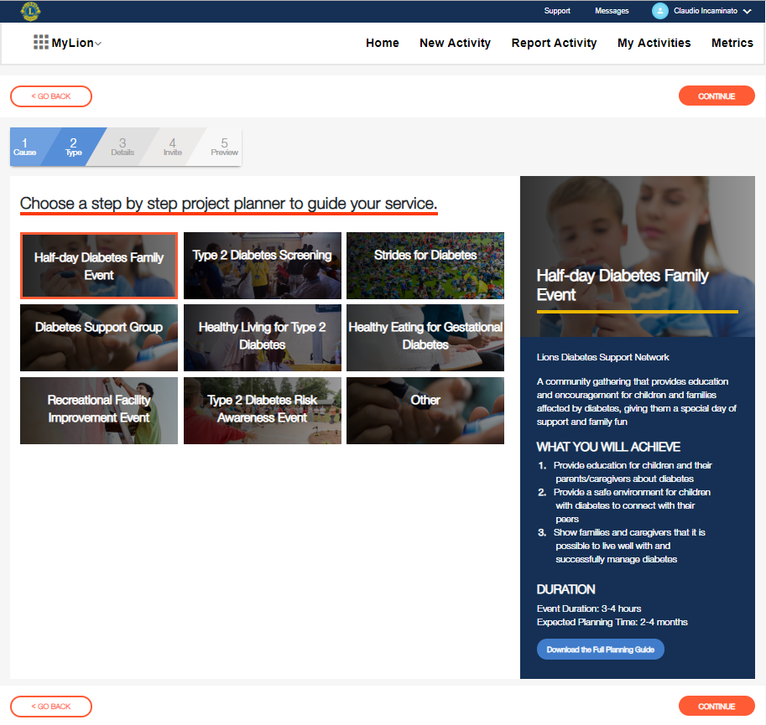
Choose a step by step project planner to guide your service
Get inspired and organized with Service Project Planners
Choose from a variety of popular service activities or create your own with “Other”. Each titled activity comes with its own Service Project Planner, or step by step guide to help you get organized.
Quick details to help you choose the right planner
MyLion’s right hand panel now changes to give you details on the service activity you chose. Click through to see which activity meets your club’s interests!
Download and share
Download the full Service Project Planner to bring to your next club meeting and start organizing.

Slide 14
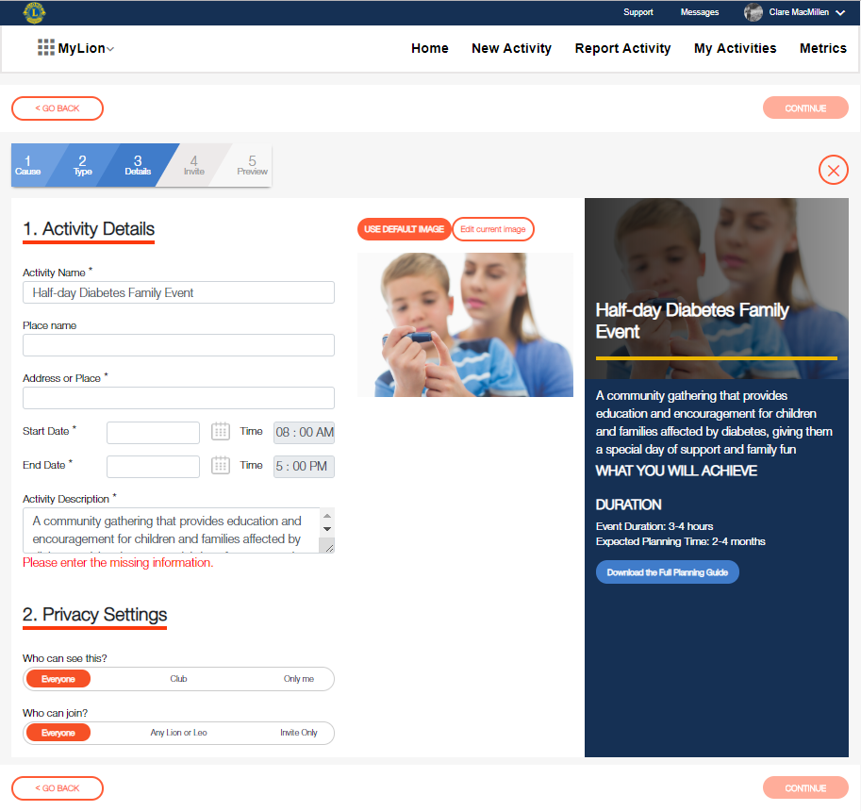
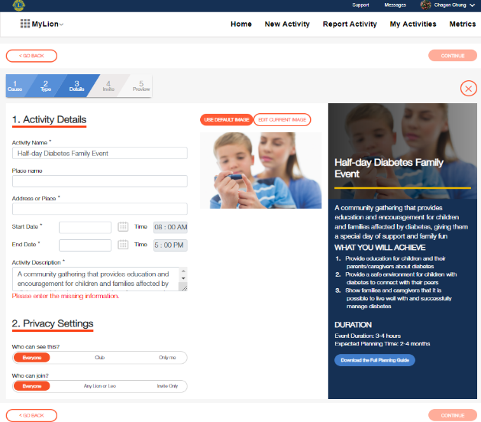
Activity details
Tell your service story
Use the activity details section to share more information about your service activity. Upload images and display what your club is planning or has achieved.
Find more information whenever you need it
If you chose a titled activity, the details of the activity and the Service Project Planner will appear again on the side panel.
Control your privacy
We’re committed to your privacy and security. MyLion gives you full control of who can view and join your activity.

Slide 15
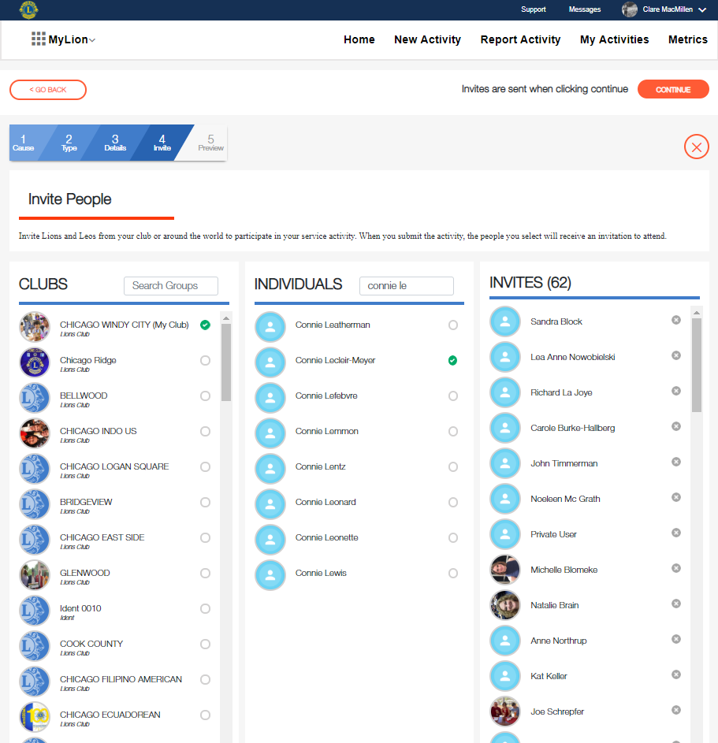
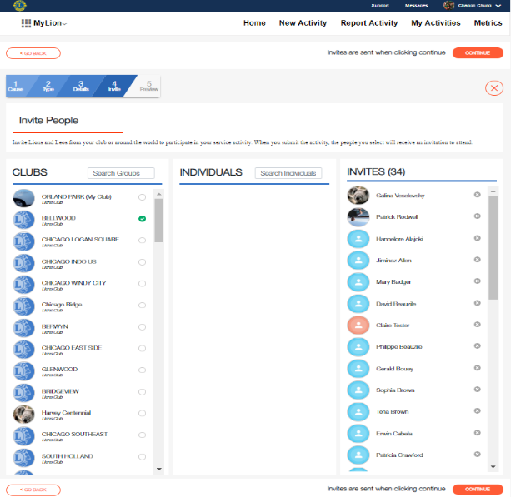
Invite people to your service activity
Search and invite at any level
Make your service activity a success by inviting others! Involve entire clubs in your district by selecting them in the Clubs column, or search for individuals.
Manage invitees with a few clicks
Add and remove invitees in the right column as you develop your activity.

Slide 16
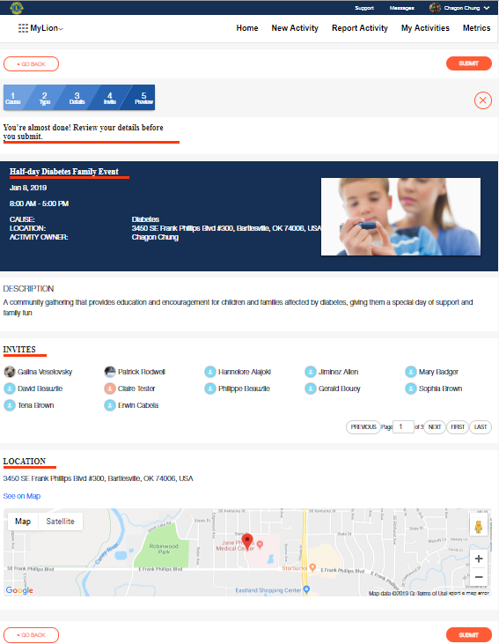
Preview
Looks like a great plan!
The review screen shares all of your service project details on one clear page.
Activity planned (and almost fully reported)
Once you’re happy with your plan, click submit and share your upcoming service with invitees and other Lions and Leos.
Add or edit details
If you aren’t quite sure about your invitation list (or other details you added), that’s okay. Navigate back to make changes.

Slide 17
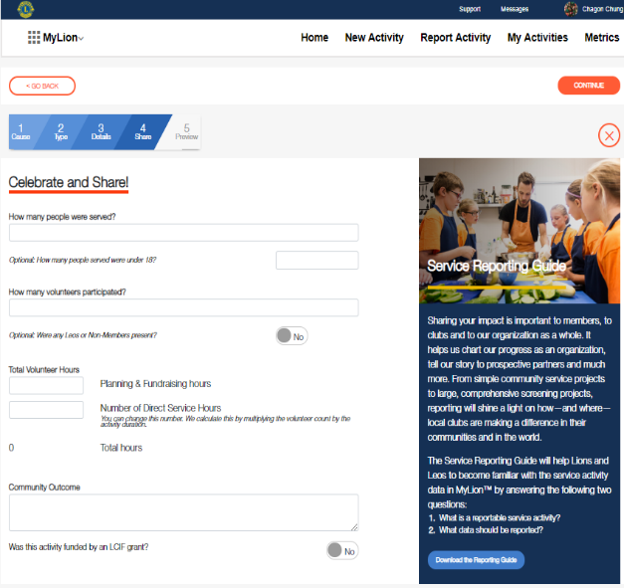
Report (for officers)
Celebrate your impact
Reporting your service is a way to celebrate your impact in your community. Share how your service activity helped your community in a measurable way.
Share the story behind the numbers
The community outcome field helps you add details to the lives you’ve impacted. Tell your story of kindness.

Slide 18
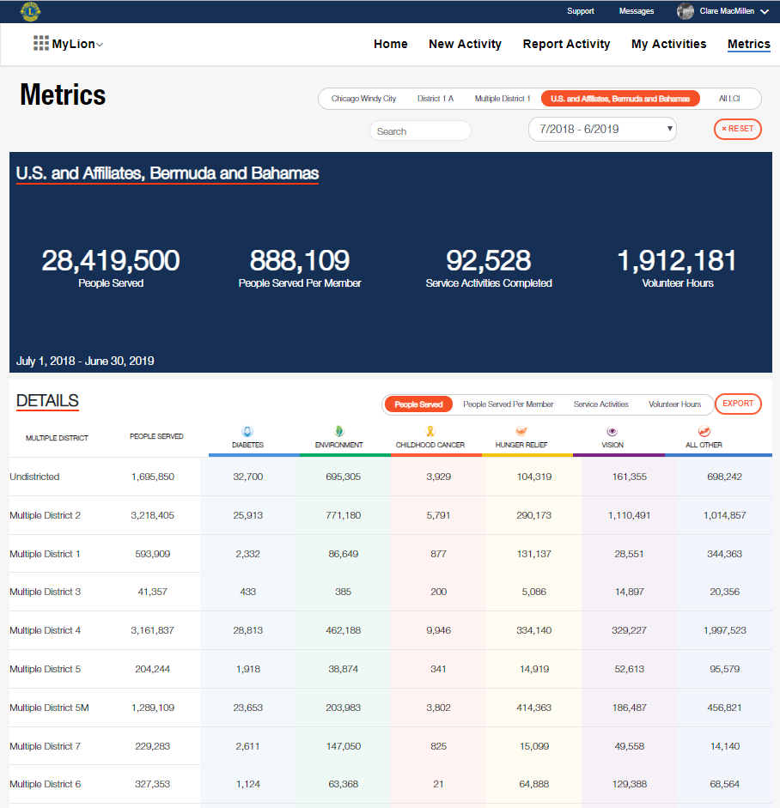
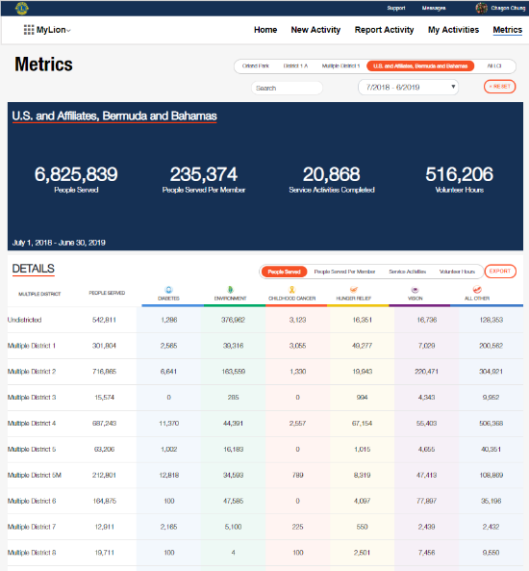
Celebrate: Explore impact with the metrics dashboard
Explore impact at every level
Use filters to see Lions service impact at a local or global level.
Your quick look at service
Our key service metrics are prominently displayed on the Metrics dashboard for easy reference.
Pull reports in seconds
Download data to your personal device using the Export function.
Become an instant data expert
Our interactive dashboard updates every few hours and shares where and how we impact the world.

Slide 19
The MyLion mobile application
Notes:
Now we’ll take a look at the MyLion app.

Slide 20
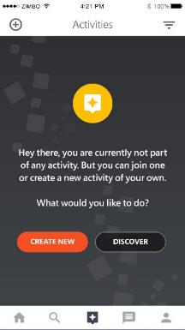
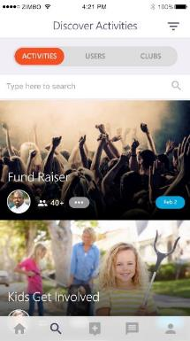
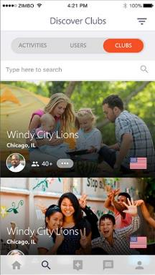
Plan and join service activities on the MyLion app
Create or support service
MyLion can help bring your service activity idea to life, or connect you to activities that need your support.
Get inspired and involved
Search filters help you find activities. Get inspired, join an activity when you travel or see what’s happening locally.
Connect with the world
Curious about other clubs or interested in particular MyLion users? Search and follow to stay in the know.

Slide 21
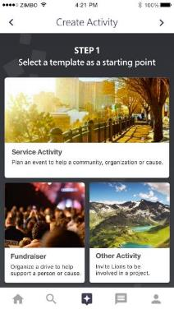
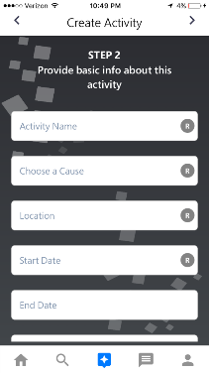
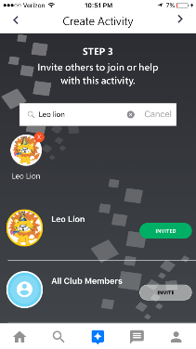
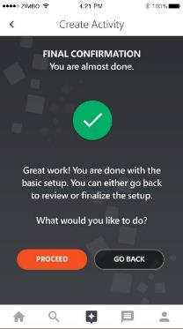
Create an activity on the go
Use simple templates
Consider what activity you’d like to organize with MyLion and choose a simple template.
Capture the details
MyLion’s prompts will help you add the details you need from the cause that motivates you to the timeline of the project.
Get everyone involved
With a few taps, invite others to join you and make your service a success.
Let’s start serving
Once you’re happy with your plan, click publish and share your upcoming service with invitees and other Lions and Leos.

Slide 22
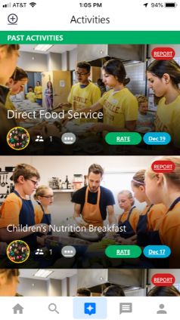
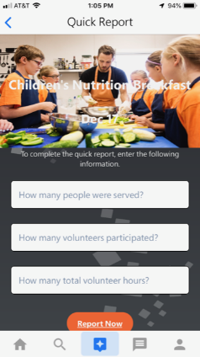
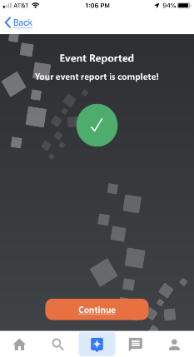
Report and celebrate your service (for officers)
Quickly report your service.
Enter a few pieces of basic information and submit for quick and easy completion of your service

Slide 23

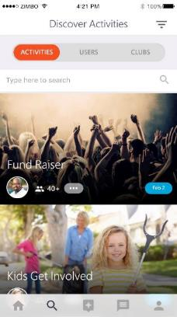
Discover your next service activity and service partners
Get inspired by local and global Lions
Search for other Lions and clubs to discover service activities near you, or get inspired by activities globally.

Slide 24
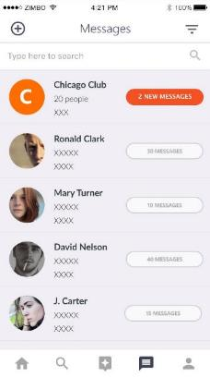
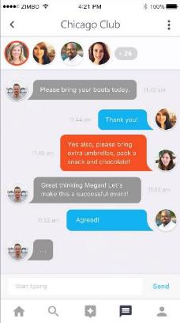
Communicate instantly
Built-in chat features
Communicate with Lions anywhere in the world, and at a local level, too.

Slide 25
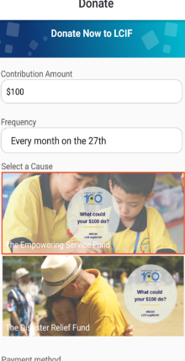
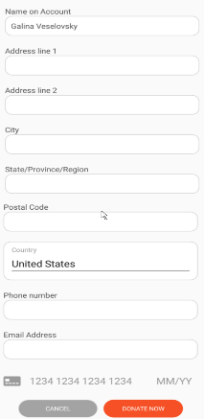
Donate to LCIF
Fast and secure donation process
Enter a few key pieces of information, including how much you’d like to give, the frequency, and your payment method, then donate! Your contribution will make a world of difference.

Slide 26
What’s next?
Notes:
Now we’ll take a look at the MyLion app.

Slide 27
Next Steps
MyLion is available everywhere, so register and login today!
  Visit https://app.mylion.org from any internet browser to register and login.
  Download the MyLion application on your mobile device:
      iPhone users: visit the App Store
      Android users: visit the Google Play Store
Contact mylionsupport@lionsclubs.org if you need help registering, logging in or using MyLion.
27

Slide 28

Thank you!
© 2018 Lions Clubs International

