Slide 1

District Webinar, March 2019
Notes:
Welcome to MyLion- Lions Clubs International’s new platform to connect and serve, now available from any device.

Slide 2
A,
aa
Lion Account
MyLion overview
MyLion for leaders
Future enhancements
Agenda
2
Notes:
What will this presentation discuss?
First, before we start talking specifically about MyLion, we’ll introduce your Lion Account, our universal login system that gives you access to all Lions Clubs International applications.
Next, we’ll share some background information about MyLion, key features and how they relate to you as Lions and as Lions leaders.
Finally, we’ll go over upcoming developments (as of March 2019).
Let’s get started with an overview of MyLion.

Slide 3
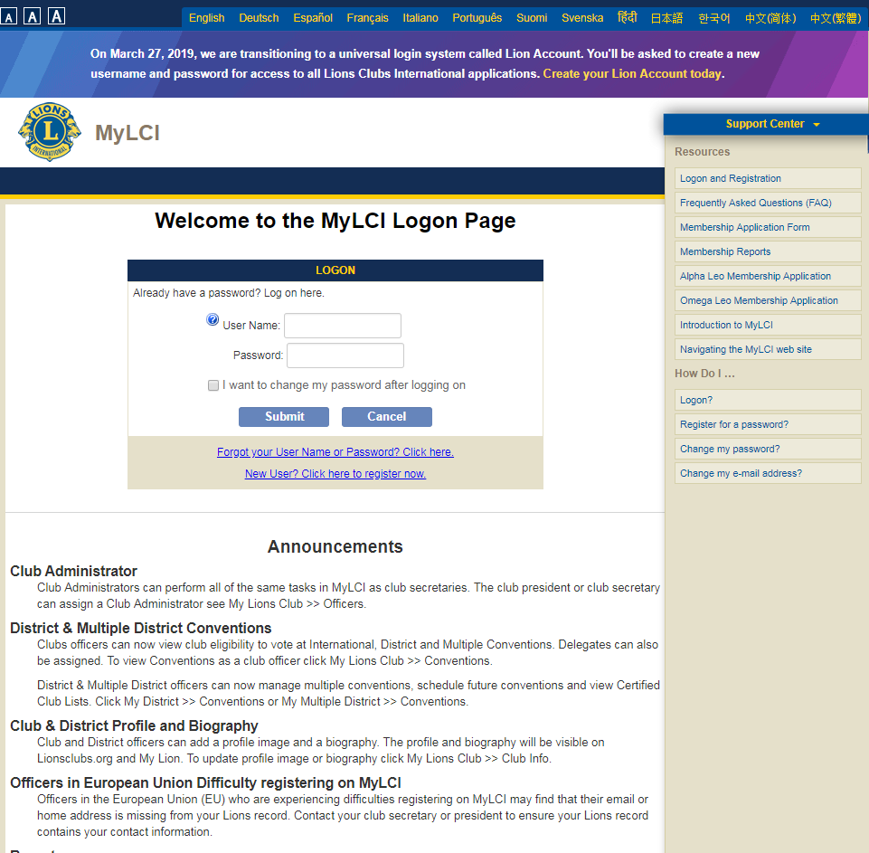
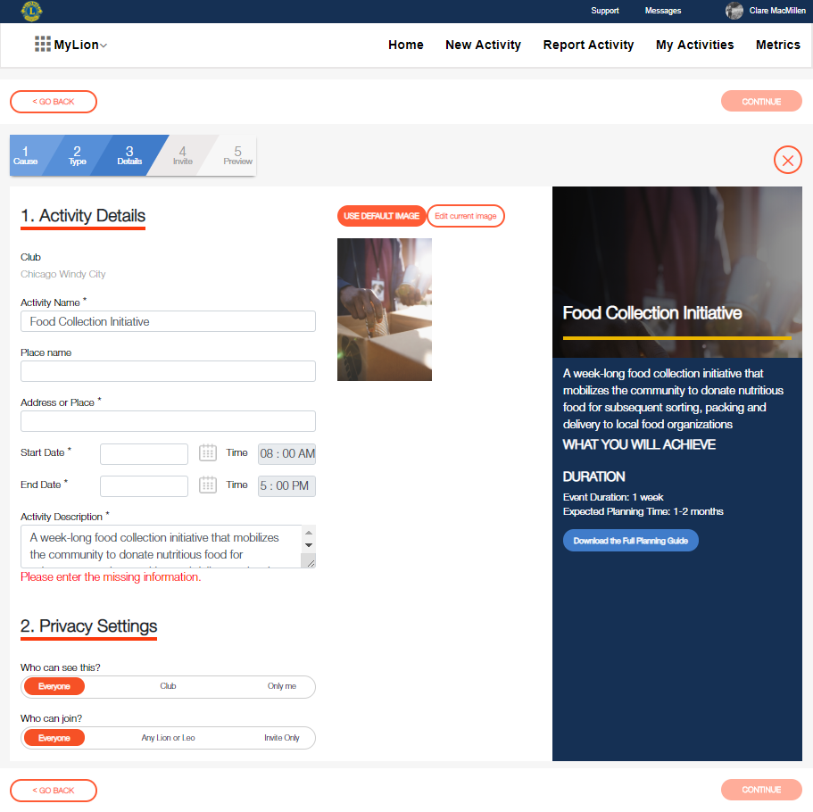
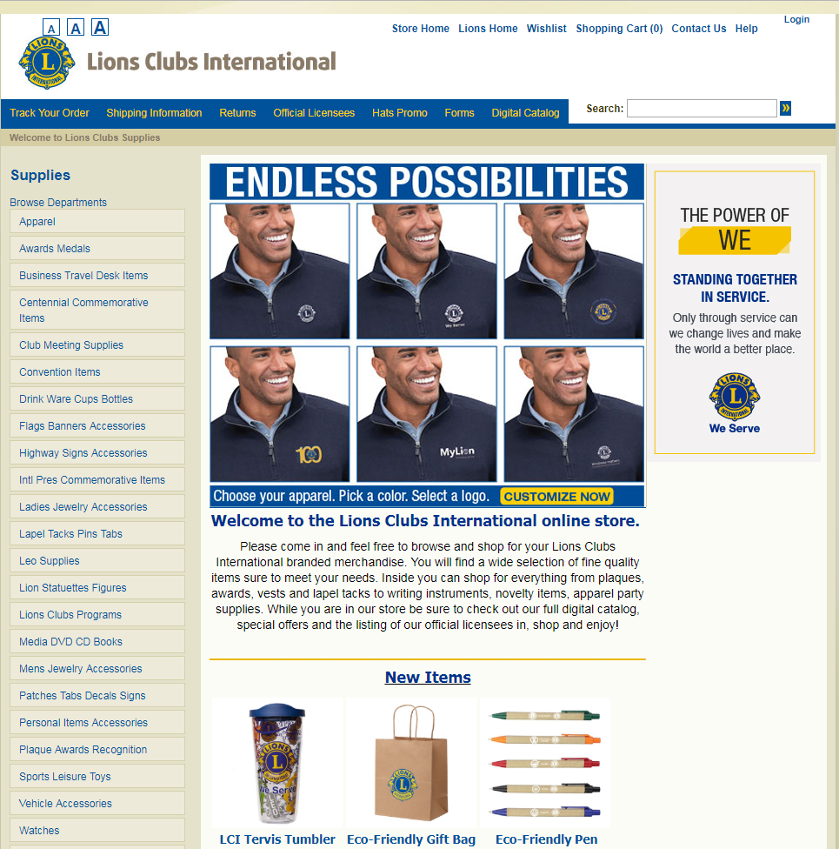
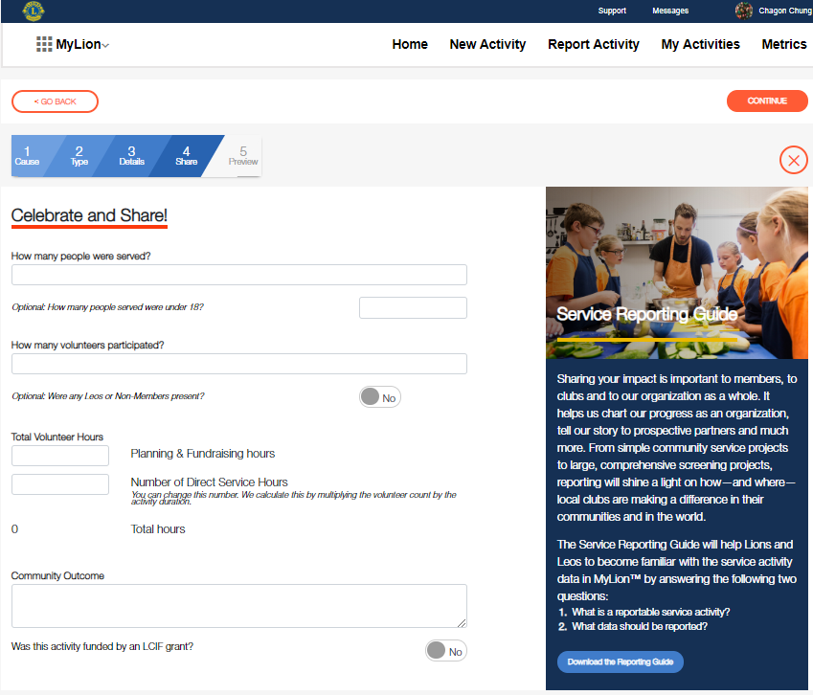
Lion Account
Your Lion Account gives you access to all your Lions applications with one set of credentials.
Your Lion Account gives you access to:
      MyLCI
      MyLion
      Shop
      Upcoming applications
MyLion users: Your MyLion login credentials are now your Lion Account. You are all set!
MyLCI users: If you aren’t registered for MyLion, register today. These credentials will be your Lion Account.
Get access to MyLCI, MyLion, Shop and more..
3
Notes:
Lions currently use different credentials, user IDs and passwords, to access different applications. We have one user ID and password for MyLCI, one user ID and password for MyLion, so on and so forth. This will only become more complicated as we add more applications that support Lions and Leos.
On March 27, 2019 we’ll fix this issue by introducing a universal login for all our systems- Lion Account.
Your Lion Account gives you access to MyLCI, MyLion and Shop. It will also give you access to any future Lions applications.
If you already have a MyLion username and password, you’re set and don’t need to create a new set of credentials. Your MyLion credentials will become your Lion Account credentials.
If you are a MyLCI user who is not registered on MyLion, you’ll be asked to create a Lion Account starting March 27, 2019.
We understand this is a disruption for MyLCI users and evaluated alternatives, such as using existing MyLCI credentials as the universal login. However, since MyLCI credentials are often shared, this approach would expose members to greater privacy threats.
Lions Clubs International is available to help any user who needs assistance creating a Lion Account. There are several ways to contact the team for support:
MyLion Support phone number: 630-468-7000
MyLion Support email: mylionsupport@lionsclubs.org
Support Hours: Monday- Friday, 8:00am – 4:30 pm CST (Chicago time)

Slide 4
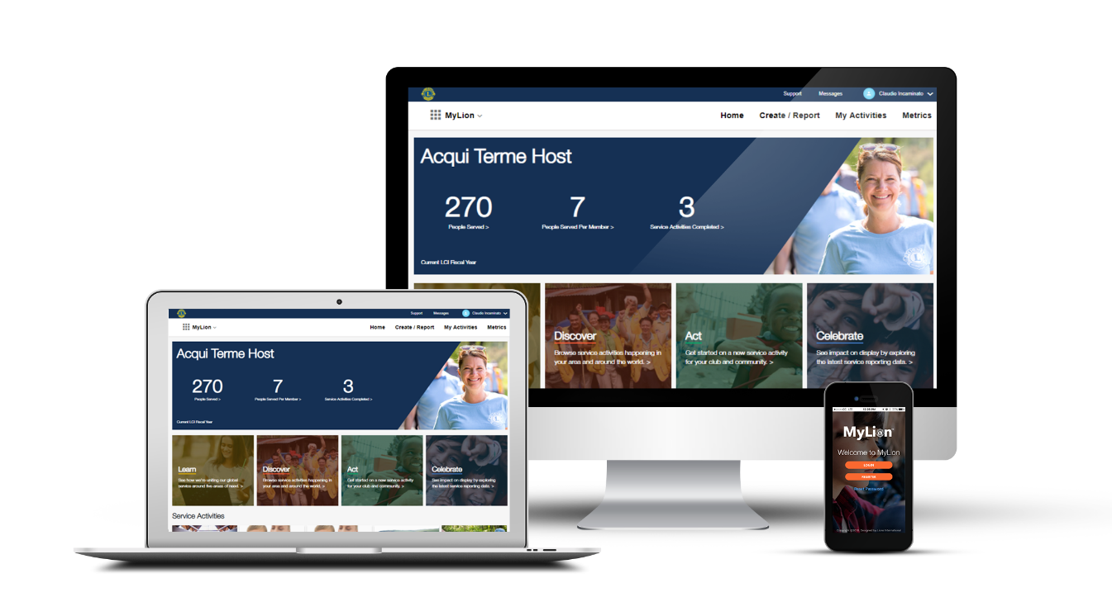

m
MyLion
  Plan, invite, and share service activities with your club
  Report service activities if you are an officer
  Find, connect and chat with Lions and Leos from all over the world
  View key service data for your club, district, multiple district, etc.
MyLion will replace MyLCI service activity reporting starting July 1, 2019. All other MyLCI features will remain available.
4
Notes:
Now that we understand our Lion Account, let’s talk about our latest Lions application: MyLion.
MyLion is one platform that can be used on your desktop computer, laptop, tablet, mobile phone, or any device with a web browser. When many of us think of MyLion, we think of the MyLion mobile application, the first version of MyLion that was available. However, MyLion is now also available as a website, so you can access it from any device with a web browser.
MyLion, whether you login on your laptop or open up the app on your phone, helps us connect and serve. It helps us do what Lions have always done, more easily. With MyLion you can:
Plan upcoming service activities, meetings, and fundraisers and take advantage of new, Lions driven service planning resources related to all of our global causes.
Club officers with reporting access, can quickly report service activities on MyLion.
MyLion users can directly send messages to one another- they can even send group messages which makes coordinating any kind of Lions event easier.
Lions can explore local and global service data, giving leaders like you more visibility into how your clubs are serving and therefore, ways we can better support each other.

Slide 5
What do I need to know about MyLion?
  MyLion is constantly being improved
        MyLion was tested by over 300 Lions and Leos and we continue to develop the platform based on feedback from users.
  MyLion will replace MyLCI service activity reporting starting July 1, 2019
        Webinars, MyLion toolkits and other resources will be available for support.
  MyLion is available everywhere from any device
        Login to MyLion from any web browser.
        Download the MyLion mobile application on your smart phone.
5
Notes:
But before we go any further, let’s emphasize a few key points.
First, we are constantly improving MyLion based on feedback from Lions and Leos. Before MyLion became globally available, Lions and Leos from all our constitutional areas tested the website and mobile application. Member recommendations, insights from Lions users, make MyLion better. It’s suggestions from Lions that have led to redesigned navigation, clearer filters, and much more.
MyLion will be the destination for service activity planning and reporting starting on July 1, 2019. MyLCI’s other features will remain available. Webinars like this one, webinars that dive deeper into specific features, blog posts, short videos, and more are under development to help Lions and Leos take advantage of MyLion and enhance our service.
MyLion is now available everywhere from any device. You can login to MyLion from any device with a web browser, including your desktop computer or laptop. For the best MyLion experience on your smart phone, please download the MyLion application from the App Store (for iPhones) or the Google Play Store (for Android phones).

Slide 6

Why MyLion?
Lions want the ability to connect, regardless of physical location.
Lions want more access, more tools, and easier reporting for service.
Lions want more control over their engagement with LCI.
Source: Digital surveys of over 1,500 Lions from around the world, 2017.
Notes:
MyLion is new, but it’s core features- planning, connecting, reporting, and controlling our information- are not.
Instead, MyLion combines the great work that Lions do on one platform, making it easier to manage activities, keep club members updated, and encourage participation in our association.

Slide 7
Why MyLion for leaders?
Explore how MyLion supports your leadership.
Notes:
MyLion is unique because unlike MyLCI, it is available to all members. Many of MyLion’s features support the day to day activities of any Lion or Leo. However, our Lions leaders have some unique responsibilities:

Slide 8

Support your district’s clubs
Increase visibility into all your district’s activities using MyLion.
Notes:
Our Lions leaders have vision and passion. They travel, coordinate meetings, reach out to clubs- all to make sure that Lions have the tools and resources they need to be successful and happy.
MyLion offers a new level of visibility into club and district activities to help you help our district’s clubs.

Slide 9
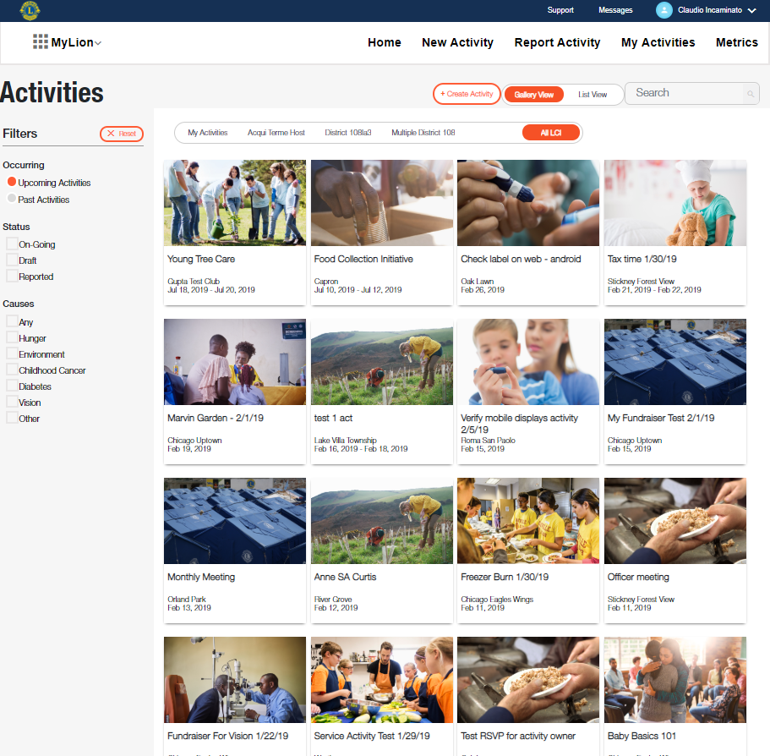
Plan and discover service, meetings & fundraisers
Coordinate travel, outreach and other support around clubs’ planned activities
Create your own activity and encourage club and district members to participate using individualized invitations
Identify opportunities for improvement
Notes:
With MyLion, any user can create an activity in advance. Depending on the privacy settings of the activity (we’ll talk more about that later) you can see what’s happening at a local and global level. Seeing and sharing has a few advantages.
First, you can create travel plans based on your goals and the needs of your clubs. Do you want to join a club-hosted training on membership recruitment to add your insight? Encourage clubs to organize it on MyLion. Are you interested in seeing what service is planned for World Diabetes Day? Explore what activities are planned for November or contact clubs who aren’t sure how to get started.
You might also want to set up an activity yourself- a meeting with other district or multiple district leaders, or a service activity when you visit a club. You can organize your activity and invite Lions to attend using MyLion.
Finally, leaders are always identifying opportunities for improvement.
You can see if any clubs in your district don’t seem to be very active- perhaps they are struggling with planning service activities and you, as leader, can offer suggestions and feedback.

Slide 10
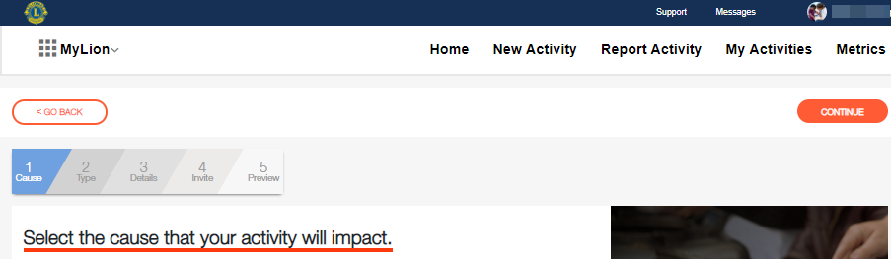
Guided planning process
Action buttons
New Activity, Report Activity, My Activities and Metrics are accessible in the header bar in MyLion.
Progress Tracker
Outlines your next steps in the process to complete each task
Notes:
MyLion provides guidance right from the start of planning . There are convenient, easy to understand action buttons at the top of the screen and the progress tracker shares each step in the planning process.

Slide 11
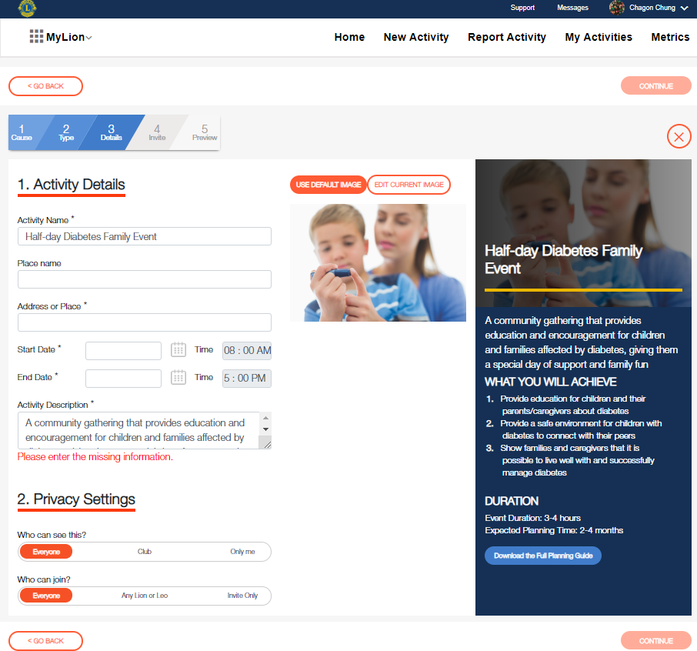
Clear, consolidated information
Tell your service story
Use the activity details section to share more information about your service activity. Upload images and display what your club is planning or has achieved.
Find more information whenever you need it
If you chose a titled activity, the details of the activity and the Service Project Planner will appear again on the side panel.
Control your privacy
We’re committed to your privacy and security. MyLion gives you full control of who can view and join your activity.
Notes:
With a few steps anyone can create an activity that is clear and informative. See how the key information of a service activity are laid out above.
Another key feature to note when you plan an activity is that an organizer can adjust the privacy settings for the event.
For example, you might make a community trash cleanup activity viewable and joinable by anyone on MyLion. You want a lot of participants to clean up as much garbage as possible. On the other hand, if you’re setting up a meeting with specific club leaders to discuss their membership goals, you would likely make that event private and “by invitation only”.
A final feature to note here is the right side bar. Here you can download an assortment of service project planners that help Lions plan service projects related to our global causes. These resources are also available on lionsclubs.org.

Slide 12
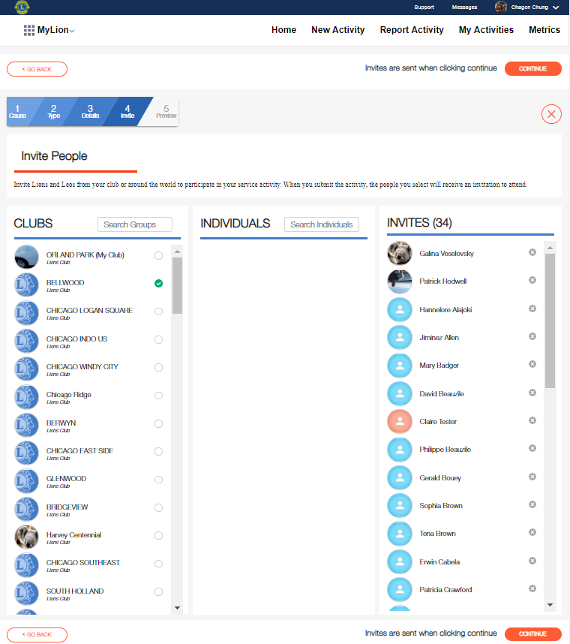
Invite people to your activity
Search and invite at any level
Make your service activity a success by inviting others to your service activity! Involve entire clubs in your district by selecting them in the Clubs column, or search for individuals.
Manage invitees with a few clicks
Add and remove invitees in the right column as you develop your activity.
Notes:
Once you set up an activity you can invite clubs and individuals to attend.
No need to find email addresses or phone numbers, or bounce between different invitation programs. The information is secure and stored in MyLion for easy use.

Slide 13
Celebrate and share
Celebrate your impact
Reporting your service is a way to celebrate your impact in your community. Share how your service activity helped your community in a measurable way.
Share the story behind the numbers
The community outcome field helps you add details and depth to the lives you’ve impacted. Tell your story of kindness.
Notes:
Once a planned service activity is completed, officers can report key information like how many people were served, number of volunteer hours and more. Most of the “reporting” work is done in advance when the activity is planned on MyLion.

Slide 14

Achieve your district’s goals
Explore your district’s real time service data on MyLion.
Notes:
Another major responsibility of district leaders is goal setting, including service goals. In order to set measurable goals, review progress, and adjust accordingly, you need access to information and fast.
With MyLion, you can explore service statistics from the club level to the constitutional area level.

Slide 15
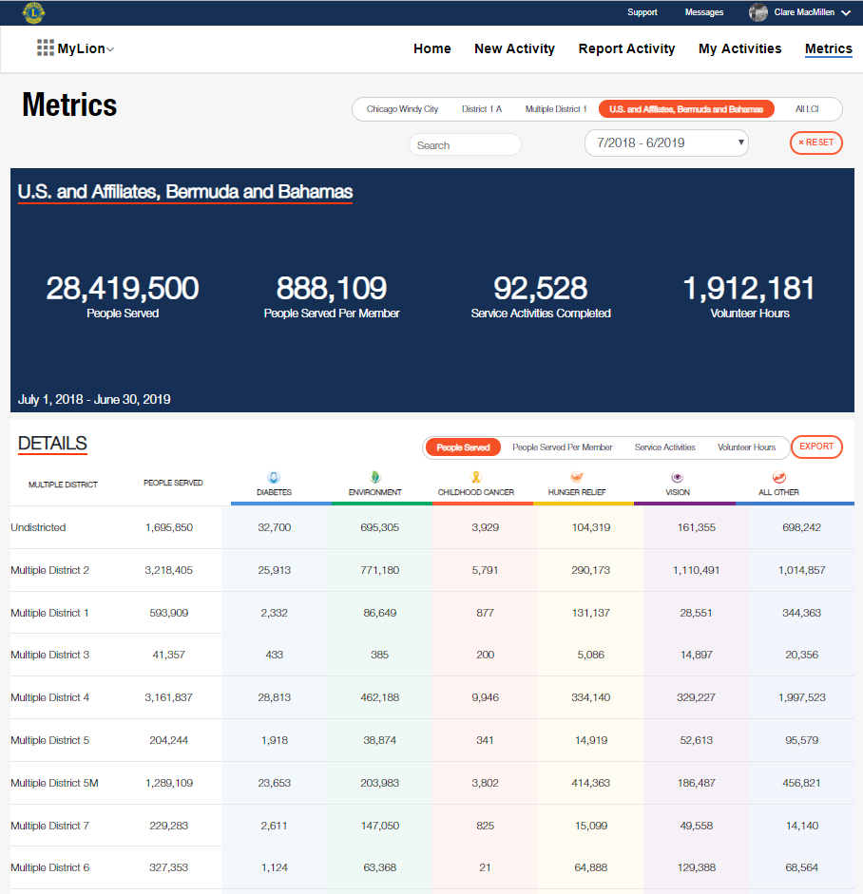
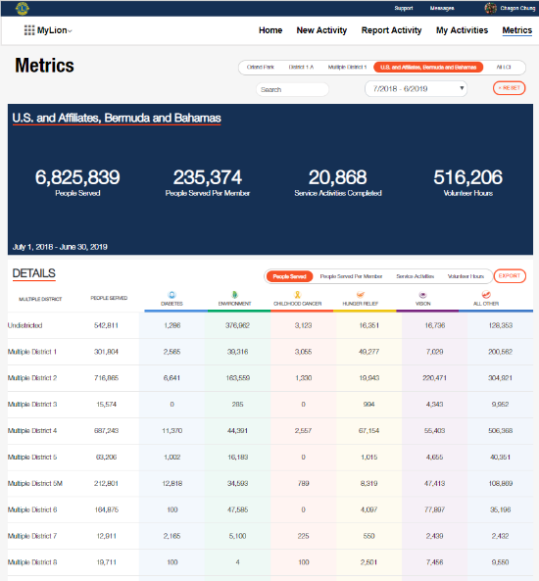
Metrics
Save time
See what clubs in your district are up to
Check out the service impact of Lions at different levels
Crunch the numbers that you want
Notes:
Viewing real time impact with the metrics dashboard helps you:
Save time by providing detailed information at a glance.
Metrics, like the planning and discover features of MyLion, also offers even more visibility into clubs in your district. If you’d like to explore data outside of your district, simply adjust the filters in the header.
Finally, if you don’t want to manipulate the data within MyLion, you can also export the information you want into a an Excel spreadsheet and work on it offline.
Information is power, and the metrics dashboard will give us new insight into how Lions are serving and reporting.

Slide 16

Inspire Lions collaboration
Showcase your Lions spirit and district while controlling privacy on MyLion.
Notes:
One of the reasons Lions do so much good in the world is because we are a network- we learn from one another and we work together.
We’ve heard time and time again, that Lions want more opportunities to connect and share their passion for service. As a leader, you inspire and participate in that collaboration. You also lead by example.
MyLion gives you a polished, easily navigable platform to showcase who you are as a Lion and who your district is, all while comfortably maintaining what information you want to share and when.

Slide 17
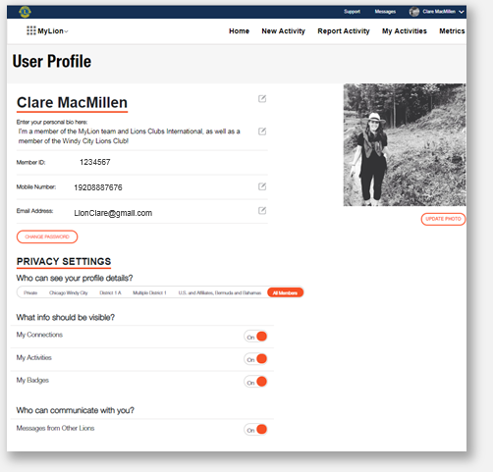
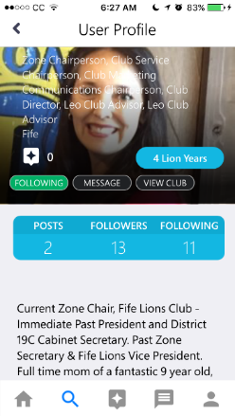
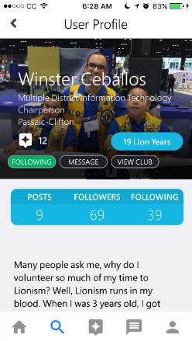
Your personal MyLion profile
Share who you are with other Lions
Modify your email address and phone number online
Manage your personal privacy settings
Notes:
It starts with sharing your personal Lions story through your MyLion profile.
Think of your profile as your “calling card”, introducing you to Lions around the world. This is a great way to show other Lions who you are, where you’re located, what club you belong to, and what you’re interested in. ​
The image labeled “Clare MacMillen” is from the vantage point of a MyLion user. Each user can upload a photo, add a description and set their privacy settings. You’ll also see that, for the first time, members can retrieve their own Member ID number and edit their own contact information!
The smaller images are screenshots of users taken from the MyLion app. These profiles have a few pieces of information from MyLCI- including their titles and how long they’ve been a member. However, these users added their own profile images and descriptions.

Slide 18
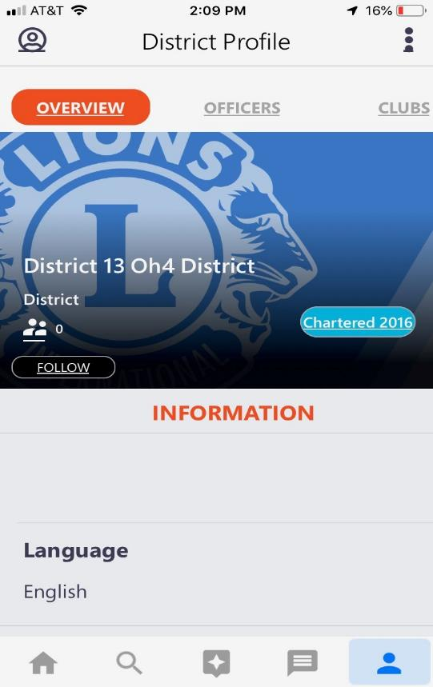
Your district profile
Essential information about your district at your fingertips.
Quickly view the District officer list and the club list using MyLion.
Introduce your District to Lions and Leos around the world
Create your District profile and highlight the features your district excels in. Be the flagship district for your country.
Notes:
The District profile is similar to your user profile. There is also a club profile that club officers can manage.
You can use the district profile to introduce your district to Lions and Leos around the world.
Add photos, highlight how your district serves, and promote the great work your clubs are doing.

Slide 19
Getting clubs ready for MyLion
Registration
Notes:
The first step to taking advantage of MyLion is registering for a Lion Account. We know some of us have struggled to set up a username and password. However, most registration issues arise when we don’t have the personal, Lions information we need.

Slide 20
Getting your district ready for MyLion
1
  Update MyLCI with member emails and phone numbers.
2
  Encourage club secretaries to provide Lions with a copy of their Member ID.
3
  Contact mylion@lionsclubs.org if you need help.
Notes:
There are three key things you can do to help your clubs get registered for a Lion Account and using MyLion.
First, update every club members’ information in MyLCI, and most importantly, provide a personal email address or mobile phone for EACH club member.
Next, make sure you club secretaries provide every Lion with a copy of their Member ID. Once members are logged into MyLion they’ll be able to access and control that personal data. Until then, they’ll still need support.
Finally, please reach out to us if you’re having trouble. Our member support center will be happy to assist.

Slide 21
Coming soon
Notes:
As I mentioned earlier, we are constantly improving MyLion based on feedback from Lions and Leos. Member recommendations make MyLion better, so look forward to these upcoming changes and additions!

Slide 22
Coming soon to MyLion
Registration: support/alternative verification options
Reporting
  Signature activities
  Additional categories for service projects
Access: District/Multiple District level service activity planning and reporting
Notes:
Online help with verification during registration
To protect your privacy, MyLion currently uses member id , email address or phone number to verify who you are in our Lions world.
We’re adding a new verification option to help members register.
When you are registering, if the system can’t verify your email address or mobile phone number a few additional security questions will be presented. They will involve questions about your current club president and meeting location, so make sure those details are updated in MyLCI.
We heard that Lions missed the sub categories and signature activity options in MyLion. Our service and MyLion teams are exploring the best way to add those details and make it easy to report.
And finally, you will be able to create and report activities directly affiliated with your district and multiple district.

Slide 23

Do you have questions? We can help.
Please email mylion@lionsclubs.org if you have additional questions.
Notes:
If you have additional questions about MyLion, please contact our Member Support Center at mylion@lionsclubs.org.

Slide 24
Thank You
© 2018 Lions Clubs International
2019 February
Notes:
Thank you!

