Slide 1


Plan for Your Club’s Success
(Global Membership Approach)

Slide 2

Coming together is a beginning. Keeping together is progress. Working together is success.
- Henry Ford
2

Slide 3
Global Membership Approach for Clubs
1
Build a Team of Club Leaders
2
Build a Vision, Assess Needs and Set Goals
3
Build a Plan to Achieve our Goals
4
Build Success
3

Slide 4
Build a Team of Club Leaders
Current Leaders: Identify who can carry out and lead the development of the strategy.
Future Leaders: Include Lions who can serve as future leaders. Lions who have held leadership positions, who can provide insight, support and are interested in the future of the club.
Poll the Members: To gain a full perspective of your club’s needs. Look for a cross section of members who represent the club or in smaller clubs involve as many members as possible (established members, new members, young Lions, professionals) to both understand their needs and engage their talent.
4

Slide 5
Build a Vision, Assess Needs and Set Goals
Grow membership within the club
Revitalize your club with new service opportunities
Rejuvenate your club with new members
Excel in leadership development and club operations
Share your club’s achievements with your community
2
3
1
4
5

Slide 6
Focus Area 1
Rejuvenate Club with New Members
Discussion Questions
What opportunities exist to expand membership?
What do we need to do to better recruit members?
Why are members not joining our club?
Why do people join our club?
6

Slide 7
Focus Area 2
Revitalize Clubs with New Service Opportunities
Discussion Questions
Are the club’s service projects relevant to current community needs?
Are members enthusiastic and actively involved in service projects?
Is club leadership receptive to members’ ideas for new service ideas?
Do our service projects attract new members?
7

Slide 8
Focus Area 3
Excel in Leadership Development and Club Operations
Discussion Questions
Do club officers participate in training for their positions?
Are members encouraged to take leadership positions?
Do members regularly attend and participate in club functions?
Do you need to reconsider the format of club meetings?
8

Slide 9
Focus Area 4
Share your Club’s Achievements with your Community
Discussion Questions
Is the club active on social media (Facebook, Instagram, Twitter)?
Does your club have an e-Clubhouse or website?
How are you keeping the public informed of your events?
Do we include welcoming messaging that encourages people to join?
9

Slide 10
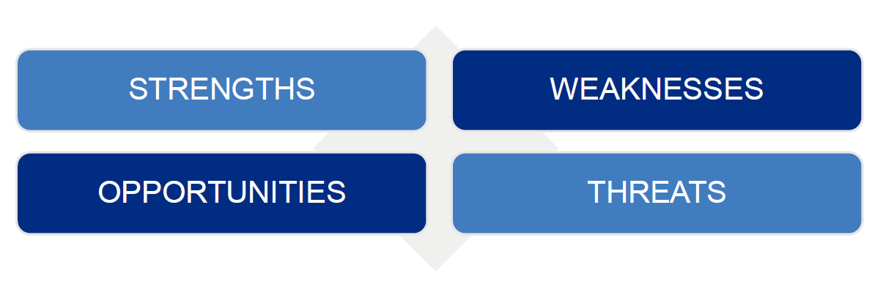
Introduction to SWOT Analysis
This brief course will support you in building a general understanding of what a SWOT Analysis is and why it is useful in developing a vision, goal or action plan.
10

Slide 11

RESOURCES TO SUPPORT FOCUS AREAS
11

Slide 12




Resources
12

Slide 13



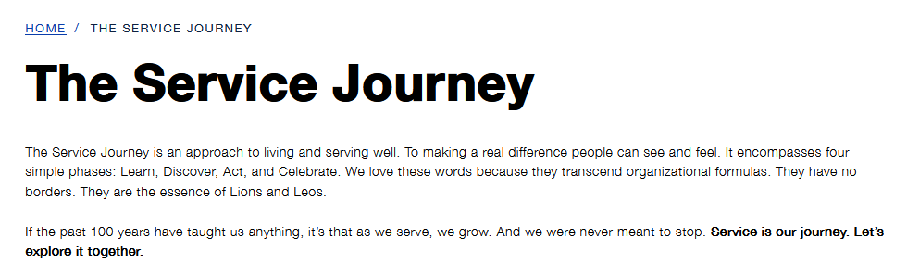
13

Slide 14

14
Notes:
The Troubleshooting Guide for clubs identifies common club issues and provides resources with potential solutions

Slide 15
ESTABLISH GOALS
15

Slide 16
S
M
A
R
T
S
M
A
R
T
pecific
easurable
ctionable
ealistic
ime Bound
Ensure that the objective is clear.
Benchmarks and progress must be measurable.
Each goal must be achievable.
Timeframe that outlines a schedule of progress.
Challenging but not unrealistic.
16

Slide 17
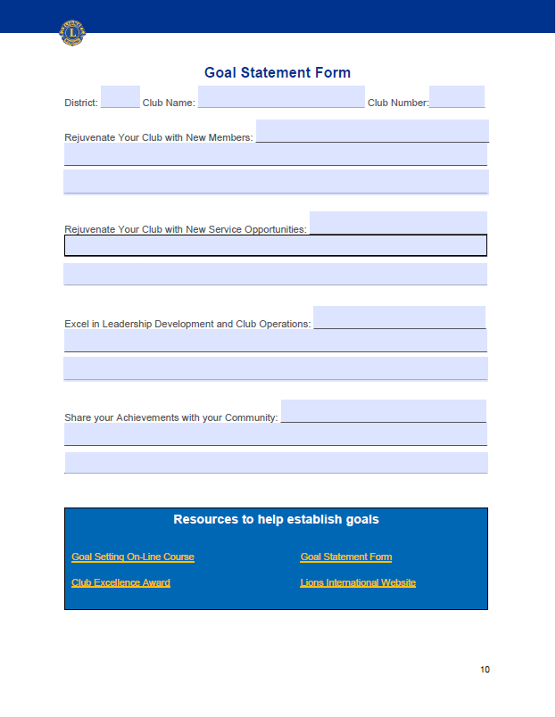
Goal Statement Form
17

Slide 18
BUILD A PLAN TO ACHIEVE OUR GOALS
18

Slide 19
Build A Plan to Achieve Our Goals
For Each Area
What? (Goal Statement)
How? (Action Steps)
When? (Deadline for Completion)
Who? (Person (s) Responsible for Action)
How Will You Know? (How Will You Know It’s Accomplished)
DEVELOP YOUR ACTION PLAN by outlining the steps you will take to achieve your goals.
This step outlines how the goal will be achieved (action steps), when each step will be completed, who will be responsible for the step, and how you can determine each step has been completed. The Action Plan Worksheet is a tool you can use as you develop a plan to achieve each goal. Together, the plans for each goal comprise your Vision.
19

Slide 20
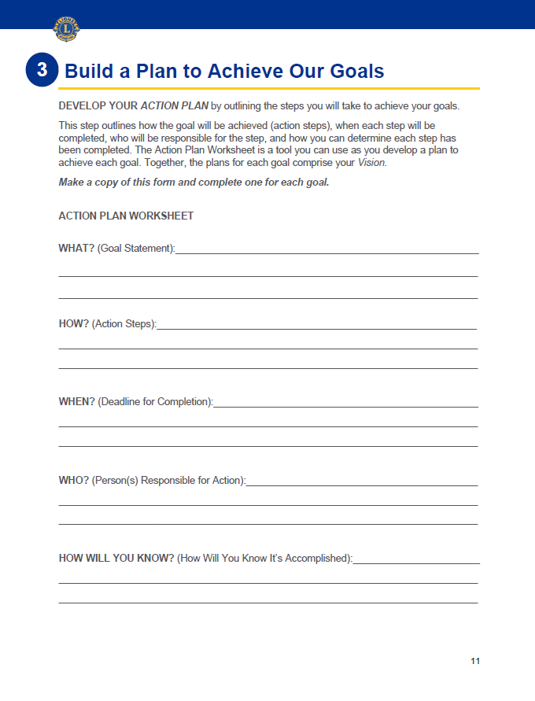
Action Plan Worksheet
Make a copy of this form and complete one for each goal
20

Slide 21
BUILD SUCCESS
21

Slide 22
Build Success
To be Successful:
SHARE
SUPPORT
RECOGNIZE
EVALUATE
CHANGE
Share
Support
Recognize
Evaluate
Change
22
Notes:
Share: your club’s Vision with all club members so that they are aware of what the club wants to achieve, along with their role in achieving club goals. It is very important to the health and vibrancy of any club that its members feel connected to the club’s success.
Support: the members committed to the plan by ensuring they have the resources they need to succeed. Leaders should check in with members to make sure they feel supported and receive the guidance they need.
Recognize: milestones so members feel valued and know they are moving in the right direction. Every journey was started with a single step. Reassure members frequently to keep them motivated and engaged. Don’t keep your success a secret! Share the success with your community to get like-minded (and prospective members) involved!
Evaluate: the plan. It is also critical to evaluate your plan on a regular basis. As circumstances change, your plan may require revision. The creation of the initial Vision is just the beginning. Keep it alive and relevant by measuring progress and gathering feedback from club members on a routine basis. This is how you will realize your desired results.
Change: the Plan. Don’t be afraid to change the plan as opportunities change to keep the plan relevant. Regularly revisit the plan, assess needs and refine action steps. Keep plan members involved in decisions so they stay involved and committed.

Slide 23
REMEMBER TO CELEBRATE
23

Slide 24
Remember to Celebrate
The LCI Store is an easy way to order certificates, plaques and more to celebrate. If you have further questions regarding club supplies, please email orderdetails@lionsclubs.org.
How will you celebrate?
24

Slide 25



Designed for you to use in your club
Download the Guide, Full PowerPoint and resources to further help your club.
Webpage
PowerPoint
Guide
25
Notes:
Visit the Plan for Your Club’s Success Webpage to download your copy today of the Plan for Your Club’s Success Guide and accompanying PowerPoint

Slide 26
Thank You
© 2022 Lions International
26

