Slide 2
To Make A Difference, To Serve
To Identify with a Cause or Project
To Be with Friends
To Increase Professional Development
To Network
Notes:
Why did you become a Lion?
We all became Lions for various of reason. Here are some of the ‘why’ we serve:
Make a difference
Serve with pride
Build your network
Gain Lion credibility
Develop new friendships
Show your leadership
Receive global support
*Note: Take the time to tell you own story*

Slide 3
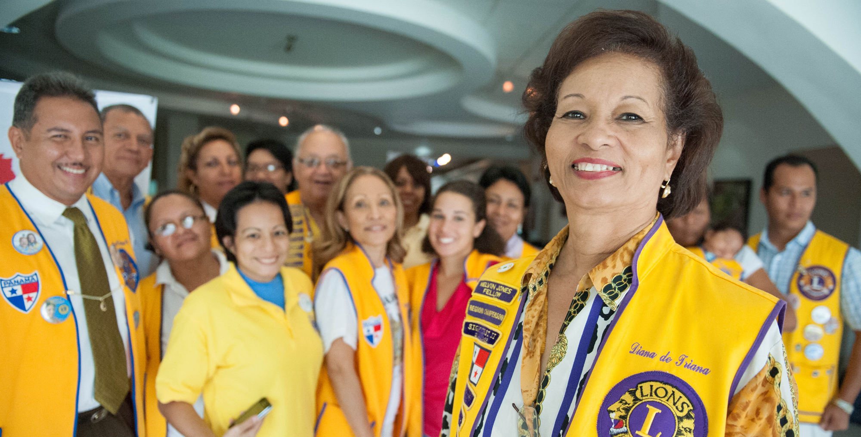
Engaged and fulfilled members
Your club must decide what is more important:
100% Attendance or 100% Service
Then sell the product that you are going to deliver.
Remember…engaged Lions are:
Eager and enthusiastic
Enjoying fellowship and friendship
Feeling respected and welcome
Confident and proud of their clubs’ service
Notes:
Tell a membership related story…(ex. How a club reengaged its members, change their approach engaging with members, or how they improve club satisfaction to grow)
Your club has to decide priorities for your members, whether it is essential, they are in Attendance at Club Meeting or Being Involve in Service Projects. But no matter which direction your club chooses, it is vital that we support member retention by creating harmonious club atmospheres. We do this by making members feel like they’re part of the Lions family while serving the local community.
Engaged and fulfilled members are eager and enthusiastic, enjoying fellowship and friendship, feeling respected and welcome and confident and proud of their clubs’ service
LCI data reveals that clubs and membership are decreasing in many areas—most notably in the oldest, most foundational areas of throughout CA 1 and 2.
Providing reliable service projects offer opportunities for our members to re-engage in Lions. Service also gives potential members a firsthand chance to see the work we do in our communities and around the world. When we provide meaningful service, our visibility in the community increases and new members will be encouraged to join us. Our service impact will help keep our members committed for years to come. ​
Lions and especially Lion leaders must remember to remain open. Open your:
…eyes and ears to seek new opportunities for service and view potential members in a new way.​
…mind to consider how you are currently impacting Lions' mission of service, and explore service needs and opportunities for the future.​
…heart by being a promoter of new and unique service opportunities through nontraditional or special approaches to clubs and members.​
…mouth. Share your enthusiasm and pride in your service with those around you—social media. It will inspire others to ask why you are so happy why you are so fulfilled. Because, as a Lion, you serve with Lions!​
Share these things both inside and outside your club.

Slide 4
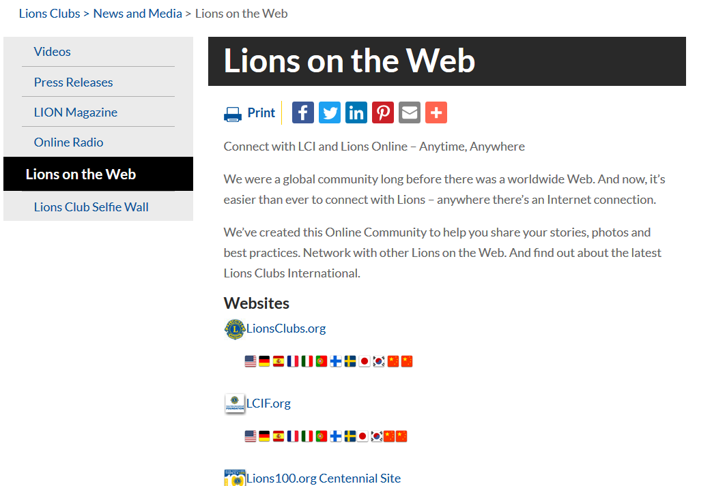
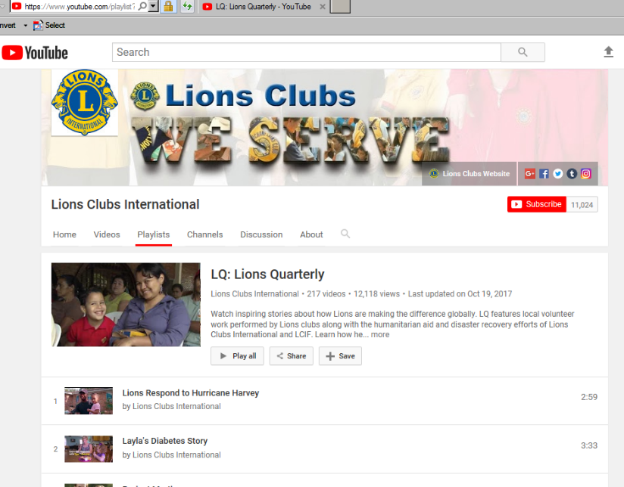
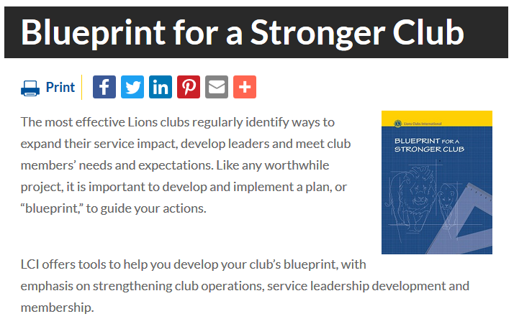
Preparing to Engage New Volunteers
Prior to inviting others to join our club, we need to truly evaluate it, such as the satisfaction of current members and our accomplishments and goals.
Available Tools
Membership Satisfaction Guide
Blueprint for a Stronger Club
Club Quality Initiative (CQI)
Your Club, Your Way!
Lions 360 YouTube Channel
Notes:
The Lions 360 YouTube Channel is a great resource for acquiring new members. A picture is worth a thousand words, and action speaks louder than words. This channel shares inspiring videos about how Lions are making a difference globally.
By using these videos, we can engage friends, family and the community through service. SHOWING is more effective than TELLING. On this channel, you can select auto-subtitling in the local language. It may not be perfect, but it’s pretty good. I believe that these videos are worth testing to see what they can do for the members attending club meetings and the potential members attending informational meetings.
In addition, all Lions 360 videos are in all languages with the exception of Glimpse of 100 Years and Where Are They Now. These videos are on our site and YouTube. To select languages on our site, go to closed captions and select language.

Slide 5
Updating Your Club by Serving in New Ways
Community Needs Assessment –
Evaluate current projects.
Consider new ones.
Make a list of service provided in last 18 months.
Set “Service Impact Goals” for the next 12 months.
Notes:
The clubs and members of an area should reflect the community and its people, interests and needs of the area.
We shouldn’t be a barrier to those wanting to serve in a way that is different from us.
We shouldn’t limit or exclude.
This is why it is important that we conduct community needs assessments, and revaluate the way we serve our communities. Other things to consider are “Specialty Clubs” and “Club branch.”

Slide 6
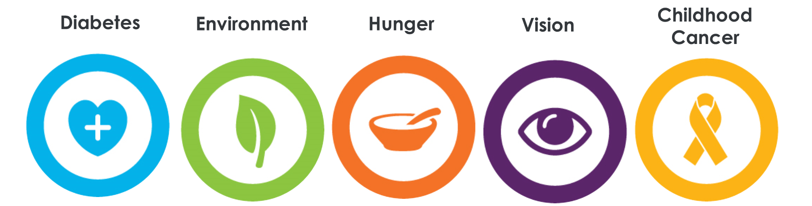
What’s On the Membership Menu?
Lead with Service
Where there’s a need, there’s a Lion.
Global Causes: Present significant challenges to humanity, and we believe it’s our turn to meet them.
Low Cost, High Visibility and High Impact
It costs nothing but time to serve others…
Notes:
Our global causes illustrate the range of humanitarian areas Lions Clubs International will support. We have achieve the strategic goal of serving 200 million people per year. Our global causes focus on resources geared towards the development of vision, hunger, environment, diabetes and childhood cancer engagement opportunities.
Children and youth are recognized as both beneficiaries of the service Lions provide, as well as strategic partners in service development and delivery.
It doesn’t cost much to serve considering the impact it has made on communities around the world.
After more than a 100 year of service has taught us anything, its that as we serve, we grow. And we were never meant to stop.

Slide 7
Recruitment Ideas:
Checklist for Success
Broadcast your advantage
Getting it right from the start
Make prospective member feel important
Welcome letter for potential members
Keep a list and don’t give up!
Leaders should lead by example
Maintain an up-to-date list of potential members
Establish committees
Incentives for recruitment
Evaluate club.
Correct areas of concern.
Assess community needs.
List service provided in the past 18 months.
Set service impact goals for next year.
Notes:
Recruitment Ideas:
Broadcast your advantage.
What makes our association better than everyone else? Share the benefits of being a Lion, example leadership development program to various learning opportunities as our online Lions Learning Center platform. Importantly be clear with prospective members from the start. Being willing to listen, answer questions, and be transparent about expectations of being a Lion in the community
2. Getting it right from the beginning.
The schedule should fit into the member’s routine. Make it easy for him or her.
3. Make prospective member feel important.
Don’t sell, invite! It may be off-putting for some when they’re being sold to, especially in this case when our “product” is service. This may make it seem like the organization is only concerned about donations and increasing its members rather than on building genuine relationships. When you invite, it will make prospective members feel special and important.
When talking with someone about joining the organization, it is important to remember that the focus of the conversation should not be simply on what the organization does, but, more importantly, on how the individual can fit in with the organization. The tool needed to recruit a new member isn’t the ability to talk; it’s the ability to listen. An effective recruiter will try to find out what the prospect’s interest is and then respond by highlighting ways that the organization meets or can meet these interests. This is how you target a person’s “what’s-in-it-for me” spot.
4. Welcome letter for potential members.
The letter should be concise and include the names of the association recruitment committee, contact information and best times to contact them. It should also be properly branded (official logos).
5. Keep a list and don’t give up!
Whenever possible, it is helpful if the organization maintains a list of nonmembers and prospects and regularly includes these individuals in future meeting and event communications. It may take several interactions with one or more members to encourage the prospect to join. They may not be a member today, but they might be tomorrow.
6. Leaders should lead by example. How many members have you recruited? Practice what you preach.
Ask your members with the most influence over your target audience to help you recruit using word of mouth from “the right mouth.” Ask members – and even nonmembers – what they need from you. If you already offer that service, let them know. Be proactive, rather than reactive, when engaging members. With the right person sharing the news about your association with those in his or her influence group, the best way to attract potential members who may be on the fence about joining is by building relationships with them and listening rather than selling to them. Ask yourself: why aren’t they members? Is there something we can learn from the reasons they haven’t joined?
7. Have incentives for recruitment to encourage other club members to recruit. (e.g., free, one-year international dues to be paid by the club).
8. Establish committees to take ownership of specific responsibilities.
This eliminates confusion and potential misunderstanding. The underlying rule should be that each committee represents one part of the overall plan, which is to grow membership.
9. Maintain an up-to-date list of potential board candidates.
Schedule time to regularly review and edit the list. It will allow potential candidates to experience first-hand how the board functions. It is helpful to candidates in deciding if he/she wishes to pursue a board candidacy.
It will also help to emphasize the value of all the good work that donors have done in the past to further the organization’s cause. It will establish that individuals, companies and other organizations recognize and trust the value of LCI’s work and its impact on communities.

Slide 8
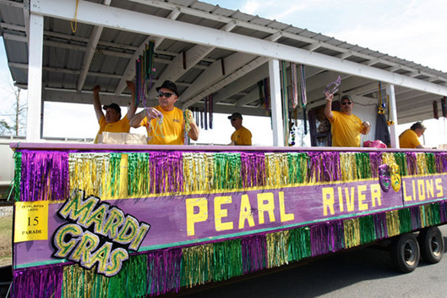
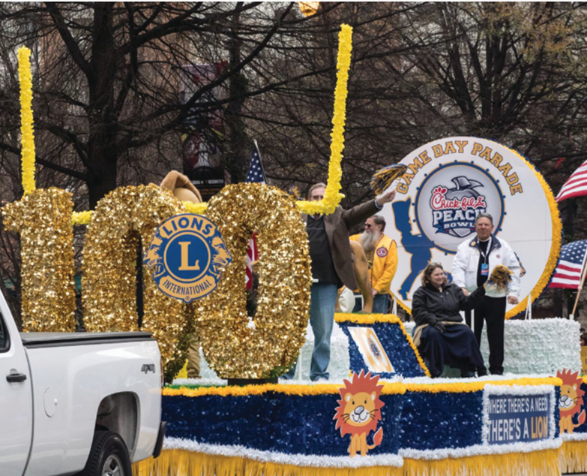
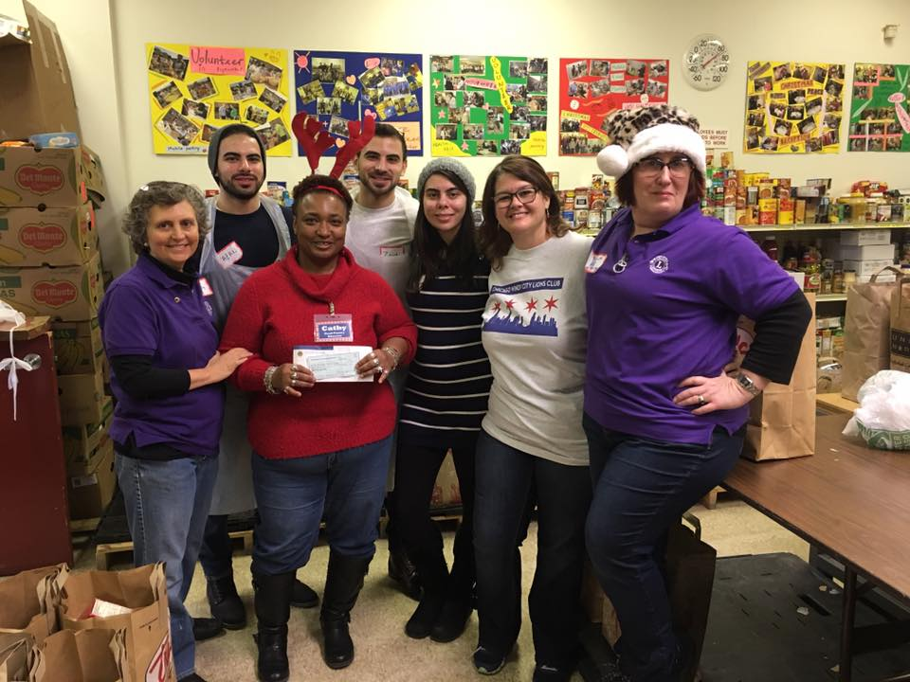
Host A Membership Growth Event. No More Membership Drives!
Notes:
If you go on to Lionsclubs.org site and search Membership Growth Toolbox you will find a six week planning guide under material. Reference the Membership Growth Event Checklist that provides your club enough time to review resources as Just Ask! Guide, Membership Satisfaction Guide, Club Quality Initiative, and Club Community Needs Assessment to be able to:
Evaluate your club identifying improvements and assessing your community needs
Set Clear Achievable Objectives and Goals for your club
Develop Action Plan
Identify a target audience of whom you will be recruiting
Timeline: planning, recruitment, event, and follow-up

Slide 9
Time To Invite Guests
Friends, Family, Neighbors
Each club member invite 5 to 7 prospective members.
Determine with the board of directors what event your inviting the potential member to either a social or service project event.
Club president sends written invitation to the event.
Notes:
Find a common cause to invite prospective members to engage and empower new members to be involved.
It important to not only work with sponsors but identifying mentors who will help with onboarding
Invite friends, family, neighbors, and people from your community as well partner organizations as local health groups, businesses, places of worship, schools, and local nonprofits.

Slide 10
Kindness Matters…The Personal Touch
HOST A MEMBERSHIP GROWTH EVENT
Follow up after the president sends the invitation.
Sample 7 days in advance script.
Sample 3 days in advance script.
Notes:
After your club president has invited the prospective members, it is essential to follow up; a sample template has all ready for you to utilize or customize as you see fit. It is vital that you allow enough time and space when following up.
Note* All the templates for The Follow up after the president send the invitation, Sample 7 days, and Sample 3 days scripts samples are on the membership growth toolbox page on the LionsClubs.org.

Slide 11
Last Minute Details for Hosting a Successful Membership Growth Event
Key Things for Your Event:
Decorations
Refreshments
Name Tags
Membership Applications
Test Audio Visual Equipment
Stick to Your Agenda
Notes:
Before you event takes place make sure that you have designated someone or few lions to be responsible for the refreshment and entertainment and setup.

Slide 12
Engaging Prospective Members
Follow Up
First Impressions Are Lasting Ones
Lions club members should personally contact every guest who did not turn in a membership application.
“Mix and Mingle” with guests. This is the time for us to listen to our guests and assess their interest in serving.
Notes:
Remember
Every club member should be ready to meet and greet guests.
If possible, have displays highlighting upcoming service projects and discuss previous service projects with guests.
Escort guests to each project display, engage discussion, ask them to assist.
Everyone should be positive and upbeat.
The purpose of the follow up is to:
LISTEN -- Get his or her feedback.
Answer questions.
Extend a second invitation to SERVE

Slide 13
Focused and Intentional
Lions 360 videos on YouTube Channel
Identify a speaker
Engage senior or junior member of your club
Highlights club’s accomplishments
Membership applications and fees.
Notes:
Use Lions 360 videos on YouTube Channel that complement your club’s activities.
Identify a speaker from either a community partner or individual/group who has benefited from one of your club’s service projects.
Secure either a senior or junior member of your club or district as your keynote speaker to talk for 10 to 15 minutes. You need someone who can energize and engage an audience with his or her service journey as a Lion.
The club president (or designee) highlights club’s accomplishments, meeting times, dues and extends an invitation to join.
Someone should be at the door to collect membership applications and fees.

Slide 14
Beyond the Event
Notes:
Inform: Provide prospective members the information they need to understand the organization's vision and mission, along with how Lions feel about the organization.
Inspire: Connect prospective members to the organization's vision and values so that they can take pride in the work that the organization does.
Interact: Keep communication ongoing with propsective members to show that they are more than just a number.
Involve: Ensure that propsective members are invited to service projects and upcoming meetings
Induct: Now that they are invested in the organizations mission and values, induct them into your club!

Slide 15
Repeat the Process
Survey club members and set service impact goals annually.
Host a membership growth event every 6 months.
Notes:
Just a reminder is always a good idea for your club to review over the Membership Satisfaction Guide, Club Quality Initiative, and Club Community Needs Assessment to evaluate and analysis your success of your impact internally and in the community.

Slide 16
Additional Recruitment Ideas
Club Branch Program
This is important. When you go into a community, you don’t always have 20 people interested to start a new club right away. You might have 5, and you can build from there. To start a branch, you only need 5 members.
Leo-Lions Conversion
Leo members are key to growth. These young people share the same passion for service as Lions do.
Chartering New Clubs
We start new clubs to bring new people on board to help our communities. It is important to reintroduce new clubs to the areas in which we lost clubs and to new areas where no Lions clubs exist yet.
Increase Club Service Activities
The more frequent and visible the service activities are, the more we can interest people in joining. They will reach out to us because they see the impact we’re having in the community.
Notes:
Chartering New Clubs:
Opening a new club requires research and canvassing in the community to determine if there is a need and what those needs are. This requires a considerable amount of follow up, which involves time and commitment. With this in mind, it is absolutely important to have the right people in these roles. Remember that we have volunteers and not paid employees in the field, so teamwork and proper distribution of responsibilities is important. While we expect realistic membership results, we should also take into consideration the realistic responsibility of any district or multiple district role.
You can identify needs from reading newspapers, social media group postings or talking to residents. This could be the basis of a discussion while recruiting.
A new club requires a Guiding Lion. It is important to remind the Guiding Lion that his or her role is to guide not lead. This role may make or break the new club. The Guiding Lion should not tell the new club what to do nor should he do everything for the new club.
Some responsibilities of the Guiding Lion:
Communicator: Moderate discussions and help people resolve disputes. Encourage two-way communication between members in a positive and proactive manner.
Team builder: Help the new club learn how to function as a group; i.e., to respect the opinions of others while working together to decide what is best for the club as a whole.
Advisor: Share insights, knowledge and experience with new club leaders, while allowing them to make decisions on their own.
Liaison: Help keep the lines of communication open between the new club and the sponsoring club.
Club Branch Program
If you create a branch, you should do it as a challenge. Make sure to let members know that you will help them as long as they are growing. Ask them to continue recruiting members until they reach the goal of acquiring 20 members.
Leo-Lion Conversion
These young individuals are looking for leadership opportunities and a voice in the organization.
Increase Club Service Activities
Every event that occurs in public is important. Simply put, it is a chance to get the word out and build support for your service causes. Events offer great opportunities to acquire new members.
Making use of social media to promote activities is encouraged. You can raise awareness and build membership through peer recommendations. Individuals can write recommendations about your organization, which in turn can drive membership growth. It might also positively impact retention.

Slide 17
Additional Recruitment Ideas
Engage young people to become the next generation of Lions to serve!
Identify ways engage younger members
Engage and partner with Leos in your area.
Start a campus club with a local college or university in your area.
Notes:
What is important is identifying ways that your club can get more young people involved and help inspire new service projects. Here are some programs that already exist that your Lions clubs can use to engage with the youth in your community:
The Lions Quest program
Host a local youth service symposium
Local community service projects
Peace poster contest

Slide 18
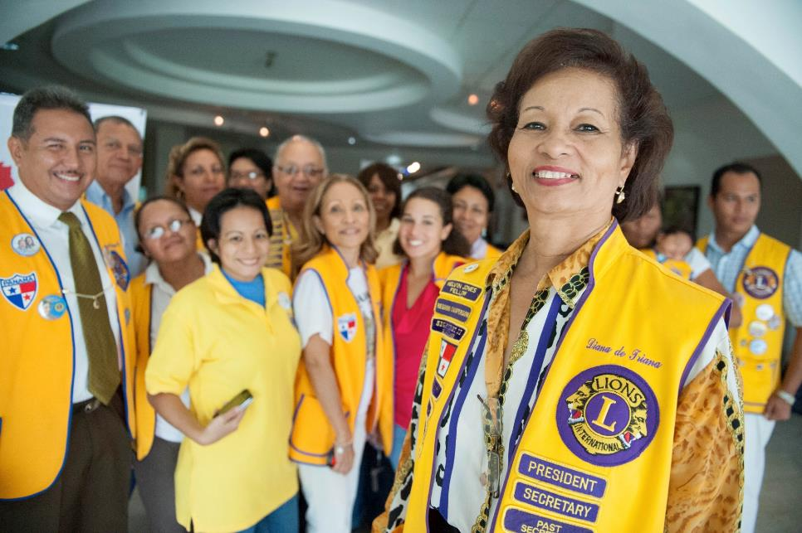
It is time for Questions and Answers

