Slide 1
Club Coordinator Training

Slide 2

Lions Clubs International
Mission: to empower volunteers to serve their communities, meet humanitarian needs, encourage peace and promote international understanding through Lions clubs.
Vision: To be the global leader in community and humanitarian service.
Notes:
As you all know, Lions Clubs International empowers Lions around the world to serve their communities, meet humanitarian needs, encourage peace, and promote international understanding through Lions Clubs. LCI is the global leader in humanitarian service. But how do Lions gather the resources to carry out large scale or global projects? LCIF!

Slide 3

Lions Clubs International Foundation
Mission: To support the efforts of Lions clubs and partners in serving communities locally and globally, giving hope and impacting lives through humanitarian service projects and grants.
Notes:
LCIF is your Foundation! LCIF supports Lions’ efforts to serve their communities worldwide. The foundation receives no funding from membership does. The programs are funded by donations from Lions like you.

Slide 4
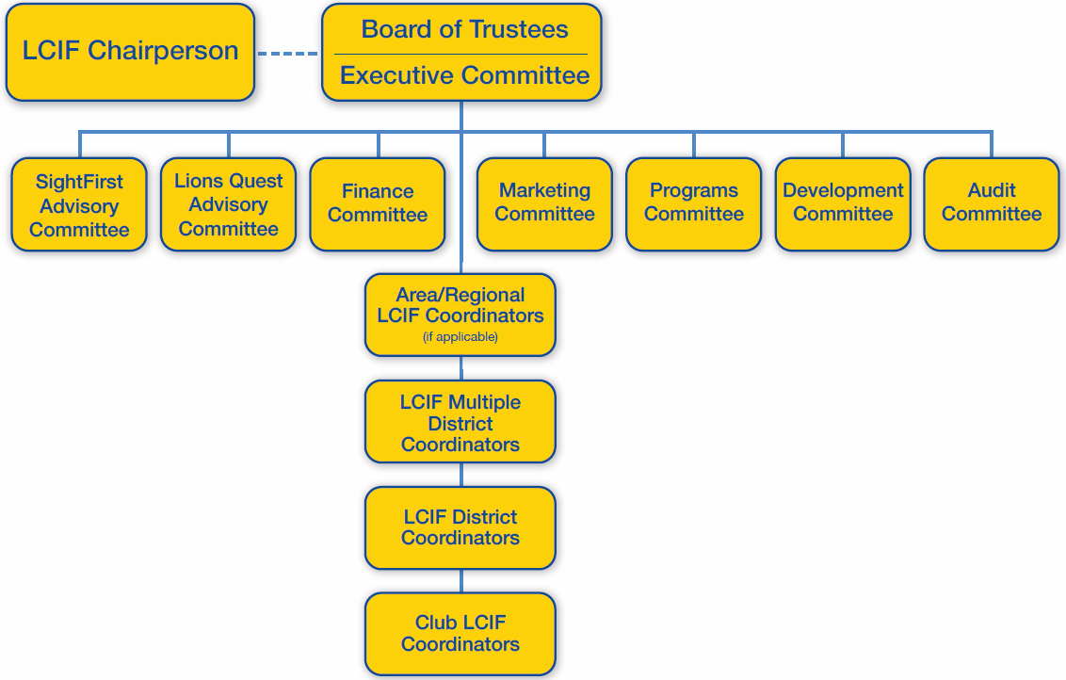
LCIF Governing Structure
Notes:
This is the governing structure of the LCIF Board of Trustees. You’ll notice that a lot is the same as before in terms of the structure. However, in addition to the composition change we have also added three more committees: marketing, programs and development.

Slide 5
LCIF Board of Trustees
Dr. Jitsuhiro Yamada, Japan, LCIF Chairperson
Chancellor Bob Corlew, USA, International President
Naresh Aggarwal, India, 1st International VP
Gudrun Yngvadottir, Iceland, 2nd International VP
Jung-Yul Choi, Korea, 3rd International VP
Clement Kusiak, USA, CA I, PIP
Garnet Davis, Canada, CA II, PID
Fabio de Almeida, Brazil, CA III, PID
Philippe Gerondal, Belgium, CA VI, PID
Shinji Kayamori, Japan, CA V, PID
Shyam Malpani, India, CA VI, PID
Nigel Jeny, Australia, CA VII, PDG
Dr. S.P. Amin, Africa representative, PID
Robert Littlefield, Ph.D., USA, largest membership country, PID
N.S. Sankar, India, 2nd largest membership country, PID
Ching-Li Lee, Taiwan, largest per member giving country, PID
Chikao Suzuki, Japan, 2nd largest per member giving country, PDG
Dr. Joong-Ho Son, Korea, 3rd largest per member giving country, PID
Joe Preston, USA, Immediate Past LCIF Chairperson, PIP
Barry Palmer, Australia, Past LCIF Chairperson, PIP
Wing-Kun Tam, China, Board Appointee
Joesph Marcheggiani, USA, Board Appointee
Notes:
This is the group of LCIF Trustees for the year of 2016-2017. Current trustees and current directors of Lions Clubs International nominated Lions to serve on the LCIF Board of Trustees. These Trustees will serve a three year term.

Slide 6

Impact of LCIF
Notes:
At a glance, LCIF seems simple – providing support for the efforts of clubs worldwide in serving their local and global community through grants. And, while it is true that the concept is simple, the results are life-changing for so many individuals throughout the world.
The Foundation provides grant funding for large-scale projects that clubs can’t do on their own.
As a nonprofit, LCIF relies solely on donations from Lions and others who share our mission, which is why it is important for not only our clubs to support the Foundation but for us as individual Lions, too.
Since being founded in 1968, LCIF has given out more than US$870 million in grants! It is always impressive to hear that number, but it is even more impressive and touching when you think about the millions of lives that Lions changed through those grants.
Our Foundation changes lives around the world. It does this through four areas of service…

Slide 7
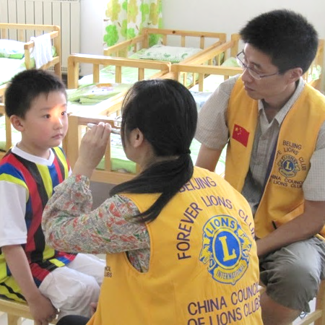
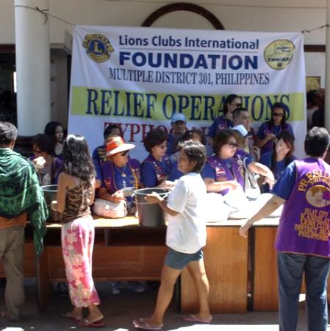

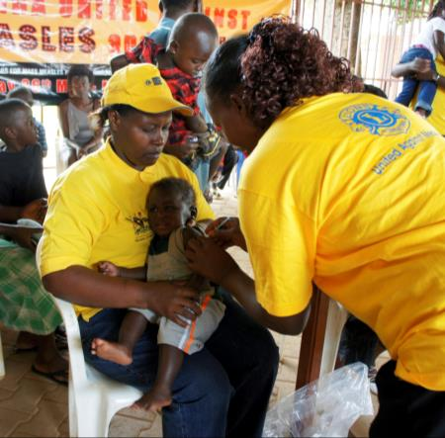
Sight
Disaster
Youth
Humanitarian
Notes:
The Foundation’s four pillars of service include serving youth, providing disaster relief, meeting humanitarian needs, and saving sight.
The first area of service is, of course, SAVING SIGHT.
Campaign SightFirst II was a huge success for LCIF. Thank to that campaign, we are saving sight and preventing blindness, while helping to change the lives of those who have lost their sight.
The next area of service is PROVIDING DISASTER RELIEF.
LCIF’s relief efforts continue around the world where needed – we have been seeing an increase in requests for disaster relief grants. It is a good feeling knowing that LCIF can help Lions around the world in their time of need, like we did last year in the Philippines.
LCIF also helps Lions SUPPORT YOUTH in many ways, our most important program being Lions Quest – a social and emotional learning program which is implemented in schools through Lions’ assistance and promotion.
Finally, LCIF helps Lions MEET HUMANITARIAN NEEDS in communities throughout the world. We address global health issues such as measles, and diabetes prevention and education. We also empower people with disabilities and are exploring the ways that we can make a difference through microenterprise.

Slide 8
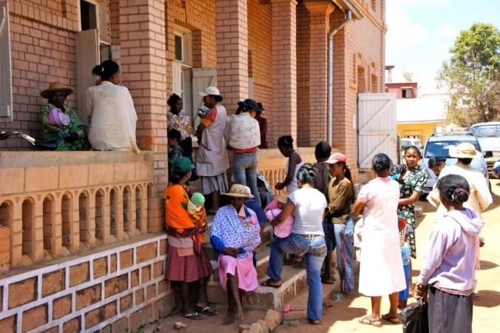
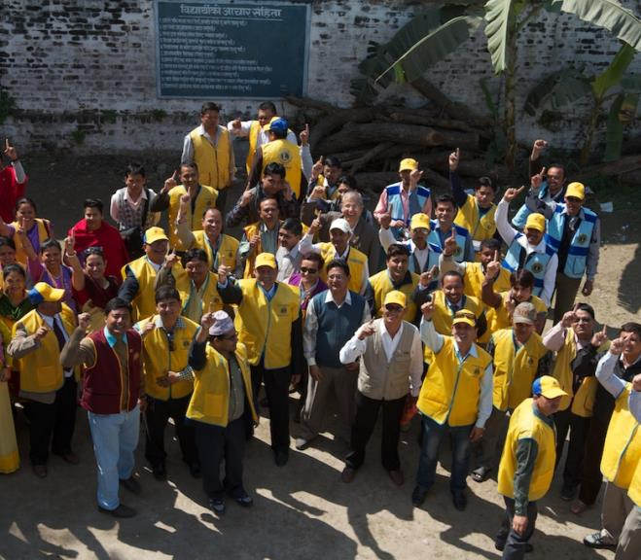
How Does LCIF Help Lions?
Helps Lions respond collectively to humanitarian concerns around the world
Enables Lions to help Lions
Funds projects too big for districts/clubs
Develops grant-making initiatives to help Lions
better serve communities
Notes:
How does LCIF help us as Lions?
We respond collectively. We encourage Lions in one region to show their global friendship and help out Lions in another region during a time of calamity. We make possible what may be beyond the capacity of a single club or district. And, more and more often, we are giving service opportunities to Lions.

Slide 9

How can you help build our Foundation?
Tell the LCIF story.
Encourage individual giving.
Increase club donations
Notes:
LCIF is our foundation. The foundation should be supported by all clubs and all members. So we must work to increase the participation percentage.
As a club coordinator, what can you do? I ask you, please tell the LCIF Story. Tell how grants are making possible essential activities for clubs, and changing people’s lives. Please tell members that every dollar counts. Tell members how $20 can make a difference.
Please help all Lions to understand that LCIF is our foundation – LCIF supports Lions to grow, and Lions are in charge of making LCIF grow. As a leader in your area, you are in charge of LCIF as well. So when you have speaking opportunities, please also talk about LCIF. Please do not forget. This is our Foundation. And if we all do what we can, we will have a great year.

Slide 10
LCIF Grants

Slide 11
Types of Grants
Types of LCIF Grants
Standard
Major Catastrophe
SightFirst
Core 4
Intl. Assistance
Emergency
Notes:
As you can see, the foundation’s grants are grouped into six categories.
Standard Grants are the most common type of grant, awarded for large-scale Lions’ humanitarian projects. Grants must be for projects that serve a large number of people and are beyond the scope of a district or club to carry out alone.
Core 4 fund large-scale projects in specific areas related to Lions’ four core service commitments: preserving sight, combatting disability, promoting health, and serving youth.
International Assistance grants foster partnerships between Lions clubs in developed countries and those in less-developed regions. Grants can be used for projects such as medical missions, health care and clean water.
Emergency grants assist Lions in helping their community following a natural disaster. Funds must be used for immediate needs like food, water and clothing.
Major Catastrophe grants are awarded by the LCI President and the Chairperson of LCIF for major disasters. Lions do not apply for these grants.
SightFirst grants are awarded to fight preventable and reversible blindness. Grants can be used to build hospitals and clinics, train doctors, distribute medicine and raise awareness of eye-disease.

Slide 12
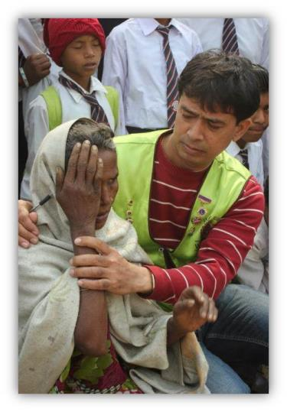
SightFirst Grants
Focus on the major causes of blindness
Reach underserved populations
Funds sustainable projects that:
    Deliver eye care services
    Develop infrastructure
    Train personnel and/or provide rehabilitation
Notes:
Here is a bit more detail about SightFirst grants and the criteria for these applications. We continue to target underserved populations to deliver comprehensive eye care services.
I would also point out that there are regional technical advisors and SightFirst district chairpersons that are trained to assist your districts in developing SightFirst applications.

Slide 13
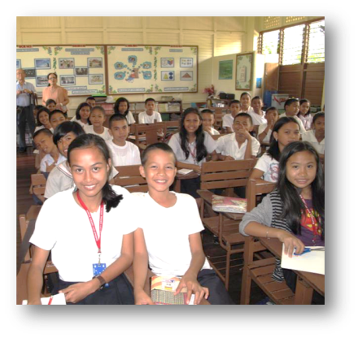
Standard Grants
Broadest category of
LCIF funding
Matching funds between US$10,000 and US$100,000
Support large scale Lions projects (equipment or construction - no operating costs)
Lions identify/develop projects
Provides local impact and community visibility
Notes:
This is our most popular grant category, with funds available from US10,000 up to US$100,000. These new funding amounts are effective towards grant applications submitted July 1, 2014 and later.
Let me give you a few examples of what past standard grants have provided:
A clean water and sanitation project in Togo with the assistance of Lions in France
A playground for disabled children at a school in Argentina
Mobile health screening units to reach people in rural areas in MD300 Taiwan
Construction and expansion of a school in the Philippines, seen in this photo
Vision screening devices to screen children’s sight in the United States
And countless other humanitarian efforts that give hope to people in need.
(Transition to Core 4 Grants)

Slide 14
Core 4 Grants
Support special initiatives under the four primary service commitments of Lions:
Grants are given on a 3-to-1 matching basis in most instances (25% local funding), up to US$200,000
Lions Quest grants are under ‘Serving Youth’ for up to US$100,000
Preserving Sight
Serving Youth
Promoting Health
Combating Disability
Notes:
There are special priority projects under the Core 4 grant program: preserving sight, promoting health, serving youth and combating disability.
For example, Lions Quest is a popular grant activity as the foundation helps districts to implement the program in schools by providing matching funds for teacher training workshops and student materials. You will hear more about Lions Quest from the manager of the program later in the presentation.

Slide 15
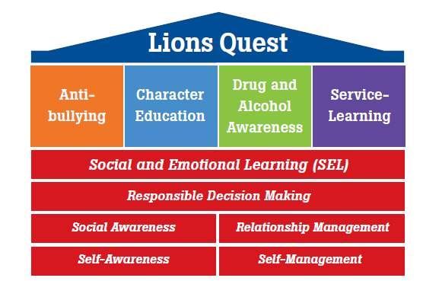

What is Lions Quest?
Notes:
How many of you here today have Lions Quest in your district?
For those of you who are not as aware of Lions Quest, it is a life skills program owned by the Lions Clubs International Foundation. It is our program, which means that Lions worldwide have the chance to improve education in their own communities.
Lions Quest teaches young people important skills so they can work together, develop positive behaviors and make good choices. For 30 years, Lions Quest has brought positive change to the lives of children, their families and entire communities.
K – 12 Social and emotional learning (SEL) curriculum
Social and emotional skills can be taught and learned in the same way as academic skills
Classroom curriculum that may be integrated into existing courses or taught on its own

Slide 16
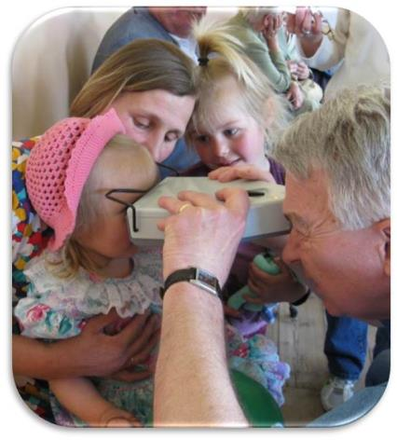
International Assistance Grants (IAG)
Support for international projects
Lions clubs in at least two countries must partner –
one developed and one
lesser developed
Sponsor club/district fundraise and apply for grant
Host club helps implement
Supports club twinning projects; US$5,000 to US$30,000
(one per district)
Notes:
Through the International Assistance Grant program, the foundation has provided for water wells, medical missions and eyeglass recycling.
Lions in two countries partner, and the sponsoring club fundraises and applies for the grant. The host club then helps implement the project.

Slide 17
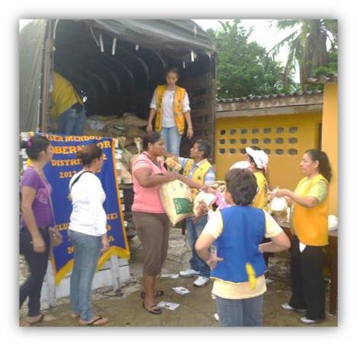
Disaster Grants
Emergency Grants: Provide up to US$10,000 for districts impacted by natural disaster.
Major Catastrophe Grants:
Awarded for long-term rebuilding
efforts after catastrophic disasters
Disaster Preparedness Grants: Support natural disaster
preparedness, response and
recovery efforts
Notes:
Many of you probably already know our emergency grant program for natural disasters. Emergency grant funds can be used to purchase and distribute immediate relief supplies. Major Catastrophe grants are awarded for long-term rebuilding efforts after catastrophic disasters. And Disaster Preparedness grants support natural disaster preparedness, response and recovery efforts.
Perhaps the most relevant of these is the Emergency grant. Some key points to remember about emergency grants are:
Natural disaster and affecting 100 or more people
Lions must be involved in the relief efforts; grants are not given so that the funds can be given to another organization
Request should be made as soon as possible by the district governor and within 30 days of the disaster. Sometimes, given the scope, we will even contact you.
Funds must be spent within 60 days.
One grant per disaster, per district.
Please submit a final report on how the funds were used.

Slide 18
LCIF Grants 2015-2016
During the 2015-2016 year, LCIF awarded
453 grants totaling more than US$45.2 million
Notes:
The results of these grants are tremendous.
It is easy for us to say we awarded more than US$45 million in grants this past year and more than three-quarters of a billion dollars in grants throughout our history. But, it is really about the individual lives that are being changed because of what you are doing with support from our foundation.
We now have a short video to share with you that highlights the great work of LCIF and also encourages District Governors to work with LCIF coordinators to increase awareness of the foundation. Following the video, Nate Miles, the Chief Development Manager for the foundation, will present.
(Transition to video)

Slide 19
Roles and Responsibilities

Slide 20
LCIF Club Coordinator
MDC
DC
DC
DC
Club Coordinator
Club Coordinator
Club Coordinator
Club Coordinator
Club Coordinator
Club Coordinator
Club Coordinator
Club Coordinator
Notes:
The LCIF Chairpersons will serve as ambassadors for Lions Clubs International Foundation in their clubs. They will share the stories of LCIF programs, motivate others to support LCIF, and enable the foundation to advance its humanitarian work in their communities and around the world.

Slide 21
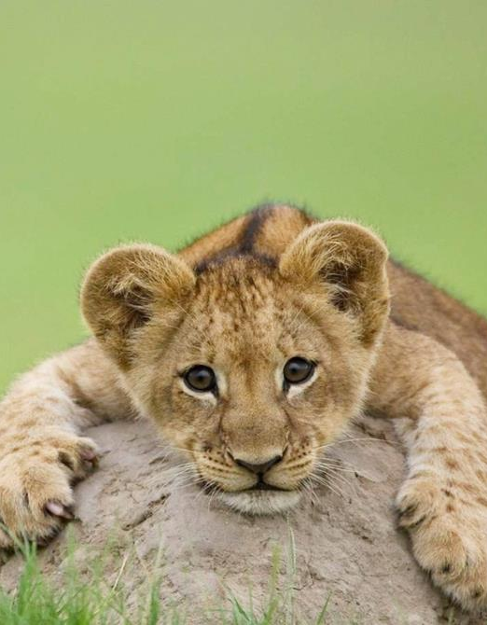
Club Coordinator
Educate Lions about the mission and success of LCIF and its importance to Lions Clubs International
Make at least one presentation to club about LCIF
Implement LCIF development strategies within club
Collaborate with LCIF DC to promote LCIF
Notes:
The LCIF Club Chairperson is nominated by the clubs nominating committee, elected as an officer and will serve a one-year term until re-nominated the following year. LCIF Club Chairperson works closely with local club leadership and communicates directly to LCIF DCs to ensure alignment with district goals.
The LCIF Club Coordinator will serve as ambassadors for Lions Clubs International Foundation in their clubs. They will share the stories of LCIF programs, motivate others to support LCIF, and enable the foundation to advance its humanitarian work in their communities and around the world.

Slide 22
Check-in Calls
Quarterly check-ins with District Coordinator
  September
  December
  March
  June
Notes:
First call – train the trainer
Second – half way update
Third – convention preparation
Fourth – thank you

Slide 23
Club Visits
Notes:
With the new position, the club visit model will change a bit

Slide 24

Club Presentation Goals
LCIF goal: every club receives a presentation
DCs work with Club Coordinators
DC will follow up with Club Coordinators and Club Presidents after club presentations
  How was the presentation?
  Will you make a club gift?
  Will you make a personal gift?
Notes:
LCIF goal is for each club to receive a presentation
Worldwide club participation rate is ___
Club participation rate in your CA is ___
DCs need to work with Club Coords
DC is responsible for presenting at any club with no appointed Club Coordinator
DC will personally visit top clubs in area (we recommend at least 20/4 visits per ¼)

Slide 25

Club Presentations
Tailor club presentation to specific club
Use standard LCIF PowerPoint presentation if possible
Hand out brochures and other resources
Leave contact information and business card
Consider asking a grant beneficiary to speak about their experience
Notes:
Club visits should be tailored to the specific club that is being visited.
If there is the ability to present, use the standard PowerPoint presentation and adjust for your audience.
Bring brochures and other resources to hand out
Give out your contact information and business card in case anyone has questions in the future
If your area has recently received a grant:
consider asking a grant beneficiary to come and talk about their experience, for example if LionsQuest is active in your area, you may ask a student who has participated in the program to come and talk about their experience
Consider asking a Lion who was involved with the project to talk about what the experience meant to them

Slide 26

Club Visit Follow-Up
DO NOT EXPECT THAT A CLUB WILL DONATE JUST BECAUSE YOU PRESENTED THEM. ALWAYS FOLLOW-UP!
Thank the club!
Answer questions
If the club is interested, but not ready to make a donation:
  Offer to visit again
  If there is an active LCIF project in your area, see if it’s possible to engage the club
  Invite them to any fundraisers or events that you are planning
  If the visit was positive, ask club president
  if they are planning to make a donation
  How to make a donation
  Recognition programs
Notes:
Always follow up after a club visit:
DO NOT EXPECT THAT A CLUB WILL DONATE JUST BECAUSE YOU PRESENTED TO THEM. YOU ALWAYS NEED TO FOLLOW-UP!!!!!!
Thank the club for hosting you.
Provide answers to any questions that were asked.
If the club is interested, but not ready to make a donation:
Offer to meet with them again
If there is an active LCIF project in your area, see if it’s possible to engage the club
Invite them to any fundraisers or events that you are planning
If the visit was positive, ask the club president if they are planning to make a donation
Provide them with logistical info (how to make a donation)
Provide information regarding recognition programs that may interest the club

Slide 27
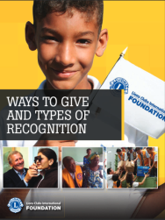

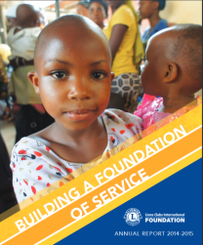
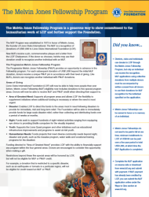
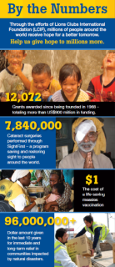

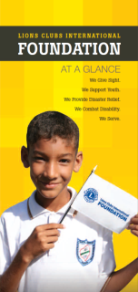
Resources for Club Visits
LCIF PowerPoint
Melvin Jones Fellowship
Donor Contribution Forms
LCIF By the Numbers
One Life One Shot: Measles
LCIF At A Glance
Help Support
Programs/Grants Overview
Pledge cards
Ways to Give and Types of Recognition
Notes:
You will be equipped with a basic LCIF 101 PowerPoint for use during your club visit.
Among others, these are some of the resources we can send to you for distribution.

Slide 28
LCIF Five Year Goals

Slide 29
Donations from FY 2015-2016* June 30
*unaudited and figures in US$
$39.48 million
95% of goal
Goal: $41.3 million
$24.2 million
Unrestricted
$10.5 million restricted
$4.6 million
measles
Notes:
Donations received last year total US$39.48 million, which is 95% of our goal for the year.
Thank you for your support.
I am asking for your help in continuing to encourage Lions to support our foundation. Specifically, you can see here that we received a total of US$24.2 million in unrestricted donations last year. However, we awarded more than US$23 million in grants from that fund. When you are speaking to Lions about LCIF, please encourage them to donate to the area of greatest need. These donations allow LCIF the flexibility to supplement initiatives where additional funding is necessary or where the need is most urgent. These funds meet diverse community needs beyond sight, disaster and youth, such as the measles program, water wells and vocational training programs for the disabled.

Slide 30

LCIF’s Five Year Financial Goals
LCIF Five Year Goals
US$ 50 million
annually by 2018
US$ 45.4 million
US$ 41.3 million
US$ 38.4 million
US$ 35.7 million
Notes:
The LCIF Board of Trustees has outlined a 5 year goal so the Foundation can continue to support these wonderful initiatives. In 2017-2018, LCIF will celebrate its 50 year anniversary - fifty years of helping those most vulnerable and at risk within our communities. The goals reflect the growing demand for financial support by Lions around the world. As Lions serve their communities at an increased rate, the demand for LCIF funds also grows.
The goal for 2016-2017 is US$45.3 million. Why does LCIF need to grow?

Slide 31

Case for Support
Why does LCIF need to grow our support?
Notes:
It’s simple. There is more demand for grants and we are also moving into new areas in response to global needs and the interests of our members.

Slide 32
Case for Support
Notes:
You can see in this bar graph that grants approved exceeded our grant budget for several years. This graph does not include fundraising or grants for our work in the Measles Initiative or other restricted programs such as SightFirst.
We have been able to approve more than we budgeted in some years because of our fiscal responsibility in managing donations prudently through investments, and also keeping our fundraising and administrative expenses low. But, there is great potential to achieve more donations – currently less than 50% of our clubs give to LCIF.

Slide 33
LCIF Updates

Slide 34

Centennial Service Challenge
Notes:
One unrestricted donation to LCIF per fiscal year will count toward CSC recognition. Only clubs that report their LCIF CSC donation through MyLCI will receive credit.

Slide 35
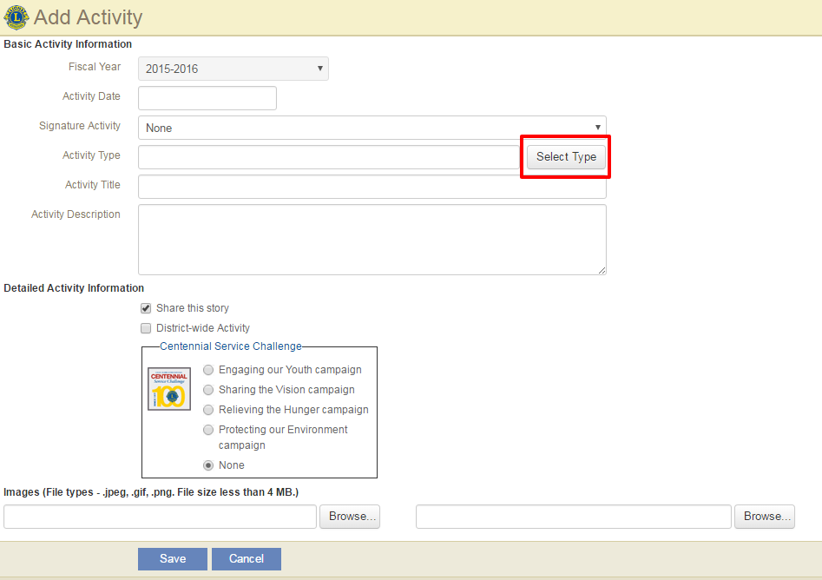
Centennial Service Challenge

Slide 36
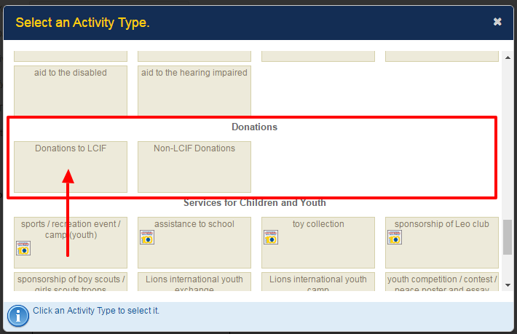
Centennial Service Challenge

Slide 37
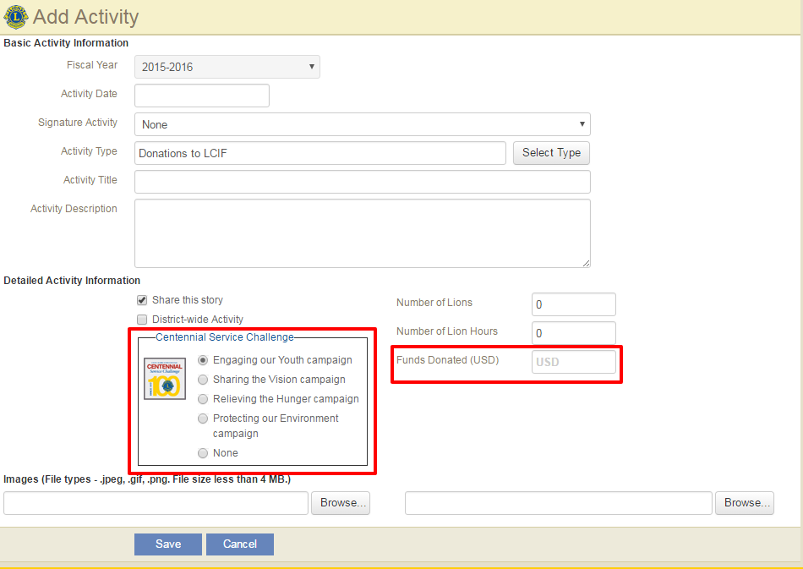
Centennial Service Challenge
Notes:
Remember to select a CSC Campaign for your club’s donation!

Slide 38

Contributing Member Program
Beginning July 1, 2016:
Giving Criteria:
  US$20 Bronze pin
  US$50 Silver pin
  US$100 Gold pin
Every donation will qualify for both Contributing Member and Melvin Jones Fellowship credit
Pins will not be sent automatically
All clubs where each individual has given US$20 or more will qualify as a 100% Contributing Member club
Notes:
The giving criteria will remain at the following levels:
US$20 Bronze pin
US$50 Silver pin
US$100 Gold pin
Every donation will qualify for both Contributing Member and Melvin Jones Fellowship credit
Contributing Member pins will not be sent automatically. Donors must request a Contributing Member pin by checking the appropriate box located on the Contributing Member form
All clubs where each individual has given US$20 or more will qualify as a 100% Contributing Member club
Club donations do not qualify for Contributing Membership credit

Slide 39

Individual Recognition
Contributing Member Program
  All contributions are MJF eligible
MJF/PMJF
Friend of Humanity Award
LCIF Helping Hands Award
Humanitarian Partners
Notes:
As we talked about earlier, all CM contributions are now MJF eligible
As usual, we want to encourage MJF recognition, as well as moving up the levels of the Fellowship program
Friend of Humanity Award - recognizes a few Lions each year who have supported LCIF at the highest level. The LCIF Chairperson determines the recipients, who are awarded with a medal.
LCIF Helping Hands Award - recognizes Lions who promote greater awareness of and support for LCIF at the club, regional, district or multiple district level or through the media. To apply, complete the nomination form and provide documentation of the Lion’s efforts
Humanitarian Partners - honors individuals whose cumulative donations exceed US$100,000, $200,000, $300,000 and $500,000, respectively. Recipients receive an elegant bronze, silver, gold or platinum pin, respectively. The program has recently introduced new pin levels recognizing donations in US$20,000 increments through the US$300,000 level.

Slide 40
End of Year Recognition
Top 5 Clubs certificates
  Total donations
  Per member average
Top 5 Districts certificates
  Total donations
  Per member average
Top 5 Multiple Districts certificates
  Total donations
  Per member average
Notes:
At the end of every year, we distribute certificates based on the above criteria
Recognize any MDC in the room who may have received recognition

Slide 41
Club Recognition
Club plaque / patch / chevron
100 Percent MJF Banner
100 Percent Contributing Member banner patch
Notes:
Club plaque/patch/chevron – clubs that donate $1,000 or more to
100 Percent MJF Banner – all current club members are MJFs
100 Percent Contributing Member banner patch – all current club members are contributing members

Slide 42
Club Giving Patches

Slide 43
Optional Personal Story
Insert picture or text here

Slide 44
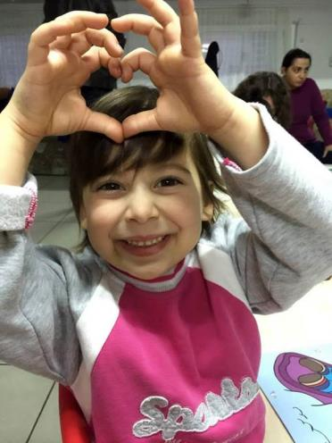
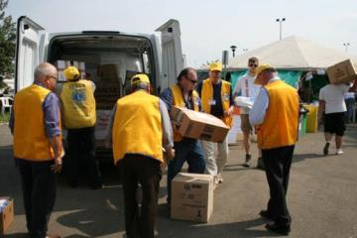
Enriching Lives
WE ARE COMPASSIONATE AND CARING
We enrich lives in communities all over the world!
Notes:
Thank you very much for your time today, and thank you for your support. I am looking forward to working with you this year.

Slide 45

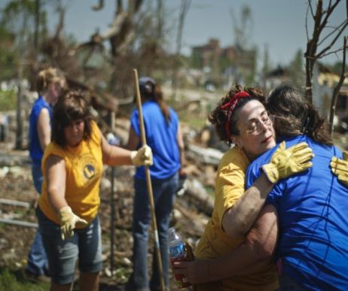
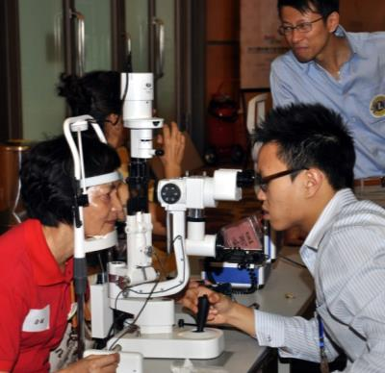
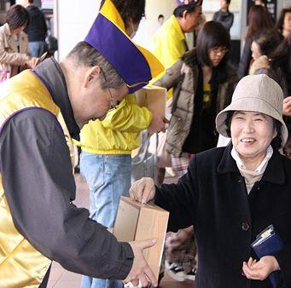
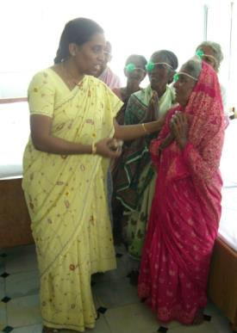
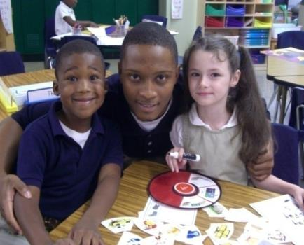
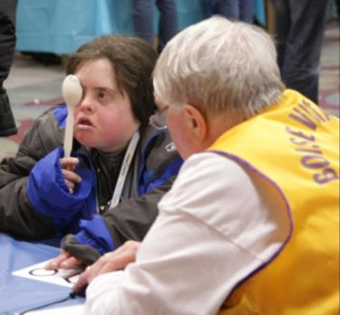
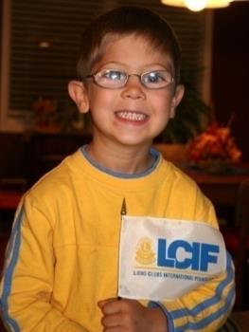
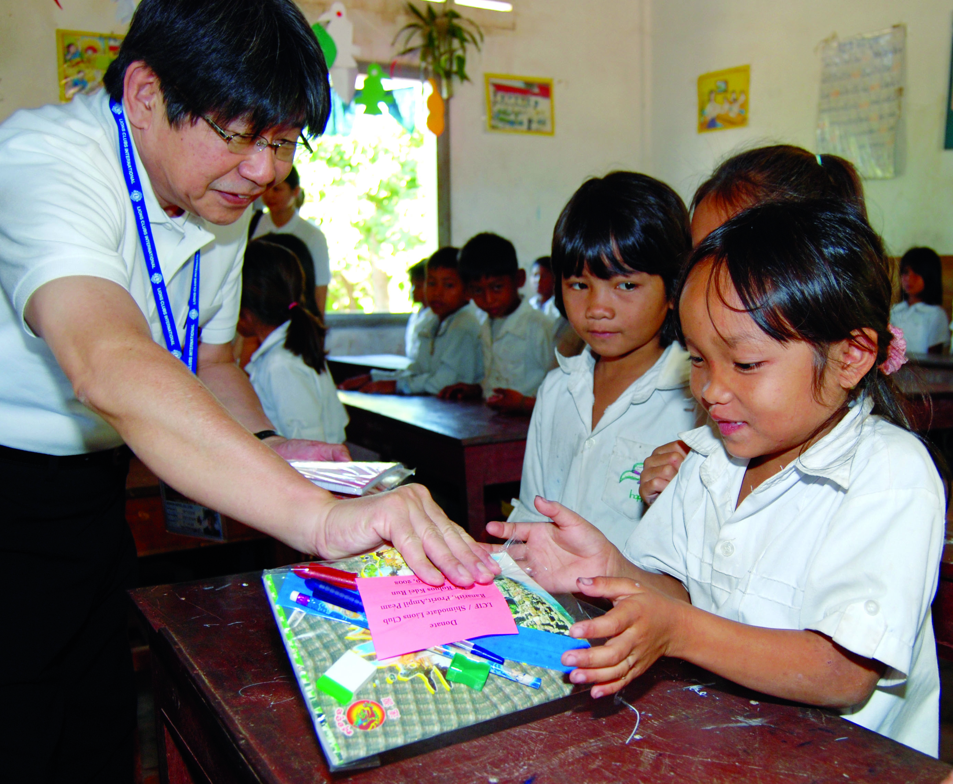
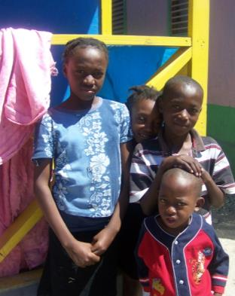
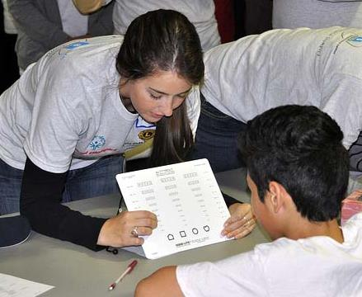
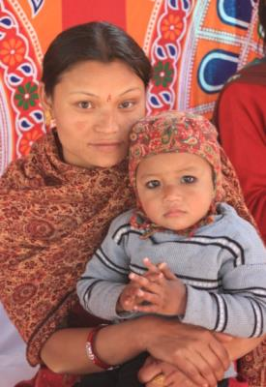
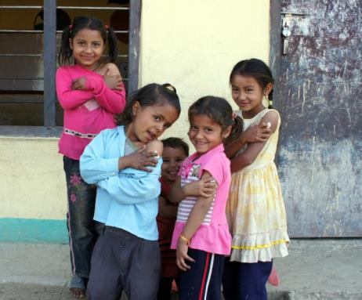

THANK YOU FOR YOUR SUPPORT!
Notes:
Thank you!

