Slide 1
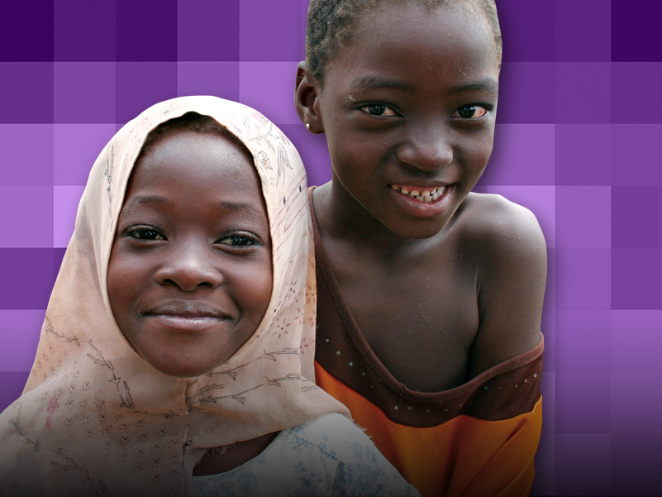
LIONS CLUBS INTERNATIONAL FOUNDATION
One Shot, One Life: Lions Measles Initiative

Slide 2
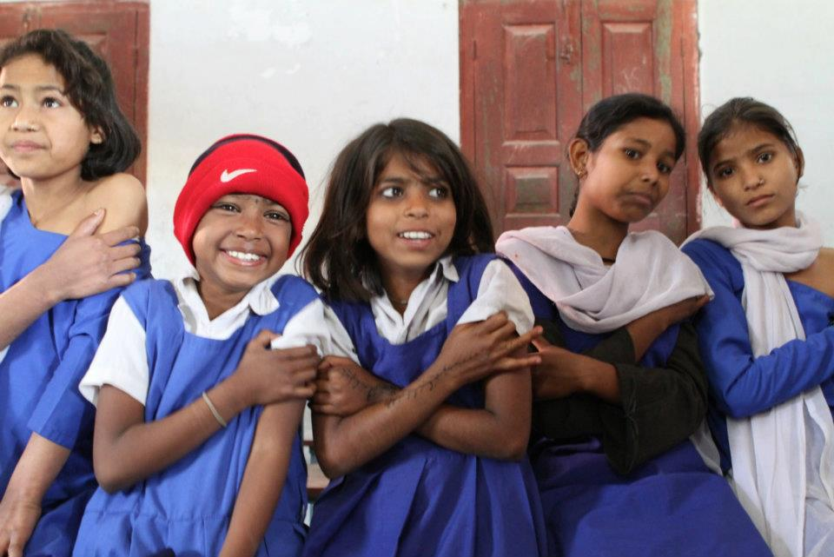
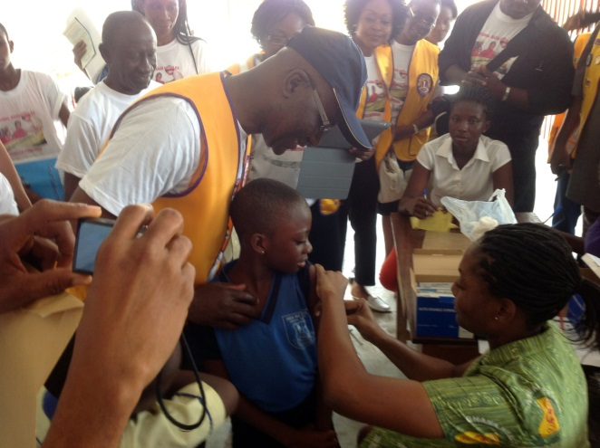
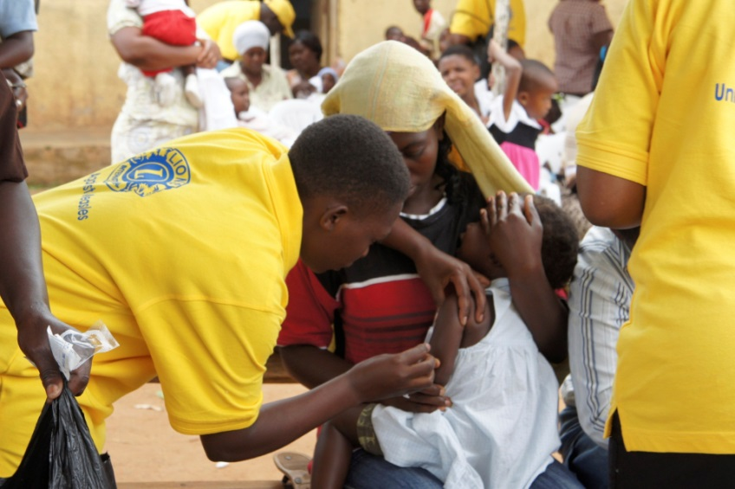
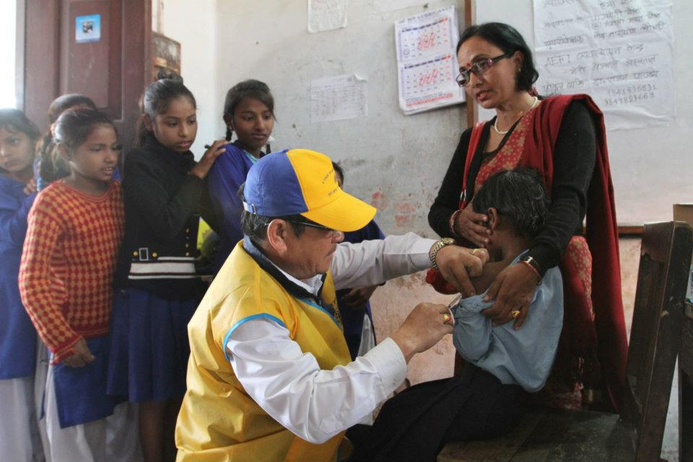
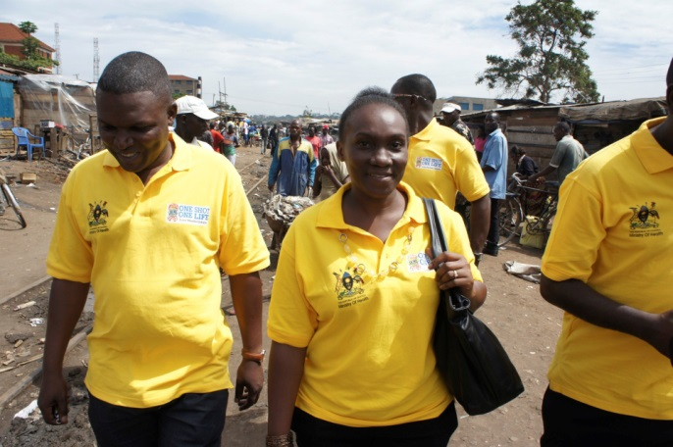
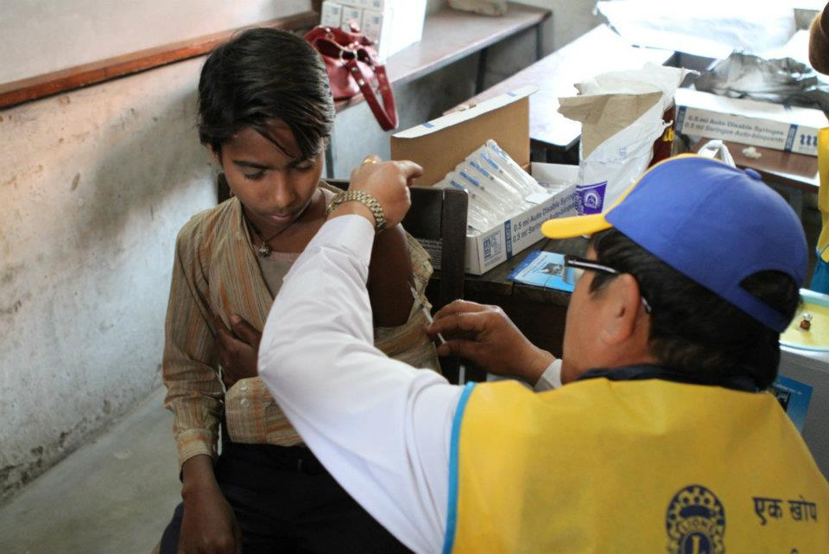
Lions in Action
Notes:
Lions have been active in the fight to eliminate measles since 2010, when Lions and LCIF partnered with the Measles & Rubella Initiative and the Bill & Melinda Gates Foundation to conduct pilot programs in African countries, vaccinating more than 41 million children.
Over the last few years, Lions have played a key role in social mobilization efforts by working with local leaders, coordinating community-level publicity, and serving as volunteers at vaccination centers. Millions of children have been vaccinated because Lions have been hard at work in their communities. But why is the fight to eliminate measles so important?

Slide 3
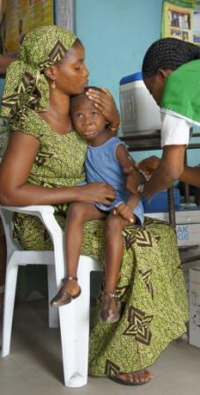
Measles: A Challenge for Lions and the World
Measles takes the life of 335 children every day – more than 122,000 a year. And it’s completely preventable.
We as Lions have vowed to continue the fight against it.
Children in communities around the world need your help in order to be safe from measles infections!
Notes:
Measles takes the life of 335 children every single day. That’s more than 122,000 children in a year. And it’s completely preventable. Many of you in the room today may be familiar with measles. But you may not be familiar with the devastating impact measles still has around the world, and the reasons that Lions have agreed to continue the fight against it.
Today, you’ll learn about these reasons – and I hope you’ll join in this fight. We can only win against measles with your help and that of your fellow Lions.

Slide 4
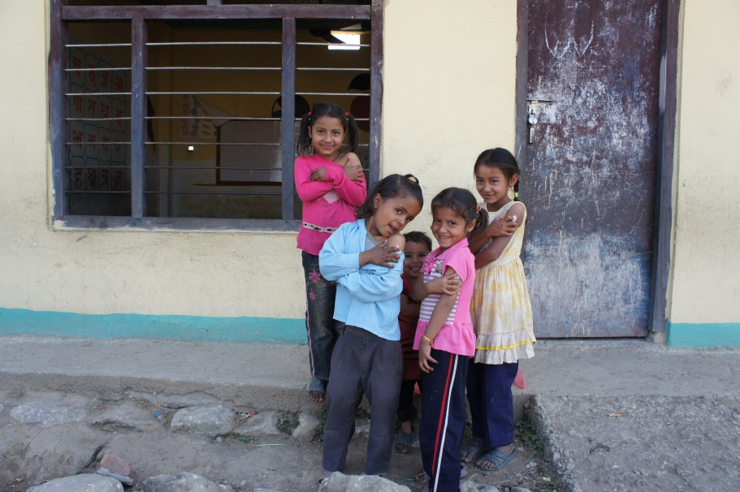
What is Measles?
Measles is…
One of the top five causes of vaccine preventable deaths in the world
Easy to prevent – the vaccine costs less than US$1
Found in every part of the world
One of the most contagious diseases
Notes:
I’d like to tell you a little bit about measles.
Measles is one of the top five causes of vaccine preventable deaths in the world
It is easy and inexpensive to prevent – the vaccine costs less than US$1 and gives life-long immunity
It is found in every part of the world – measles outbreaks have taken place on every continent and in all climates
Measles is one of the most contagious diseases – 90% of those exposed to the measles virus will catch it if they do not have immunity

Slide 5
A New Challenge
New partnership with GAVI Alliance
US$30 million by 2017
1:1 match under GAVI Matching Fund
Continuation of Lions efforts to make measles history
US$60M
GAVI Matching Fund Partners
Notes:
A new partnership with GAVI Alliance was announced in July 2013. The new partnership allows LCIF and Lions to continue our fundraising and field partnership efforts very similarly to those we’ve pursued since 2010 and will help to protect tens of millions of children in the world’s poorest countries against measles.
Lions have committed to raising US$30 million by our 100th anniversary in 2017. The funds raised by Lions will be matched through GAVI Matching Fund partners, the United Kingdom’s Department for International Development (DFID) and the Bill & Melinda Gates Foundation, bringing the total to US$60 million. Through our joint efforts with GAVI and other partners, Lions will increase access to quality immunization services at every level – globally, nationally and locally – to benefit children around the world.
Lions will also play a key role in social mobilization efforts by working with local leaders, coordinating community-level publicity and serving as volunteers at vaccination centers. Through our fundraising and advocacy efforts, Lions will help immunize more than 114 million children.

Slide 6
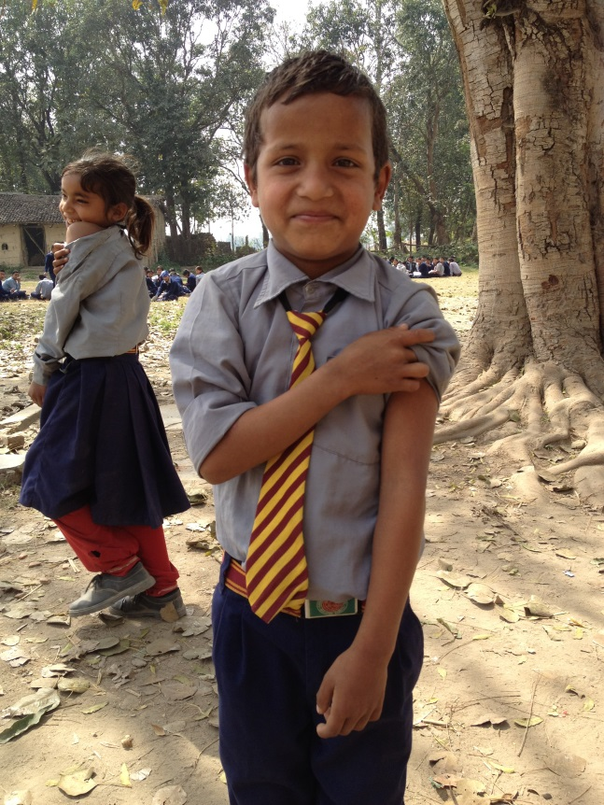
GAVI Alliance
Global Alliance for Vaccines and Immunisation (GAVI)
Mission: To save children’s lives and protect people’s health by increasing access to immunization in the world’s poorest countries.
440 million children immunized
We Care. We Serve. We Accomplish.
Notes:
GAVI Alliance was established in 2000 as the Global Alliance for Vaccines and Immunisation (GAVI) to fund vaccines for children in more than 70 of the world's poorest countries. GAVI’s mission is to save children’s lives and protect people’s health by increasing access to immunization in the world’s poorest countries.
Since 2000, an additional 440 million children have been immunized against leading vaccine-preventable diseases, including measles, in the world's poorest countries with GAVI support, preventing approximately six million future deaths.

Slide 7
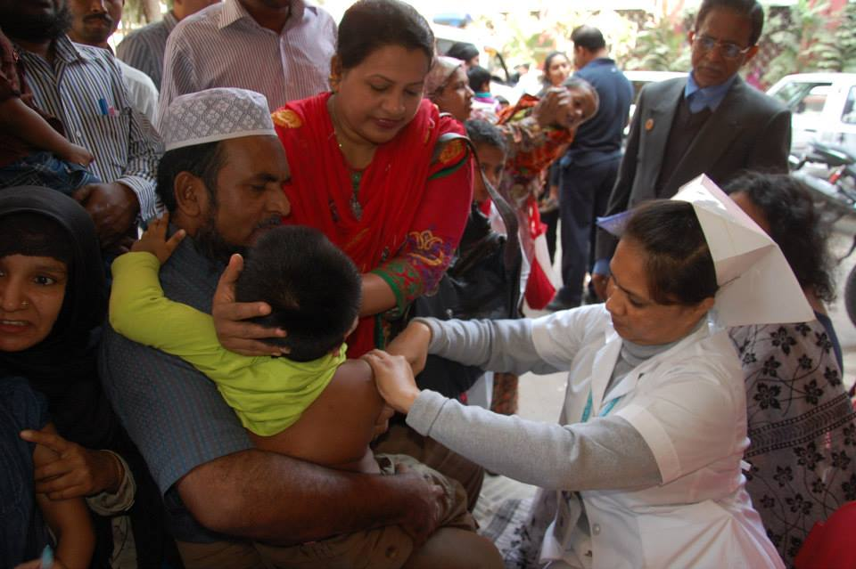
Why target Measles?
What areas of the world are currently affected by measles?
Developing countries
Africa
Africa, Asia, and Europe
Every part of the world is affected by measles
We Care. We Serve. We Accomplish.
Notes:
Now, we’re going to have a little Q & A. Go ahead and shout out the answer if you know it!
What areas of the world are currently affected by measles?
Developing countries
Africa
Africa, Asia, & Europe
Every part of the world is affected by measles

Slide 8
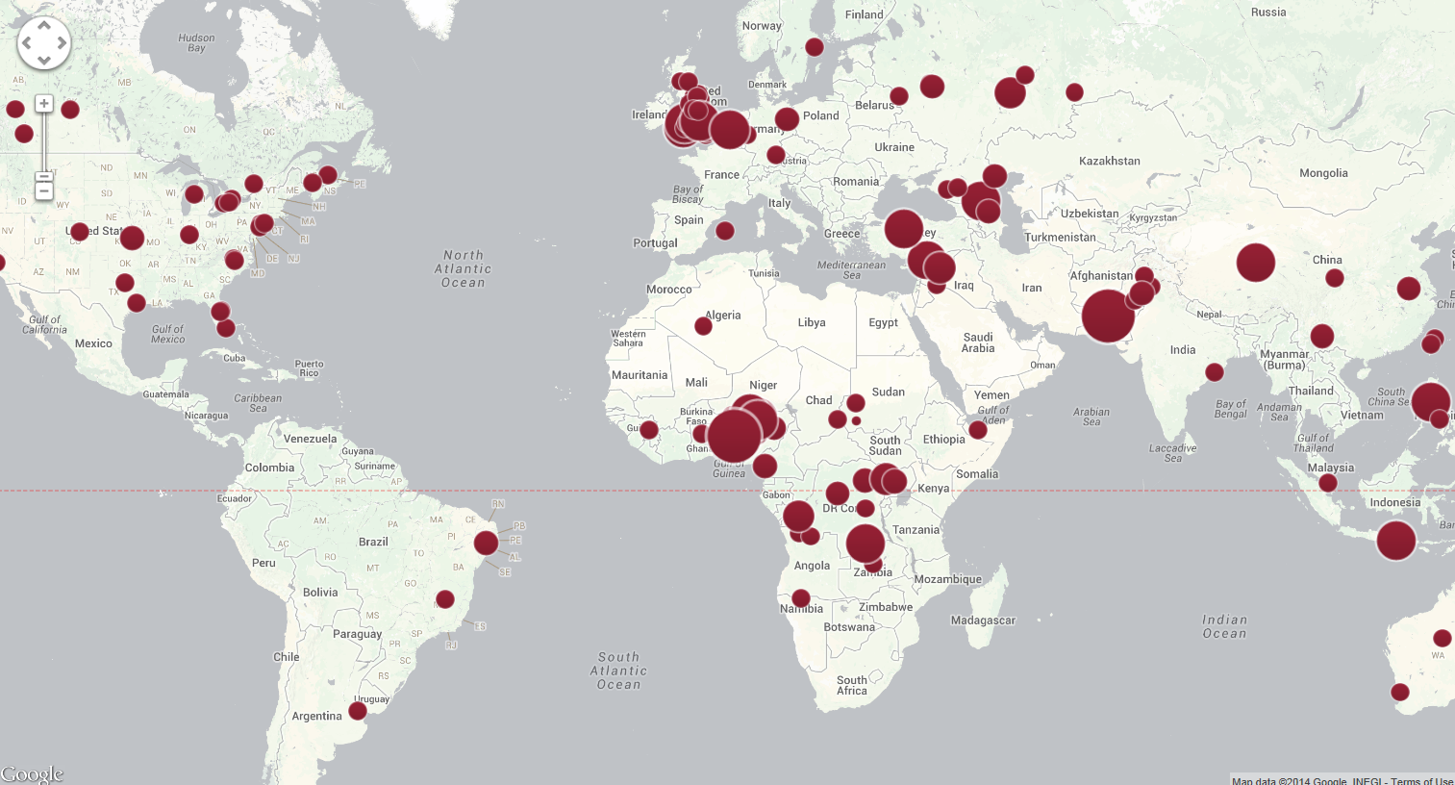
Current Challenges
D. Measles Affects Every Part of the World
2013 Outbreaks
Notes:
The dots on this map show all the locations that suffered a major measles outbreak last year. As you can see, every part of the world is affected by measles. Even those areas of the world (such as the Americas and Europe) where measles is thought to be under control can have significant outbreaks if the population does not maintain a high level of vaccination.
Measles has been declared eliminated in many countries throughout the world but often the disease continues to be spread in unvaccinated populations by residents returning from abroad or from visitors. If your family travels abroad and comes into contact with someone with the measles virus, you will be fine because you have been vaccinated against measles. But what if your child or grandchild who has yet to be vaccinated, comes into contact with someone who has the measles virus? The outcome can be deadly. That is why Lions have joined the fight to eliminate measles.

Slide 9
Why Target Measles?
Which of these serious side effects can result from a measles infection and lead to lifelong health complications or death in children?
Blindness from corneal scarring
Encephalitis
Pneumonia
Severe diarrhea
All of the above
We Care. We Serve. We Accomplish.
Notes:
Measles is a dangerous disease that can cause a lot of damage, especially in the developing world. Which of these serious, life-altering side effects do you think can result from a measles infection?
Blindness from corneal scarring
Encephalitis
Pneumonia
Severe diarrhea
All of the above

Slide 10
Why Target Measles?
E: All of the above! About 1/3
of measles cases develop
complications, including:
Corneal scarring and blindness
Encephalitis
Pneumonia
Severe diarrhea
We Care. We Serve. We Accomplish.
Notes:
Those of you who guessed E, all of the above, are correct. About 1/3 of measles cases develop complications, including corneal scarring and blindness, encephalitis, pneumonia, and severe diarrhea. These complications are most dangerous in areas of the world where children do not have access to adequate medical care, or where they may already be suffering from poor health due to an inadequate diet, poor drinking water, or other diseases.

Slide 11
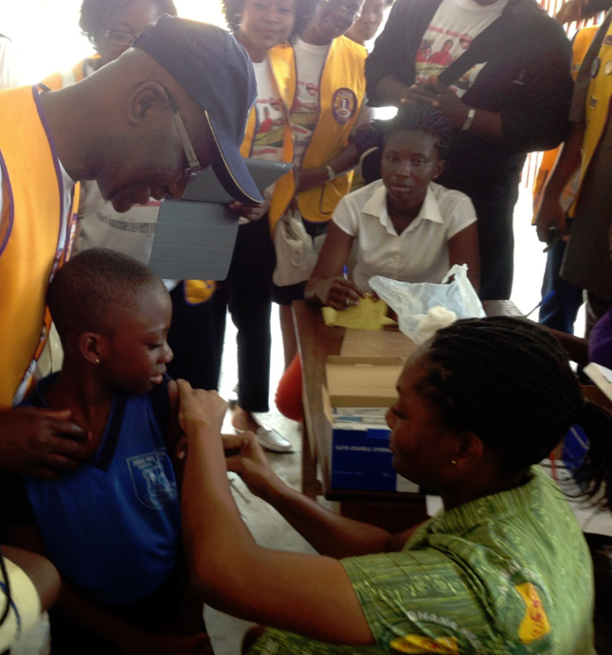
Why Target Measles?
How many deaths have been prevented by measles vaccination efforts since 2001?
2.3 Million
5.8 Million
7.1 Million
13.8 Million
20.2 million
We Care. We Serve. We Accomplish.
Notes:
How many deaths do you think have been prevented by measles vaccination efforts since 2001?

Slide 12
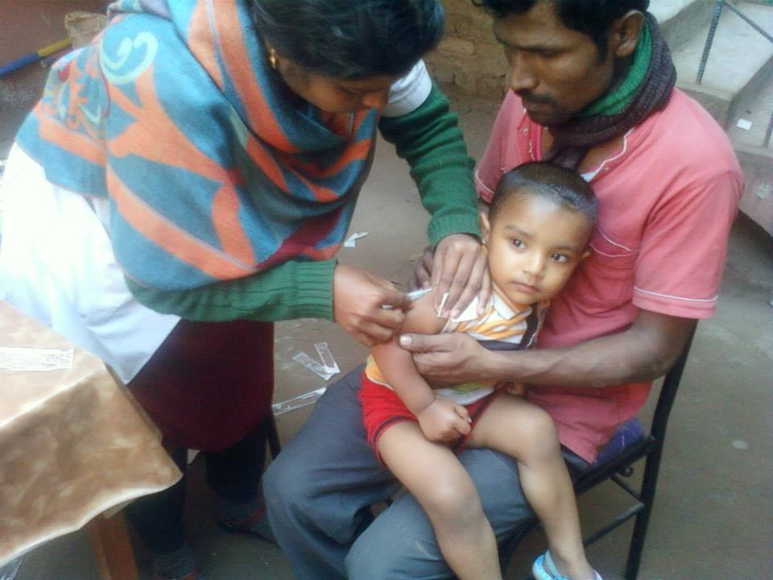
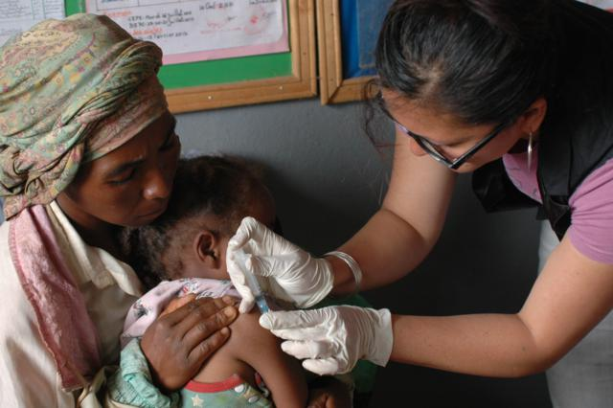
Why Target Measles?
D. 13.8 million deaths have been prevented!
We Care. We Serve. We Accomplish.
Notes:
The answer is astounding – 13.8 million deaths have been prevented! Vaccinations have the power not only to save lives but also transform lives by protecting against disease – giving children a chance to grow up healthy, go to school, and improve their lives. For $1, a child can be vaccinated against measles, making it one of the most cost-effective health interventions available.

Slide 13
Why Target Measles?
78% Reduction in measles deaths since 2000
We Care. We Serve. We Accomplish.
Notes:
The results are amazing! Through Lions support and the work of our partners millions of lives have been saved. Yet, there is more work to be done. 335 children still die from measles every day, that’s 14 deaths every hour.

Slide 14
Lions Generosity in Action
Lions Donations
LCIF
GAVI Alliance
Vaccines to Countries
Health Workers Trained
Lions Mobilize Community
Children Vaccinated – Lives Saved!
We Care. We Serve. We Accomplish.
Notes:
As you’ve seen, Lions support has helped reduce measles deaths around the world but what is the path your donation takes to achieve those amazing results?
Click mouse once
Generous clubs and Lions support One Shot, One Life by donating funds to LCIF.
Click mouse twice
LCIF supports GAVI.
Click mouse once
GAVI purchases vaccines at the lowest cost and then distributes vaccines to priority countries where measles outbreaks are numerous and parents do not have access to immunization services that could protect their children from measles. Factors such as poverty, poor health systems, and a lack of information can make it difficult for families to secure preventative vaccinations for their children.
Click mouse twice
Health workers are trained for vaccination events throughout the country. Lions work with local leaders to spread the word to those in their community about the vaccination events. Lions work hard encouraging families to bring their children to be vaccinated. Lions post flyers, go door to door, organize transportation for families to get to the events, and Lions serve as volunteers during the vaccination day.
Click mouse once
Lions are hard at work at every stage of the process from working with GAVI and health officials to organize vaccination campaigns, to promote vaccination events in their communities, and to serve as volunteers during the events.
The end result of Lions dedication, hard work and generosity is amazing. Millions of children's lives are saved!

Slide 15
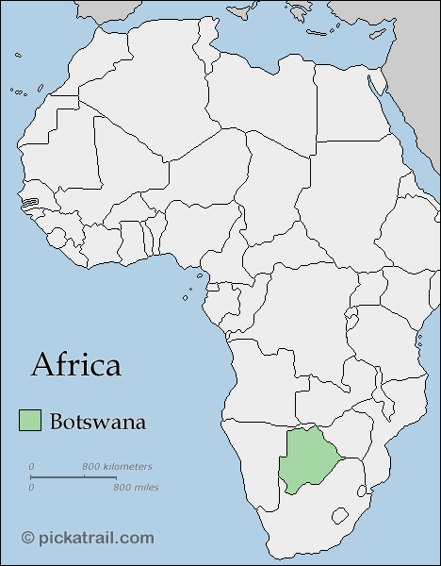
Lions Making Measles History – An Example from Botswana
Nationwide vaccination campaign
Almost 200,000 children immunized
Lions played key role in outreach
Staged shows
Went door to door
Transported families
Organized outreach convoy
We Care. We Serve. We Accomplish.
Notes:
Here is just one example of Lions working in their community to make measles history.
At the beginning of November, Botswana’s Lions helped the country’s Ministry of Health with a five-day campaign to reach 95 percent of under-fives with measles vaccinations, Vitamin A supplements and deworming pills. Almost 200,000 children were immunized during the campaign.
Lions played key role in getting the message out about the campaign. Across the country, Lions helped to hire public address systems, truck trailers and even arrange motorcades of vehicles to take messages about the looming immunization drive directly to the people.
In one area of the country, two teams of Lions went from house to house knocking on doors reminding families they should take their children to be vaccinated. In Tonota in Botswana’s east, Lions helped pay for a bus to bring families from remote areas to the village so that they did not miss the chance to be vaccinated.

Slide 16
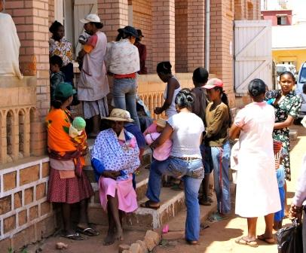
How Can
You Help?
One Shot,
One Life
Notes:
Now that you know the problem that measles poses, you may be asking yourself how you and your fellow Lions can help. There are many important ways to do that, including telling other Lions and non-Lions about measles and raising awareness of the importance of vaccination. But the most important thing you and your club can do right now is to help raise funds for the One Shot, One Life initiative.

Slide 17
Make a Donation – and Make it Count!
If your club gives US$1,000 to the One Shot, One Life Initiative, how much in matching funds will your donation provide?
Nothing
US$250
US$500
US$1,000
We Care. We Serve. We Accomplish.
Notes:
Consider this question: If your club gives US$1,000 to the One Shot, One Life Initiative, how much in matching funds will your donation provide?
The answer is US$1,000. That means your club’s donation will be even more powerful and help save twice as many lives.

Slide 18
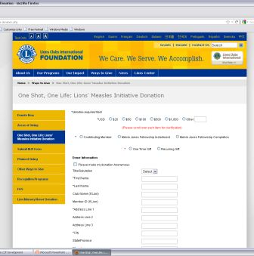
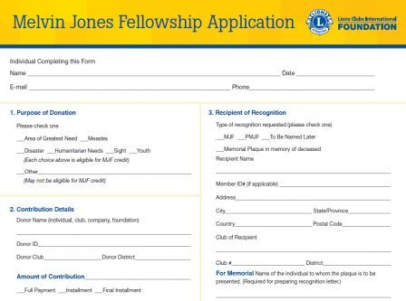
How to Give
Recognition Programs:
Melvin Jones Fellowships
Major Gifts (pledges accepted)
Methods of Payment:
Credit card online
Check (US dollars only)
Bank transfer
Local Lions Account Deposits
Include MJF form
Check “Measles” under
1. Purpose of Donation”
Notes:
It’s easy to give a donation. You can go online to www.lcif.org and make a credit card gift, or you can send in a check in US dollars. You can also transfer money directly or through local Lions’ deposit accounts. However you choose to give, be sure to mark the donation for ‘measles’. If you are requesting an MJF for the donation, please remember to check “Measles” under “Purpose of Donation”.

Slide 19
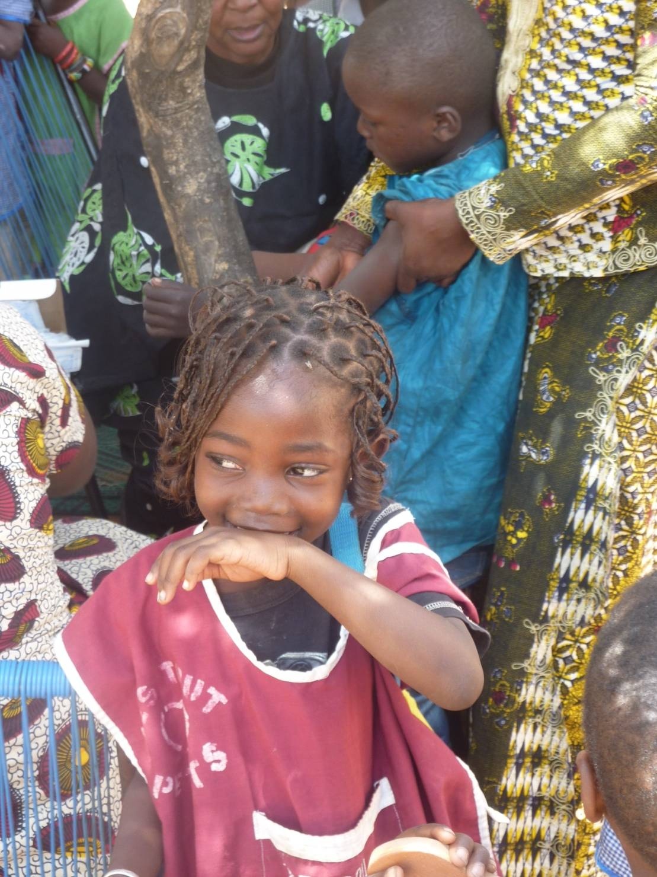
Questions?
One Shot, One Life
Notes:
I hope you’ve learned a bit today about measles and the One Shot, One Life initiative. I’m happy to answer any questions you have.

