Slide 1

How to use MyLion to support your service.

Slide 2

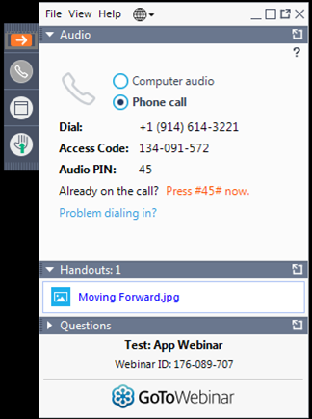
Control panel
1
2
3
Notes:
Before we get started, there are a few webinar details I want to share.
First, what you see on the screen is the control panel. This is where you will find audio information and the question pane.
If your control panel disappears, click the double arrows by arrow number 1 to make it reappear.
If you are using a telephone, dial-in information is displayed by arrow number 2. In the event you are disconnected, you can dial back in using that number.
Finally, the questions pane is located by arrow number 3.
I encourage you to ask questions throughout the webinar. We have about 600 Lions and Leos joining us today so rather than pause and respond to questions as they arrive, I’ll look at the questions at the end of the prepared portion of today’s webinar. I’ll answer as many questions as time allows.
If your question isn’t answered, please don’t worry! We’re compiling all of our attendees questions and will send out a webinar FAQ when live sessions conclude. This webinar is also being recorded and will be emailed to everyone, as well as available on lionsclubs.org in the Resource Center.

Slide 3
A,
aa
Lions and service
Supporting Lions service with digital applications
How to plan & report with MyLion (website focused)
Finding support
Getting started
Let’s talk about…
3
Notes:
So, let’s dive in. What are we going to discuss today?
First, we’re going to talk a little bit about service since service is at the heart of Lions.
Next, we’ll talk about the digital world of Lions including your Lion Account, MyLion, and a few other digital applications available to our members.
Then we’ll really dive into two of the biggest features of MyLion- planning and reporting.
Finally, we’ll review where you can get more support on MyLion, as well as a few steps to get started.

Slide 4
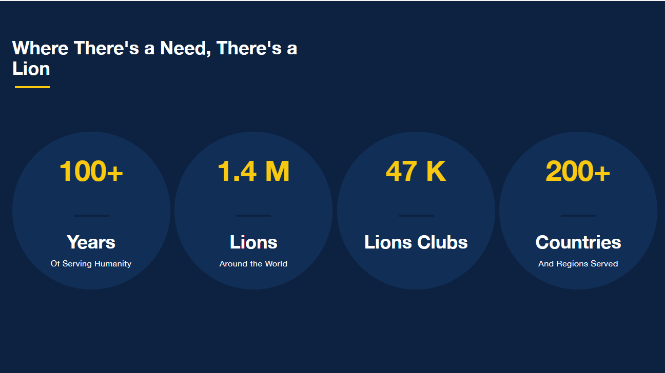
We’re here today because we serve.
What are our service goals as an association
Emphasize “connection”/fellowship- to one another, to our local communities, to a global network of people connected by kindness
Background of service?
Any context that sets “Why are we all here, why are we Lions”
Notes:
Before we can talk about MyLion or MyLCI or Lion Account, we need to talk about service.
For over 100 years, Lions and Leos have made an impact in our communities both locally and globally. Today we have 1.4 million members in over 200 different countries and you, our club officers, represent almost 50 thousand clubs.
While the desire to serve hasn’t changed much over the past 100 years, a lot of other things have. We’ve expanded our number of official languages, begun communicating using internet technologies, seen members from different countries working together to leverage their resources- all to grow our impact.
This growth of membership and service means our network of Lions is stronger and more complex than ever.

Slide 5

We act, then we report.
We serve to improve communities locally and around the world. But why do we report service?
  Celebrate the contributions and achievements of members, clubs, and our association.
  Discover and replicate impactful service projects.
  Set goals to grow our impact.
  Increase awareness of local and global needs.
  Learn more about why we report service.
Notes:
Given that growing and complex network of Lions, an important part of our service journey has become reporting our service to capture the impact of Lions around the world.
There are a lot of other reasons we report service. We report to:
Recognize the contributions and achievements of our clubs and association as a whole. To celebrate and appreciate the power of working together for the greater good.
See how others are serving, and perhaps replicate that activity with our own club.
Help us set new impact goals and encourage ourselves to serve more or differently.
And we report so that we can show what issues matter to us globally and locally, as well as encourage others to think about these issues.

Slide 6

Challenges reporting service, heard from Lions.
  It’s hard to find motivation when we can’t see our impact on a large scale and only a few people have access to information.
  It’s time consuming.
  We normally report our activities at the end of the month. It’s hard to remember all the activity’s details.
  Reporting rules and definitions aren’t
  always clear.
Notes:
However, Lions have shared that there are some challenges to reporting service.
In today’s world we’re accustomed to accessing a wide variety of information quickly and easily. Whether it’s how many steps we’ve walked today or why our heating bill was so high last month, we want information on multiple levels and we want to be able to access it ourselves. Sometimes at Lions International that easy, effortless access isn’t there.
Another challenge is that reporting can be time consuming.
Currently only select officers can report an activity in MyLCI. This is good so leaders like you can control the quality of information that we add to our database, but it also can be inconvenient. Sometimes we have a club member who has taken the lead on an activity and has all the key information like when was it held, where did it take place, and what is an appropriate description. That club member has to pass their information to a reporting officer and cannot enter it themselves.
A second piece of the time issue is that, since currently we can only report an activity after it’s occurred, we can’t enter information into MyLCI as an event develops. No real-time entry of information, no easy upload of pictures. This means that a lot of our clubs have decided to do all reporting at the end of the month, even though we run the risk of forgetting details.
Finally, when we’re in the system and ready to report, we still might run into barriers. How should I interpret this impact metric? How do I categorize this activity? Sometimes we interpret MyLCI prompts differently. That makes us ask the good question- if we don’t have a clear way of reporting service, why report at all?

Slide 7

Supporting Lions service
Overview of digital applications for every Lion & Leo
Notes:
These challenges mean there is an opportunity to make service easier for Lions and Leos. And a big piece of that is expanding and improving our digital applications. We aren’t changing 100 years of service, we aren’t going to stop reporting- but we can make connecting, serving, reporting and celebrating easier.
So let’s talk about Lions digital world, how it serves you as officers and the ways Lions are helping us improve all of our digital applications.

Slide 8


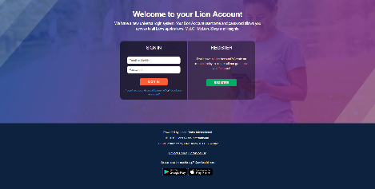


M
Your Lion Account
  Lion Account is our universal login system.
  Your Lion Account gives you access to:
    MyLCI
    MyLion
    Shop
    Insights
    Upcoming applications
  All Lions and Leos can create a Lion Account.
  Contact mylion@lionsclubs.org for support.
Quick Tip: Lions and Leos will need their Member ID and an up to date phone number or email in MyLCI to register
8
Notes:
It all starts with your Lion Account. Your Lion Account is your new universal login. It is your key to all of Lions digital applications. It gives you access to MyLCI, MyLion, Shop, Insights (which is our newest application) and future applications. Every Lion and Leo can create a Lion Account.
Members who have previously registered for MyLion do not need to re-register for a Lion Account. Their MyLion login information is now their Lion Account.
If you haven’t registered for a Lion Account already, now is a great time. You’ll need your member ID and an up to email or mobile phone number in MyLCI.
For some members, creating a Lion Account was easy. For other members, we’ve encountered barriers like outdated phone numbers or email addresses in MyLCI. We understand this has been a disruption for MyLCI users, so thank you to everyone who has contacted us for support.
If you need assistance creating a Lion Account, or as you begin encouraging members to create a Lion Account, please contact Lions Clubs International staff at mylion@lionsclubs.org. The support team would be happy to help!

Slide 9
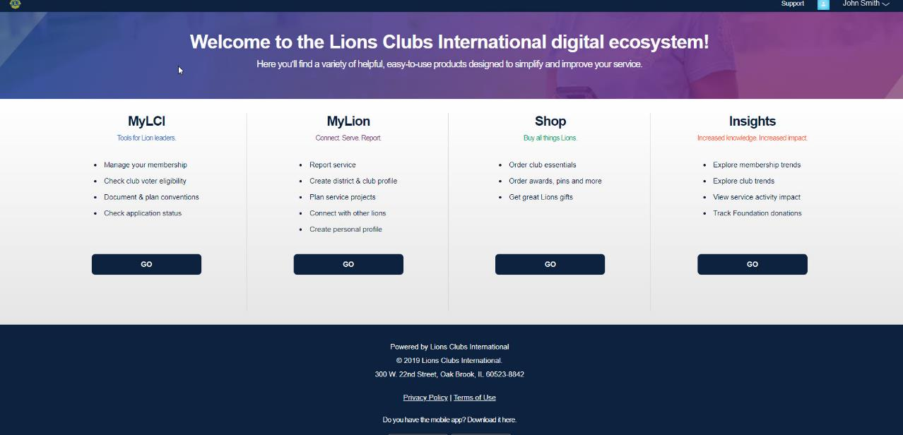
Select the application of your choice.
Notes:
Once you’re logged into your Lion Account, you can easily navigate between any of our applications. Lions members currently have access to all the applications on the screen EXCEPT MyLCI. MyLCI remains an officer application and appears greyed out to non-officer members.

Slide 10
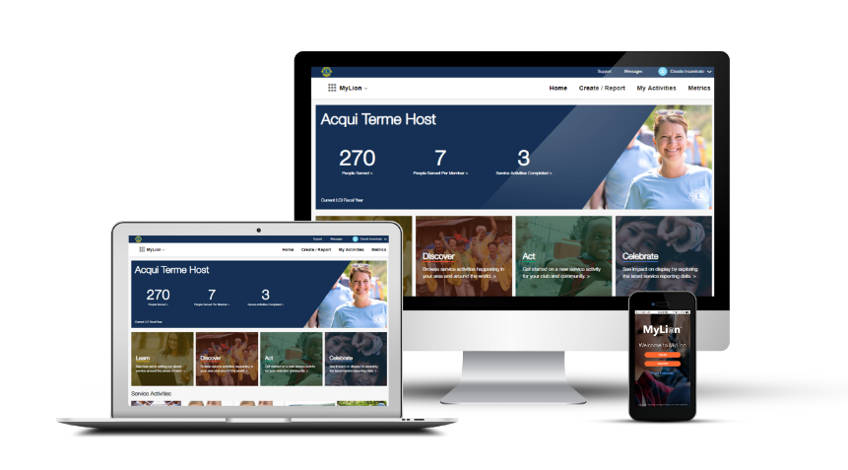
m
MyLion
Connect and serve.
MyLion is the destination for service activity reporting starting July 1, 2019.
10
Notes:
Let’s take a look at MyLion. MyLion is our new service application and focuses on the core of Lions- service and fellowship.
MyLion offers opportunities to better connect with fellow members, to discover and be inspired by service activities around the world, and also to promote our service.

Slide 11
Serving with MyLion.
Two pathways: New Activity or Report Activity
Notes:
These opportunities- connecting, discovering other service ideas, and more- are possible because of two big changes in the way MyLion works compared to MyLCI.
First, any Lion or Leo can use MyLion. This is our first application that is open to all members.
Second, and the focus of our webinar today, is there are now TWO pathways to create an activity. In MyLion, you can create an activity BEFORE it occurs, or plan it, or you can report an activity after it has occurred.

Slide 12

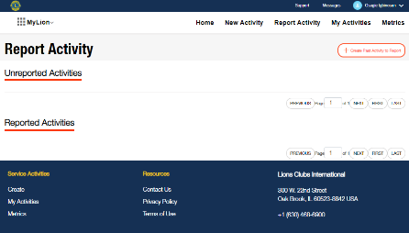
Reporting a past activity in MyLion.
Choose Report Activity if you want to report an activity that has already occurred. Then:
  Add key details
  Upload photos
  Enter impact numbers
Only officers with reporting access will be able to Report Activity.
Available on the website and the MyLion app.
Notes:
We’re going to start with reporting an activity after is has occurred since this is the pathway we all are most familiar with.
If you choose to report an activity after it has occurred, not much changes from MyLCI. Only officers are able to report an activity after it occurs. You will choose “Report Activity” from the main navigation and enter all the activity’s details, then submit.

Slide 13
Demonstration: Report a past activity (website).
https://www.youtube.com/watch?v=kP3498MrHxE&feature=youtu.be
MyLion is the destination for service activity reporting starting July 1, 2019.
Notes:
This feature is available on the MyLion app as well but today we’re going to watch a demonstration of a Lion user reporting an activity after it has occurred, using the MyLion web application.

Slide 14
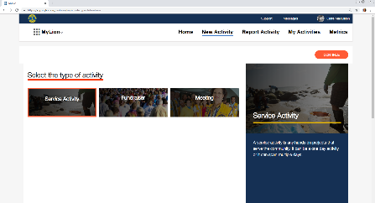

Plan an activity, then report it in MyLion.
Create and publish your upcoming activity.
Choose New Activity in MyLion, then:
  Add key details
  Upload photos
  Invite members to join
  Publish
The activity has ended? Officers add a few impact numbers and reporting is finished!
Any Lion or Leo can create a New Activity.
Notes:
Now let’s take a look at the other reporting pathway in MyLion: creating an activity before it occurs, or planning. Whether we’re going grocery shopping or working on a project at our jobs or thinking about our next service activity, planning is an important part of our daily lives.
Right now, Lions and Leos use a wide variety of tools to plan their service. Then, after the service activity is completed, we’d log into MyLCI and report. As we discussed earlier, some of the challenges with that approach are:
We double our workload. We’re probably planning our activity on Facebook, via email, or using another platform. Why not plan the activity where we will also report it?
We might not remember all the great details of activity. Entering information after it takes place increases the likelihood we’ll forget some specifics.
Non-officer members can’t take as active a lead. Currently, only Lions officers can enter service activity details but non-officers may be the leaders.
MyLion changes that. We now have a pathway to not just report a service activity from the past, but to combine service activity planning and reporting.
There are also some distinct benefits planning in MyLion. We can:
Invite other Lions and Leos
Send messages to members to help get organized or share updates
We can keep our district or multiple district leaders updated on what activities they could attend or support since those activities will be searchable.

Slide 15
Demonstration: Plan an activity on MyLion (website).
https://www.youtube.com/watch?v=npuTGERBctE&feature=youtu.be
MyLion is the destination for service activity reporting starting July 1, 2019.
Notes:
Now that we’ve discussed the difference between planning, or creating a “New Activity” in MyLion versus reporting a past activity, we’re going to watch another demonstration.
Here’s our Lion creating an upcoming activity, or a “New Activity”, for her club on the MyLion website application.

Slide 16
Club officers and MyLion
Which club officers can report activities?
  Lions Club President
  Lions Club Secretary
  Club Service Chairperson
  Club Administrator
  Leo Club President
  Leo Club Secretary
What else can these club officers do?
  Delete/edit member created activities
  Report club activities
  Edit the club profile (Tip: visit the lionsclubs.org Club Locator to see your updated club profile!)
Notes:
As I mentioned, any club member can create a Lion Account and use MyLion. However, only the club officers shown here can report an activity.
There are several other unique permissions these officers have on MyLion.
They can:
Delete a member created activity
Edit a member created activity
Create a club profile on the MyLion app.
We aren’t going to look at the club profile feature too much today, but I wanted to mention it because the Club Profile is a great opportunity to share more about your club with other Lions, as well as community members who might be interested in joining your club. Club profiles on MyLion are displayed on the Club Locator on lionsclubs.org. So download the mobile app, choose a fun picture that represents your members, share a description about what makes your club special, then visit the Club Locator on lionsclubs.org to see how your club is showcased to potential members.

Slide 17
MyLion Frequently Asked Questions
I have multiple titles. How do I change my role in MyLion?
MyLion recognizes all of a user’s titles and gives you access to all the tasks you can complete regarding service activities with those titles. You do not need to change your role manually.
MyLion will be the destination for service activity reporting starting July 1. However, is there a 2018-2019 reporting grace period in MyLCI?
  Yes, you will be able to report 2018-2019 service activities in MyLCI until July 15, 2019.
Notes:
Now from our MyLion Forum on Facebook and our district webinars and general feedback from Lions and Leos like you, we know there are some nuances to how Lions plan and report service. I’m going to walk through some of our commonly asked questions and I’ll bet some of you have already written in about these exact nuances!
First, if you are a Lion with multiple titles, you’re accustomed to manually changing titles in MyLCI. MyLion is built differently. If you are a Lion will multiple titles, MyLion will recognize all of your roles within Lions Clubs International and give you access based on all of those titles. You do not need to change your role.
Second, while MyLion is our destination for service activity reporting starting July 1, 2019, officers will still enjoy the service activity reporting grace period for 2018-2019. You will be able to report 2018-2019 service activities in MyLCI until July 15, 2019.

Slide 18
MyLion Frequently Asked Questions (continued)
Where are signature activities? And is there a definition for signature activities?
  Signature activities will be available in June 2019.
  Lions Clubs International defines a signature activity as a recurring activity which represents the identity and/or specialization of the organizing club, district or multiple district.
  Based on this definition Lions and Leos will be able to decide which activities are their signature activities.
Notes:
For Lions who have begun using MyLion, a common question is related to signature activities. Where are they…and actually, what are they?
This feature of MyLion will be available in June 2019.
When we began evaluating MyLCI and building MyLion, our service team realized that definition and interpretation of a “signature” activity varied regionally.
With the help of our Global Action Team, we now have a definition for signature activities. A signature activity is a recurring activity which represents the identity and/or specialization of the organizing club, district or multiple district. It’s at the discretion of the club, district, multiple district, etc. to determine which of their activities fit that description.
Lions and Leos can use this definition to guide which activities are labeled “signature”.

Slide 19
MyLion Frequently Asked Questions (continued)
  How do I categorize my activity?
  First select the activity type (Service Activity, Fundraiser, Meeting)
  Then select the appropriate "Global Cause". If the activity does not belong to a Global Cause, please select "Other".
  Based on the Global Cause selected, there will be a set of sub-categories. Select the subcategory that most closely aligns with your activity.
Notes:
A final common question is about how we categorize service.
As we saw in the demonstrations, the first few steps are straightforward. You select a type of activity and then the global cause it relates to.
The next piece is where our service framework has changed a little bit.
In the past, Lions chose from 90 different types of service projects. 90 is a lot- Choosing the appropriate category was confusing, so our service activities team has helped streamline these options. Right now each global cause has a few different subcategories underneath them. However, in June, our most popular service project types from MyLCI are returning and we’ve added a few more options.

Slide 20
MyLion Frequently Asked Questions (continued)
  How do I report if I participate in a District or Multiple District led service activity?
    Starting in June, District and Multiple District leaders will be able to report a service activity they organized that mobilized multiple clubs in their district/multiple district.
    Leaders will simply create an activity the system will recognize if they are District or Multiple District officers.
    The clubs that participate are selected on the Invite/Participant page.
Notes:
And finally, what if I participate in a District or Multiple District led service activity?
Starting in June, our district and multiple district leaders will be able to report service activities that take place at the district or multiple district level.
The way this work is district and multiple district leaders will login and simply create an activity. The system will recognize that they are a district or MD leader and allow them to select the clubs that are participating or participated in the project. That way, the club is still recognized for its contributions.

Slide 21
MyLion & Insights: Celebrate your service impact by exploring the numbers.
Notes:
As we discussed earlier, reporting activities helps us see and celebrate the work we do as Lions and Leos. We have several digital applications that can help members and officers explore impact, set goals and see how other Lions and Leos are contributing to their communities.

Slide 22

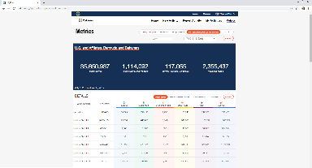
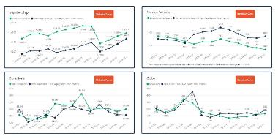

Service data for all Lions and Leos
Metrics on MyLion
Insights
Shares service impact metrics down to the individual activity level
Provides data on people served & volunteer hours
Can explore service data across multiple levels
Shares membership, service, donation & club data
Dashboard access is based on the user’s title
Notes:
On the left is MyLion’s Metrics page. You can find it in the top navigation of your screen, where we previously selected “New Activity” or “Report Activity”. The Metrics page within MyLion shares service impact metrics down to the individual activity level and includes data on number of people served and volunteer hours. Users can view data at their club, district, multiple district and Constitutional Area levels, as well as globally.
If you’re interested in taking a closer look at all the reporting information available to officers, navigate to Insights, our newest application. You can get to Insights from that original application switcher page we showed after Lion Account.

Slide 23

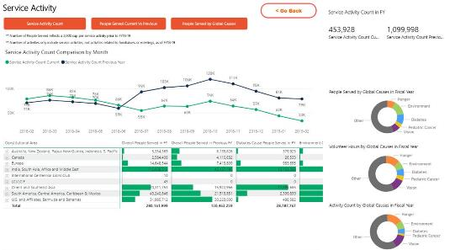
A detailed view of Lions data on Insights
Select the “Detailed View” button in each section to see additional metrics. Explore comparisons to averages and other data analyses related to the section.
Notes:
At the club level, Insights shares membership, service, and donation.
You can take a closer look at each of these data sections by choosing “Detailed View”.
The Service Activity section on Insights shows people served, volunteer hours and activities in relation to each global cause.
It also shows comparisons to average and a deeper look at service trends.

Slide 24
Finding support on MyLion.
Redefining “training”
Notes:
Today we’ve shared quite a bit of information about MyLion, but it’s impossible to cover everything! Lions who want more support, training materials, or answers to their questions can find them in a few locations.

Slide 25

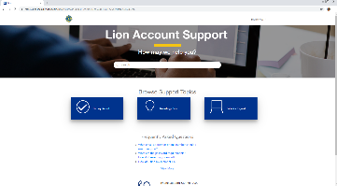

Support where you need it.
www.lionshelp.zendesk.com
  Use the “Support” button to find helpful how-tos
Want to talk to our support team?
  Phone number: 1-630-468-7000
  Email: mylion@lionsclubs.org
Join the MyLion Facebook Forum to get Lion to Lion assistance and share your ideas.
Quick Tip: On the MyLion app, navigate to your User Profile and select the three circles in the top corner to find support.
Notes:
From any of our digital application websites, Lions can select “Support” and navigate to our online help desk. The link provided here leads to frequently asked questions, how-to documents, and also the pathway to submit a question or issue.
Our member support center information is also shared here. The team would be happy to answer your call or respond to an email.
Finally, we have a growing MyLion Facebook community called the MyLion Forum. Joining the forum is a good way to find up to date information about our applications, ask questions that might pertain to the larger Lions community, and also share application ideas with other Lions and Leos.

Slide 26
What’s next?
Notes:
So, what’s next?

Slide 27
3 steps to get started on MyLion.
1
  Register for your Lion Account.
2
  Set up your personal (and club!) profile on MyLion.
3
  Plan and/or report your next service activity on MyLion.
Notes:
There are three key things we can all do to get started on MyLion and to help our members start using MyLion.
First, create a Lion Account. If you have created an account already, you can also make sure that every club members’ information in MyLCI is up to date. Members will be able to register for a Lion Account if they have an updated email or mobile phone number on record.
Next, set up your personal and club profile in MyLion. Add an image, write a description, and start making MyLion personal to you.
And finally, plan and or report your next service activity on MyLion. One of the best ways to learn the application is to try using it. MyLion will become our service activity reporting destination starting July 1, 2019, so rather than entering your next activity in MyLCI, give MyLion a go!

Slide 28

Do you have questions? We can help.
Please email mylion@lionsclubs.org if you have additional questions.
Notes:
So that concludes the regular webinar presentation, and now we can get to your questions! As I shared earlier we have over 600 attendees today so please be patient as I respond to questions. And, again, all the questions will be compiled, answered, and shared with you in the coming weeks.

Slide 29
Thank You
© 2019 Lions Clubs International

